Slide 1
The Initial Investigation:
Taking the First Steps
Susan Castaño, LCSW, Curriculum Developer
Funded by a generous grant from the

Slide 2
Housekeeping and Introductions
Schedule for the day
CEU instructions
Location of restrooms
Set cell phones to vibrate
Introductions

Slide 3
Evaluation Process
All APS Training has 3 evaluation components:
Transfer of Learning Activity
Satisfaction Survey
Embedded Evaluation

Slide 4
Developing an ID Code
What are the first three letters of your mother’s maiden name? Alice Smith
What are the first three letters of your mother’s First name? Alice Smith
What are the numerals for the DAY you were born? Nov 29th
Trainee ID Code
S | M | I | A | L | I | 2 | 9

Slide 5
Learning Objectives (A.M.)
2. Describe interviewing, communication, and rapport building strategies
1. Define intake and describe the goal of the intake process
3. Identify collaterals and other information
4. Evaluate information received in initial report
5. Describe safety precautions/ preparations
Notes:
1. Define intake and describe the goal of the intake process
2. Describe interviewing, communication, and rapport building strategies
3. Identify collaterals and other information that would assist in preparing for the initial visit
4. Evaluate information received in initial report to determine if statutory requirements are met
5. Describe safety precautions that can be taken in preparation for the initial visit

Slide 6
Learning Objectives (P.M.)
6. Demonstrate rapport building strategies with the client at the door
7. Discuss methods of dealing with client’s resistance to access
8. Demonstrate techniques for interviewing suspected abuser
9. Assess potentially dangerous situations in order to remain safe
Notes:
Demonstrate rapport building strategies with the client at the door
Discuss methods of dealing with client’s resistance to access
Demonstrate techniques for interviewing suspected abuser
Assess potentially dangerous situations in order to remain safe and discuss ways to deescalate these situations should they arise

Slide 7
How is Intake Done in YOUR agency?
Who takes initial call?
Where does that information go?
Who assigns the case?
What is the assigned worker’s first step?

Slide 8
What is Intake?
It is a process that is done differently in different jurisdictions
Intake is the gathering of sufficient information to determine if an investigation is required including:
Locating identified individual
Indicating how emergent the needs may be
Quality of intake may determine success of initial visit

Slide 9
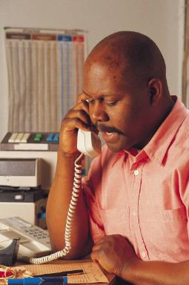
Goals of the Intake Interview
Set the tone for an introduction to the agency and program
Obtain the most relevant information on the situation
Determine if the situation meets the criteria for APS investigation
Provide clear explanations to the reporting party

Slide 10
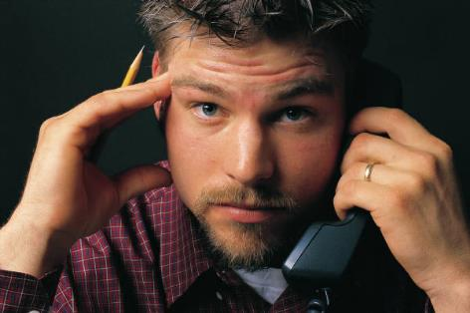
Role of Intake Worker
Communicator
Clarifier
Educator
Service Broker
Ambassador of Good Will
Notes:
Use communication skills: non judgmental, listening (not necessarily agreeing, taking your time
Clarify what you don’t understand. Active listening - paraphrase or repeat. Ask for what they mean by …..dirty, crazy, “treats her like dirt”, effective questioning. Don’t jump to conclusions or put words in referrer’s mouth. Need for patience.
Educate referrer: Confidentiality, anonymity, response time, what constitutes APS, what the process is, whether case will or won’t be evaluated and why, what other agencies might be more appropriate to answer their concerns, don’t take attacks personally
See yourself as public relations person for the agency. Maintain calm and friendly manner. Be helpful in getting referrer where he needs to go. Thank referrer -acknowledge his concern for the client no matter what you think his motives are.

Slide 11
Skills for Effective Intake Interviews
Empathy
Patience and perseverance
Listening skills
Questioning skills
Clear, non-threatening, non-lingo communication

Slide 12
Getting the S.T.O.R.Y.
Specifics
Tale
Others
Referral Source
Yes (or No)
Notes:
Specifics: Identifying info, directions to house, where entrance is, are there animals, does anyone else live in the house
Tale: What happened? How long has it been going on? Why are they referring it now?What efforts have been made to address the problem? Details of allegations _ who, what when, how? Witnesses, Description of client (physical, mental, past psych history, substance abuse history), client’s ability to care for self, defend self. Info on perpetrator. How much at risk is client? Is this an emergency? Why?
Others: Environment and Support System - condition of home, income, dr. hospitalization , pharmacy, meds, other agencies involved, family members involvement, how client gets food, transportation, manages money.
Referral source: relation to client or perp, identifying info, ask about need for anonymity, explain that even though you will not reveal referrer’s name, client may suspect. Discuss expectations - what does referrer want to happen - is this realistic? Would referrer be available for helping gain access if necessary.
Yes or No: Does case meet criteria for an APS evaluation? If so, explain what will happen. If not, explain why and what you suggest (other referral, police,)
You won’t get all this info - so don’t make yourself crazy. Referrers may be fearful, unwilling to get involved, just not know all the details.

Slide 13
Specifics
Names, ages, relation-ships
Complete address including specific directions
Disabilities that would affect worker visit
Environ-mental issues that would affect worker visit
Safety issues

Slide 14
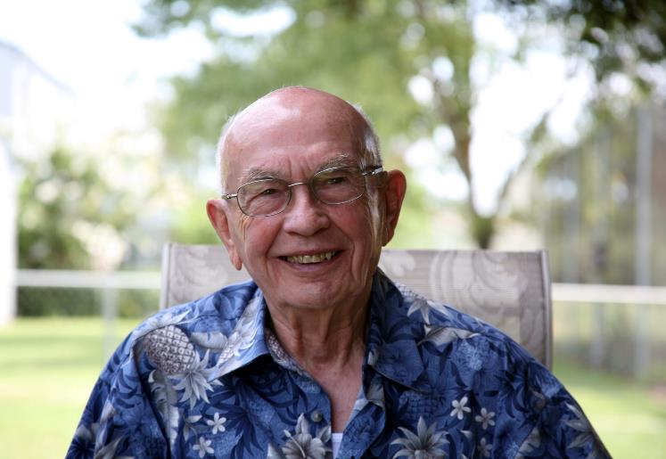
Tale
Allegations, reason for report
How long has it been going on, previous efforts at resolution, why report now?
Who, what, where, when, why?
Victim’s ability to protect him/herself
ADLs/IADLs
Witnesses
Drugs, guns, law enforcement involvement
Environmental concerns

Slide 15
Others
Family, friends, support system
Medical/mental health providers
Recent hospitalizations
Medications
Service providers
Attorneys and bankers
Health/housing inspectors
Income and source(s)

Slide 16
Reporting Party
Allegations, reason for report
How long has it been going on,
previous efforts at resolution, why report now?
Who, what, where, when, why?
Victim’s ability to protect him/herself
ADLs/IADLs
Witnesses
Drugs, guns, law enforcement involvement
Environmental concerns

Slide 17
Yes or No: Ending the Intake Call
Discuss expectations
Explain responsibilities and limitations of program
Clarify what will happen and when
Discuss confidentiality issues
If case screened out, explain why and provide I and R, options, etc
Leave door open for future contact

Slide 18
Screen In or Out?
Compare allegation against mandate
When in doubt, screen in
When screening out, take the next step
Consult with others

Slide 19
A Few Facts about Safety
44% of licensed social workers face safety issues in the workplace
They are more likely to be:
In the first 5 yrs of SW practice (26%)
Work in private, non-profit (37% ) or government settings (23%)
Work in social service agencies (17%)
(2004, NASW Workforce Studies Survey)

Slide 20
Preparing for the Initial Visit
Gut Reaction
Pre-Investigation Investigation
Pre- Service Service Planning
Consultation/ Support/ Backup
Decision on Type/ Venue of Visit
Notes:
What do you sense about case? More experience, more instincts
Call back referrer for clarification if necessary - especially if you did not take the report.
Prepare in advance when possible. Find out as much info as possible given the referral info -Where could you go to get info on services, financial status, medical insurance? Has anyone else ever worked with client or family? How much checking with collaterals do you do before the visit?
Given the info, what possible service needs are there? Fill your bag of tricks with possibilities - although these could change as soon as you see client. If client described as DD, check with DDD to see if they have an active case. A joint visit may be helpful
If you feel anxious about visit, discuss it with supervisor.
Joint initial visits with other agencies or family members may be frowned on . Worker need to make own assessment and not be influenced.

Slide 21
Pre-Investigation Investigation
Prior history of abuse
Prior knowledge to APS
Prior/present law enforcement involvement
Existing court orders
Public records

Slide 22
Pre-Service Service Planning
Services previously used: outcomes, issues
Potential services based on income and described need
Cultural issues and availability of interpreter
Possible access issues
Friendly
Visitor
Meals on Wheels

Slide 23
Consultation/Support/Backup
Witnesses
Agencies providing services
Family members
Previous workers
Supervisor
Attorney
Law Enforcement

Slide 24
Decision on Type of Visit
Announced or unannounced
Alone or in team
Visit with other person (HHA, neighbor, family member)
In client’s home or somewhere else

Slide 25
Planning for Safety
Scheduling
Communication
Car and Travel
Tools
Involvement of Law
Enforcement

Slide 26
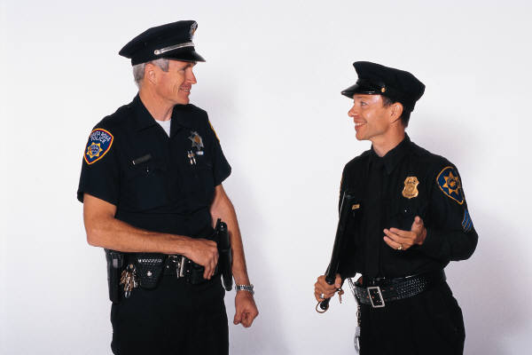
Involving Law Enforcement at Initial Visit
When is it recommended
Disadvantages
Worker feels unsafe
Fear and suspicion of client
Weapons in home
Difficult for trust-building with client and/or alleged perpetrator
Crime committed
Danger to self or others
Black/white/shades of gray: language difference between APS and Law Enforcement
Recommended by law enforcement
Recommended by supervisor or agency attorney

Slide 27
Gaining Access: Rapport at the Door
Identify yourself and
make introductions
Use respect when
addressing client
Build rapport
Use non-verbals
Prepare communication statements using universalizing, empathizing, credentializing, and clarifying messages
Notes:
How do you introduce yourself? Be careful not to misrepresent your agency and yourself. See page 31 for effective opening statements.
Essentials of introduction: who you are, why you are here, ask to come in , that you may be able to assist them in some way. Show your ID or business card.
How do you ask to come it if client is resistant? Privacy issues, only take a few minutes of time, etc.
What can you comment on at the door that might warm client up to you? Garden,
Speak and move slowly, stay calm, be/stay warm and friendly (regardless of responses), stay non-judgmental, show strength and confidence in your ability to be helpful, Maintain eye contact, respect personal space. Remember this is client’s home!
Universalize- we frequently find that …..
Empathize - we are concerned and appreciate your difficulties
Credentialize- I have been doing this work for a while…
Clarify- There are serious things we need to talk about - but at the door where neighbors can hear
Ask permission

Slide 28
Gaining Access: The Dos
Bring “sense-ability” to the door
Your eyes
Your ears
your nose
Your touch
Your ESP

Slide 29
Gaining Access: The Dos
Take your time
Use engagement techniques
Watch your verbal language
Watch your body language

Slide 30
What We Learned From Research
Rapport-building facilitates communication
Even a small amount of rapport building has a positive effect on the accuracy of recall.
Collins, Lincoln, and Frank (2002)

Slide 31
Gaining Access: The Don’ts
Don’t “bombard” at the door
Don’t make assumptions
Don’t patronize
Don’t be a hero (they don’t pay you enough)

Slide 32
Dealing with Resistance
Be aware of possible causes
Allow client to vent
Manage your own feelings
Use communication skills: listen with your body and your heart
Clarify concerns
Be as flexible as possible
Remember, you are in the client’s home

Slide 33
If you are refused access
Determine emergent need
Medical
Mental health
Law enforcement
APS statute
Return at another time
Return with an ally

Slide 34
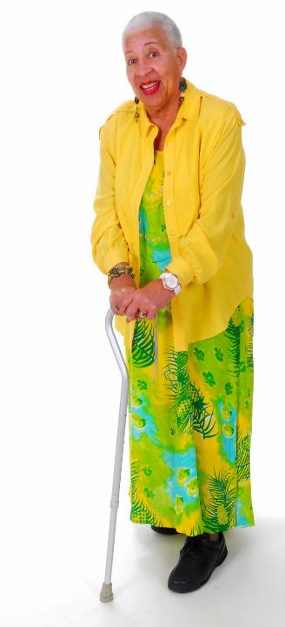
Be Aware/ Beware
Non-verbals
Cultural differences
Communication barriers
Personal reactions to client/ environment
Note-taking
Advice-giving
Accepting food, gifts, etc
Use of interpreters

Slide 35
Alleged Abuser: Initial Interview
Interview is a relationship
Start with rapport building
Goals
Participatory
Mutually beneficial exchange of information
Direct, reflective, and open-ended questions
Relaxed atmosphere
Trust-building

Slide 36
Preparing for the Interview
Anticipate emotional state
Formulate questions
Anticipate areas that may need addressing
Do not prejudge
Be aware of your own feelings and attitudes

Slide 37
The Dos
Be nice, stay nice
Identify yourself and your agency. Bring I.D. or business card
Stress your role as helper
Make questions client-centered
Use non-defensive communication skills
Listen to and acknowledge concerns
Focus on behavior
Use objective statements
Maintain personal space

Slide 38
The Don’ts
Don’t get “over-official”
Do not use emotionally
charged words or aversive
labels
Do not make assumptions,
negative or positive
Do not patronize or manipulate
Do not embarrass or put alleged abuser/caregiver down

Slide 39
Abuser Behaviors Associated with Danger
Substance abuse
Suicide/homicide ideation or attempts
Access to weapons
Centrality of the victim to abuser’s existence
Jealousy or obsessive behavior
History of violence
Increased frequency of violent incidents
Sexual assault
Pet abuse

Slide 40
Red Flags
Changes in reaction
Triggering Events
Secret is no longer hidden

Slide 41
Proactive Responses to Conflict
Defensive: Escalates
Supportive: Diffuses
Evaluation: places judgment- “YOU”
Description: “I”
Superiority: “I’m the boss.”
Equality: Working Together- “We”
Certainty: “My way or no way” –dictator
Provisionalism: reexamination
Neutrality: typical bureaucrat
Empathy: acknowledge
Strategy: manipulation
Spontaneity: open minded and up front.
Taken from Jack R. Gibb’s book
Trust, Appendix C, Defensive Communication

Slide 42
Warning Signals for Potential Violence
Physical changes
Verbal changes
Behavior changes
Thinking disorders

Slide 43
Preventing Dangerous Situations
Your attitude
Your listening skills
Your communication skills
Your gut reactions

Slide 44
Your Attitude
Be aware of your personal reactions
Display courtesy and politeness
Remain impartial
Accept person, not behavior
Be open-minded and problem solving
Remain calm and confident
Respect personal space
Model relaxed and controlled stance

Slide 45
Your Listening Skills
Keep your non-verbal cues non-threatening
Use active listening
Attend to feelings; be empathetic
Slow down
Speak quietly
Be sensitive to cultural
differences

Slide 46
Your Communications Skills
Ask permission
Validate feelings
Clarify messages
Ask reflective questions
Avoid power struggles
Ignore challenges: redirect
Don’t interrogate
Don’t make promises you can’t keep

Slide 47
Your Gut Reaction
Be sensitive to warning signs
Don’t personalize
Know when to stop
Know when to leave
Don’t be a hero

Slide 48
Exiting a Tense Situation
Try to remain calm
Leaving is a viable and professional choice
Leave if you feel threatened
Keep thinking- to review options and choose the best ones
Stay aware, even if situation seems to be stabilizing

Slide 49
Ethical Practice
Assume worth and dignity of individual
Use structured and proven methods and techniques
Maintain honesty and openness
Use supervision and peer support
Recognize the need for continuous professional renewal and upgrading of skills

Slide 50
In Conclusion
Questions
Comments
Evaluations
Good job!

