Slide 1
ASSESSING ADULT PROTECTIVE SERVICES CLIENTS’ DECISION MAKING CAPACITY
Adult Protective Services
Core Competencies
MODULE # 17
Developed by the National Center on Elder Abuse and National Adult Protective Services Association
Version 2 - Revised July 2015

Slide 2
This training is a product of the National Center on Elder Abuse (NCEA), which is funded in part by the U.S. Administration on Aging under Grant # 90-AM-2792. The project was developed by the National Adult Protective Services Association (NAPSA), and its contractor, the REFT Institute, Inc.
Grantees undertaking projects under government sponsorship are encouraged to express freely their findings and conclusions. Therefore, points of view or opinions do not necessarily represent official Administration on Aging policy.
© NAPSA 2006 & 2015

Slide 3
NATIONAL ADULT PROTECTIVE SERVICES ASSOCIATION
NAPSA is the only national organization which represents APS professionals, programs and clients
NAPSA is the National Voice of APS
NAPSA is a partner in the National Center on Elder Abuse
NAPSA has members in all 50 states
http://www.napsa-now.org/

Slide 4
APS CORE COMPETENCIES
23 NAPSA Core Competencies were identified and developed into trainings for APS staff.
This module is #17: Assessing APS Clients’
Decision-Making Capacity.
For more information about APS Core Trainings, visit http://www.napsa-now.org/resource-center/training/core-aps-competencies/

Slide 5
TRAINING GOAL
To assist Adult Protective Services professionals in identifying the factors that affect clients’ decisional capacity and to know when and how to seek a professional evaluation.

Slide 6
LEARNING OBJECTIVES
Define autonomy, capacity, and incapacity.
Describe factors that may influence client capacity.
Describe signs and symptoms that indicate capacity issues.
Identify key questions and approaches used to screen client capacity, including working with special populations.
Identify implications for case planning as a result of a finding of limited capacity.

Slide 7
WHAT IS AUTONOMY?
Autonomy is the highest principle in legal, psychological and medical issues.
“Autonomy” means the right to make one’s own decisions.
Source: Kemp 2005

Slide 8
WHAT IS DECISIONAL CAPACITY?
Decisional capacity is the ability to adequately process information in order to make a decision based on that information.
Source: Kemp 2005

Slide 9
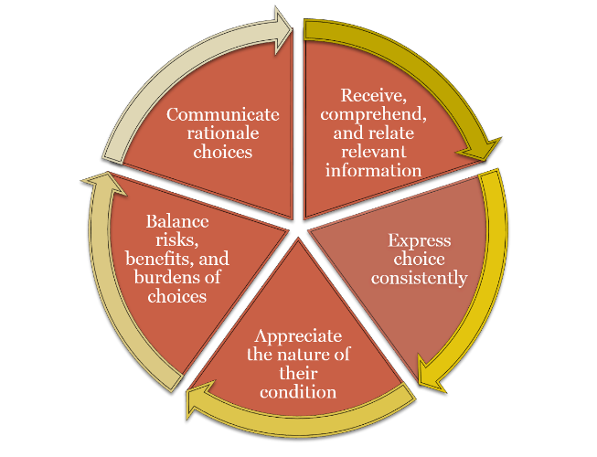
Attributes of Capacity
Notes:
Ask what interaction they have seen between the biological, psychological, and social realms – how have difficulties in one area affected others?
Point out that we fall into the trap of looking for deficits and sometimes forget that our clients have many strengths that have gotten them this far. We need to build on strengths and enhance them. We have to use our own strengths and enhance them –we are all different and have unique ways of approaching our work and our clients. Resources are different in different counties, training opportunities vary. There are many approaches to doing an assessment – we will be presenting a variety of them- use the ones that work best for you in your setting.
There are many components to the assessment. We will be highlighting the most challenging ones- the ones that most directly influence capacity issues.

Slide 10
CAPACITY MAY VARY…
As a result of physical or mental stress.
According to the complexity of the decision.
From day to day.
From morning to evening.
Source: Kemp 2005

Slide 11
CAPACITY EVALUATION
A complete capacity evaluation usually includes:
A physical examination
A neurological examination
Short and long term memory assessment
Assessment of executive function
Exam for existing psychological disorders
Diagnosis of any existing addictive syndromes.
Source: Oklahoma APS 2005

Slide 12
WHAT IS INCAPACITY?
The inability to receive and evaluate information
Or to make or communicate decisions so that an individual is unable to meet essential requirements for:
physical health
safety
or self-care
Even with appropriate technological assistance.
Source: American Bar Association 1997,1998

Slide 13
INCAPACITY
Legal incapacity is a judgment about one’s legal rights and responsibilities.
May be partial or complete.
Must be supported by evidence over time.
Must result in substantial harm.
Clinical incapacity is a judgment about one’s functional abilities.
Source: Quinn, 2005

Slide 14
JUDGMENT OF INCAPACITY
The client may lose the right to:
make decisions about medical treatment and personal care
marry
enter into contracts
testify in court
participate in research
choose where to live

Slide 15
ASSESSING INCAPACITY
Age, eccentricity, poverty or medical diagnosis
alone do not justify a finding of incapacity
Can be influenced by medical conditions such as:
medication and medication interactions, sensory deficits, substance abuse, mental illness
Can be influenced by situational factors such as:
substance abuse, depression, social setting, nutrition
Source: Quinn 2005

Slide 16
Medical Conditions
These medical conditions can impact cognition:
Dehydration
Congestive heart failure
Chronic lung disease
Urinary tract infection
Diabetes
Mini-stroke
Notes:
Refer the trainees to handout #1. All of these medical conditions can influence cognitive functioning. Point out the red flags that require immediate medical attention.

Slide 17
Medication Issues
Adverse reactions
Medication side effects
Medication interactions

Slide 18
ACTIVITY: Differentiating the 3 D’s
Question 1 | Question 2 | Question 3
What are the indicators that client may have a mental status problem? | Does the client appear to have dementia, delirium or depression? | What more information do you need and how would you get it?

Slide 19
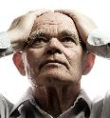
The 3 D’s
Dementia
Delirium
Depression

Slide 20
Dementia Defined
It is a descriptive term for a collection of symptoms that can be caused by a number of disorders that affect the brain. It includes a memory deficit plus a deficit in at least one other cognitive domain.
Final common behavioral
pathway” for many diseases/
etiologies that affect the brain

Slide 21
Irreversible Dementias
Alzheimer’s Disease
Vascular Dementia
Parkinson’s Disease
Frontal-Temporal Dementia
Dementia with Lewy Bodies
Alcohol-related Dementia

Slide 22
Causes of Reversible Dementias
D
E
M
E
N
T
I
A
S
rugs, dehydration, depression
lectrolyte imbalances, emotional disorders
etabolic disorders
ndocrine disorders
utritional Deficiencies
rauma, tumor
nfections (urinary tract)
cute illness, arteriosclerosis complications
eizures, strokes, sensory deprivation

Slide 23
Delirium
Disturbance in alertness, consciousness, perception, and thinking
Sudden onset
Caused by infection, dehydration, changes in chemical balance, head trauma, post surgical recovery
Medical emergency
Treatable and reversible

Slide 24
Symptoms of Depression Yesavage & Brink, GDS, MOOD SCALE
Sleep Disturbance
Loss of Energy/ Libido
Change in Appetite/ Weight
Psychomotor Retardation/ Agitation
Poor Concentration/ Attention

Slide 25
Symptoms of Depression Yesavage & Brink, GDS, MOOD SCALE
Anhedonia - Loss of Interest in Usual Activities
Somatic Complaints
Dysphoria - Flat Affect
Sense of Hopelessness/ Worthlessness
Suicidal Ideation

Slide 26
CASE STUDY ACTIVITY –
ASSESSING DECISIONAL CAPACITY
Participants are divided into small groups. Each group will be provided with a case example.
The task of group members is to find out as much information about their case as they can by questioning the group leader.

Slide 27
Components of Capacity Assessment
The client understands relevant information.
Question: Do you know that you have a serious cut on your leg?
The quality of the client’s thinking process.
Question: How can you get treatment for your wound?
The client is able to demonstrate and communicate a choice.
Question: Do you want to get treatment for your wound?
The client appreciates the nature of his/her own situation.
Question: What will happen if you don’t get your wound treated?
Source: Kemp 2005

Slide 28
Assessment Scales and Tools
Advantages and disadvantages
When/how to use
Types of assessment tools
Cognitive
Folstein Mini-Mental State Exam
St. Louis University Mental Status Exam (SLUMS)
Montreal Cognitive Assessment (MoCA)
Clock Drawing Test
Paradise-2

Slide 29
Cognitive Domains
Orientation
Attention
Memory
Language
Visual-Spatial Organization
Executive Functioning

Slide 30
Cognitive Domains: Orientation
Useful because standard.
Mostly tests recent and longer-term memory
Response is also influenced by level of alertness, attentiveness, and language capabilities.
If there has been a precipitous change in orientation, this could signal a critical medical condition such as delirium.
Screens: MMSE, MoCA, SLUMS

Slide 31
Cognitive Domains: Attention
Nonspecific abnormalities that can occur in
Focal brain lesions,
Diffuse abnormalities such as dementia or encephalitis, and in behavioral or mood disorders.
Impaired attention is also one of the hallmarks of delirium.
Screens: MMSE-registration, serial 7s; digit repetition; MoCA-digits, letter vigilance; Trails A etc.

Slide 32
Cognitive Domains: Memory
Immediate memory: recall of a memory trace after an interval of a few seconds, as in repetition of a series of digits.
Recent memory: ability to learn new material and to retrieve that material after an interval of minutes, hours or days. (e.g. word lists)
Remote memory: recall of events that occurred prior to the onset of the recent memory defect. Note: this cannot be reliably tested unless you have verifiable information.
Screens: MMSE- registration, 3-item delayed recall; MoCA- registration, 3-item delayed recall etc.

Slide 33
Cognitive Domains: Language
Verbal Fluency. Refers to the ability to produce spontaneous speech fluently without undue word-finding pauses or failures in word searching. Normal speech requires verbal fluency in the production of responses and the formulation of spontaneous conversational speech.
Comprehension- Commands (MMSE fold paper; SLUMS paragraph etc.), general ability to follow directions on exams
Naming- MMSE watch, pen; MoCA camel etc.
Repetition- MMSE sentences
Reading/Writing- MMSE write a sentence

Slide 34
Cognitive Domains: Visual-Spatial Organization
Very sensitive to brain dysfunction- can pick up mild delirium and otherwise silent lesions.
In a person’s history, listen for getting lost in previously familiar environments, difficulty estimating distance or difficulty orienting objects to complete a task.
A sensitive indicator of delirium and can occur in any dementia syndrome; it often occurs early in the course of Alzheimer’s disease.
Screens: Clock drawing; Clox; overlapping pentagons,etc.

Slide 35
Cognitive Domains: Executive Functioning
Constellation of cognitive skills necessary for complex goal-directed behavior and adaptation to a range of environmental changes and demands.
Includes planning strategies to accomplish tasks, implementing and adjusting strategies, monitoring performance, recognizing patterns, and appreciating time sequences.
Deficits associated with disruptive behaviors and self-care limitations among patients with Alzheimer’s disease.
Screens: Clock drawing; Clox; verbal fluency tasks (category and letter); EXIT-25

Slide 36
MMSE (Mini Mental State Exam)
Advantages
Well-known
Huge normative data with age and education norms
Translations for all languages we need
Correct administration directions printed
Quick, easy
Disadvantages
Copyright issues
Low ceiling, misses mild cognitive impairment
Often incorrectly administered and interpreted
“Spell world
Backwards”

Slide 37
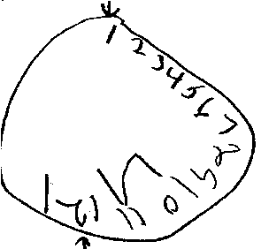
SLUMS
(St. Louis University Mental Status Examination)
Advantages
Free
Simple Directions/Administration
Good coverage of domains
Integrates clock drawing
Has education corrected norms
Disadvantages
Language translations in development
Some stimuli very small,
Would require staff-retraining
Outside providers less familiar
“Draw a clock”

Slide 38
MoCA (Montreal Cognitive Assessment)
Advantages
Free
Translations in many languages
More sensitive than MMSE
Interest in tool increasing
Disadvantages
Takes longer than MMSE
More complicated to administer than MMSE
Some directions not printed on form
No clear age and education norms
Relatively small normative data
Some stimuli very small
Outside providers less familiar
“Name the animals”

Slide 39
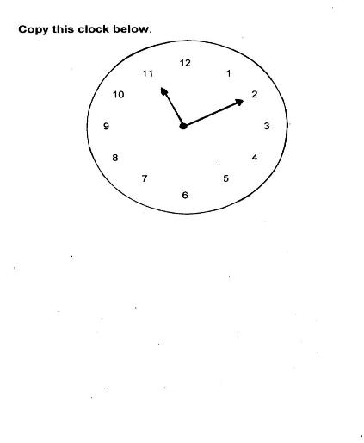
Clock Drawing

Slide 40
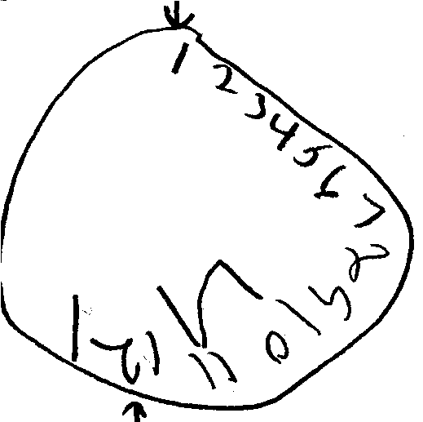
Clock Drawing: Free Condition

Slide 41
PARADISE-2
Questions on 16 behaviors and cognitive functions
May be used by non-medical professionals
Questions correspond to brain functions.
Interpretation is subjective.
Source: Blum 2006

Slide 42
Clinical Professionals Qualified to Evaluate Capacity
Geriatricians, geriatric psychiatrists
Neurologists
Neuropsychologists
Nurses
Occupational therapists
Physicians
Psychiatrists
Psychologists
Licensed social workers
Source: American Bar Association & America Psychological Association 2005

Slide 43
Capacity Assessment Skills
Do your homework: know your client
Educational level
Language issues
Cultural factors
Set the stage
Join with client
Be prepared for responses

Slide 44
Considerations
Location
Timing
Client Comfort
Source: Quinn 2005

Slide 45
Framing the Questions
Assessing the client’s ability to:
Understand and follow instructions;
Understand risks and benefits;
Make and execute a plan.
Ask questions that focus on:
The client’s understanding of relevant information.
The quality of the client’s thinking process.
The client’s ability to demonstrate and communicate a choice.
The client’s understanding of his/her own situation.

Slide 46
CASE STUDY ACTIVITY –
INTERVIEW QUESTIONS
Using the previous case examples, small
groups will develop appropriate questions to evaluate the clients’ decisional capacity

Slide 47
CULTURAL AWARENESS
Openness to learning about other persons’ beliefs, attitudes, values and customs.
Awareness of cultures of physically and
mentally challenged persons, of persons from other ethnic groups, and countries.
Source: Lodwick 2007

Slide 48
CULTURALLY SKILLED INTERVIEWING
Builds rapport
Helps get valid information
Establishes context for accurate analysis
Source: Texas Department of Family and Protective Services 2004

Slide 49
Cross Cultural Interviewing Skills
Learn as much as you can beforehand
about cultural beliefs that affect:
Values
Attitudes
Customs
Faith/religious beliefs
Family structure
Marriage
Roles
Source: Texas Department of Family and Protective Services 2004

Slide 50
Cross Cultural Interviewing Skills
Be aware that strangers are perceived as “outsiders”.
Take time to establish rapport.
Speak clearly, avoid idioms and slang.
Mirror the interviewee in tone of voice, eye contact, directness of speech.
Be respectful.
Source: Texas Department of Family and Protective Services 2004

Slide 51
Using Interpreters
Never rely on the perpetrator or a family member to act as the interpreter.
Always use independent interpreters.
When using an interpreter, direct all communication to the victim.
Source: Ramsey-Klawsnik 2005

Slide 52
Non-Verbal Clients
Ask simple “yes” or “no” questions.
Ask the client to:
squeeze your hand, or
blink his/her eyes.

Slide 53
Assisted Capacity Interviewing Skills
When a client appears to lack full decisional capacity, it may be possible to assist their decision-making by:
Treating medical problems
Providing information
Manipulating the environment
Providing encouragement and support
Source: Kapp 1990

Slide 54
CASE STUDY ACTIVITY – CASE PLANNING
Using the previous cases examples, the small groups will develop a next step for each case, based on the client capacity assessments.
These next steps will be presented to the large group for discussion.

Slide 55
Closing
Reflections
Questions
Evaluations
Resources
NCEA: www.ncea.aoa.gov
NAPSA: www.napsa-now.org/
Thank you!

