Slide 1
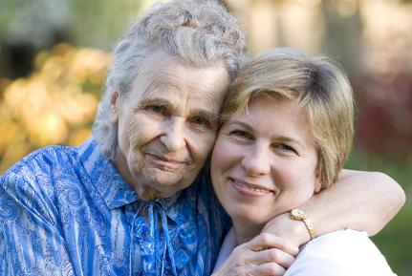
CAREGIVER OR PERPETRATOR NEGLECT
Adult Protective Services
Core Competencies
MODULE 11
Developed by Joanne Otto, MSW
Version 2 - Revised June 2015

Slide 2

How We Got Here
APS Training Project
Goal: Statewide Standardized Core Curriculum for new APS/IHSS social workers
Partners in this effort
Impact of project:
National APS Training Partnership
  California
  National - NAPSA

Slide 3

Housekeeping and Introductions
Schedule for the day
Location of restroom
Set cell phones to vibrate
Introductions
Notes:
Professional Communication
3

Slide 4
Evaluation Process
All APS Training has 3 evaluation components:
Transfer of Learning Activity
Satisfaction Survey
Pre-post knowledge assessment

Slide 5
Developing an ID Code
S | M | I | A | L | I | 2 | 9
What are the first three letters of your mother’s maiden name? (Alice Smith)
What are the first three letters of your mother’s First name? (Alice Smith)
What are the numerals for the DAY you were born? (Nov 29th)
Trainee ID Code

Slide 6

Training Goal
The goal of this training is to provide participants with the skills & knowledge necessary to perform investigations and service planning in response to allegations
of caregiver and perpetrator neglect.

Slide 7
Learning Objectives
Identify physical and behavioral indicators of caregiver neglect.
Identify factors that contribute to victim risk of neglect.
Assess allegations of caregiver neglect using 5 domains of assessment.
Describe the barriers to determining if neglect is intentional or unintentional.
Identify best practices in interviewing perpetrators.
Define components of service planning.

Slide 8
What is Neglect?
The failure of a caregiver or fiduciary to provide an elderly person/vulnerable adult with the goods or services such as food, water, clothing, shelter, personal hygiene, medicine, comfort, personal safety, and other essentials that are necessary to maintain the health or safety of the person.

Slide 9
Types of Neglect
Lack of medical treatment
Inadequate nutrition and/or hydration
Lack of assistive devices
Hazardous environment
Isolation
Lack of social / emotional support
Lack of appropriate clothing, hygiene
Abandonment
Failure to provide mental health resources

Slide 10

Who is a caregiver?
An individual who has the responsibility for the care of an elder or vulnerable adult, either voluntarily,
by contract, by receipt of payment for care, or as a result of the operation of law.

Slide 11

Exercise: Who is a Caregiver?
Activity #1 Leonard Case Example
Exercise: Shout out

Slide 12

Who are “Formal Caregivers?”
Individuals who are paid or volunteer care providing services that are linked through a social service or health care system.

Slide 13
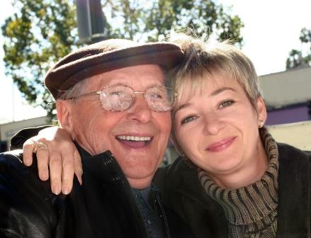
Who are “Informal Caregivers?”
Family members, relatives, partners
or friends who provide the care giving responsibilities.

Slide 14

INFORMAL CAREGIVERS
What are some of the benefits of having informal caregivers?
What are some of the possible negative outcomes of having informal caregivers?

Slide 15
What are Personal Assistance Services?
Personal Assistance Services (PAS) refers to paid care providers. Depending on the funding sources, various terms are used for PAS employees:
Home health aides
Personal care aides
Personal care attendants
Homemakers
In-home support service workers
Personal assistants

Slide 16

State Statutory Definitions
Terms for “neglect” and “caregiver” are determined by state law. It is important to familiarize yourself with your APS / Elder Abuse statutes and with the definitions used in your state.

Slide 17

Your State Statutory Definitions
Handout # 1 State Statutes for California
Exercise: Large group review of state statute definitions

Slide 18
Criminal Neglect=Serious Bodily Injury
Social Service professionals assess for the necessary services that need to be put in place.
Criminal Justice System assesses the possibility of a crime and prosecutes criminal actions.
Most state criminal statutes do not include penalties for caregiver neglect.
All state criminal statutes include penalties for some form of serious bodily injury or assault.
Neglect that results in serious harm or death to the victim may be chargeable under criminal law.
A conviction of a charge of serious bodily injury may result in criminal penalties.
Be familiar with your state’s criminal laws regarding serious bodily injury and/or assault.

Slide 19
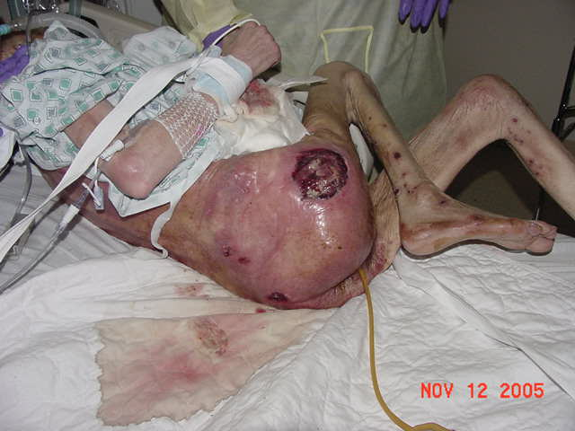
Caregiver Neglect May be Life Threatening

Slide 20
Caregiver Neglect
May be Life-Threatening
Activity # 2
Case of the 59 pound Victim
Part 1

Slide 21

Definition of Serious Bodily Injury
(language proposed by Federal Elder Justice Act 2010)
Extreme physical pain
Substantial risk of death
Protracted loss or impairment of the function of a bodily member, organ, or mental faculty; or
Requiring medical intervention such as surgery, hospitalization, or physical rehabilitation.

Slide 22
Why APS Workers Should Involve the Criminal Justice System
Preserving legal evidentiary chain
“…may provide the only way to protect the vulnerable elder.”
Motivating the perpetrator to stop the abuse
Identifying / reporting other forms of mistreatment
Emphasizing the serious results to victims
Helping to build case for successful prosecution

Slide 23

Working with Law Enforcement
Use the language from your state criminal code.
Emphasize the urgency of the situation.
Describe the physical harm to the victim.

Slide 24

How Common is Caregiver Neglect of People Age 60+?
Nearly one quarter (24%) of elder abuse reports involved neglect.
89% of the reports occurred in domestic settings.
Adult children (33%) and other family members were the most likely to be the perpetrators.
Approximately 550,000 or 1 out of 100 people age 60+ experienced abuse, neglect or “both.”
Elders who experience self-neglect, physical abuse, or caregiver neglect have triple the mortality of those never reported as abused.
NCEA 2004 Report

Slide 25

Indicators of Caregiver Neglect
Emergency Intervention
Unsafe living environment
Malnutrition
Dehydration
Lack of medical care—untreated medical conditions
Over or under medication
Abandonment
Skin breakdown / decubitus ulcers
Other indicators
Poor personal hygiene
Inappropriate clothing
Isolation

Slide 26
Who are the Victims of Caregiver Neglect?
Age 18-59
Age 60+
18% of all reports
26% of all reports
60% women
68% women
58% under age 50
43% age 80+
NCEA 2004 Report

Slide 27
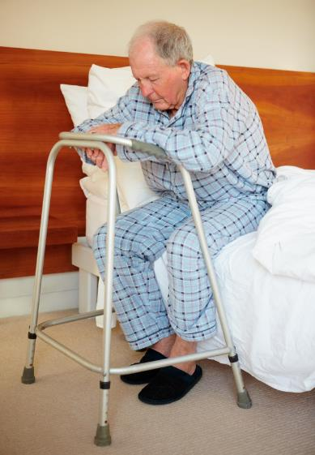
Characteristics of Victims
Physically/ emotionally isolated
Untreated disease / chronic illness
Problems with orientation and memory
Lack of assistive devices
Problems with ADLs and IADLs
Inadequate soiled clothing, poor hygiene
Skin breakdowns / decubitus ulcers
Diarrhea/urine burns

Slide 28






Victim’s History
Physically or mentally impaired
Multiple forms of mistreatment
History of oppression
Learned helplessness or depression
Guilt, personal inadequacy, and hopelessness
Victim’s concerns with being a burden

Slide 29

Victim’s Behavioral Indicators of Neglect
Fearful
Anxious, agitated
Angry
Isolated/ withdrawn
Depressed
Ambivalent
Confused, disoriented
Perceives self as helpless/ powerless
Reluctant to criticize perpetrator
Ashamed

Slide 30

VICTIM BEHAVIORS
In your small groups, take turns with a partner asking each other to develop questions for victims based on the behavioral indicators provided.
Try to avoid questions for victims that would result in “yes” or “no” answers.
Activity # 3 Responses to Behavioral Indicators
Exercise: Tabletop Discussion

Slide 31
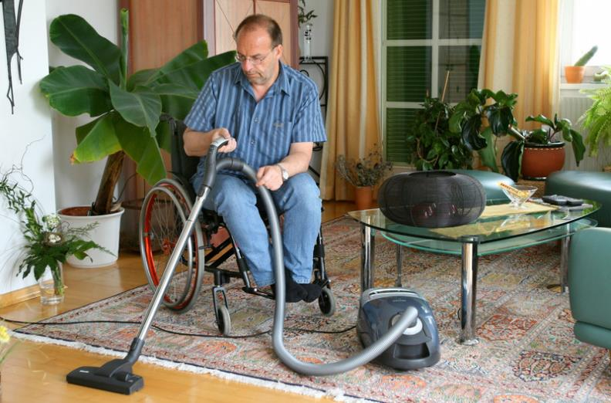
ADLs & IADLs HANDOUT

Slide 32

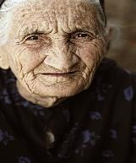
Who are the Perpetrators of
Caregiver Neglect?
Caregivers of victims age 18-59
  50% are female
  Majority under the age of 50
  20% are staff of long term care facilities
  19% are parents of the victims
Caregivers of victims age 60+
  Over 50% are female
  75% are under age 60
  33% are adult children of the victim
  21% are other family members
NCEA 2004 Report

Slide 33

Characteristics of Adult Abuse Perpetrators
Trusted person
Angry and resentful
Depressed
Substance use / drug addiction
Untreated mental illness
History of family violence and/or abuse/neglect as a child
Isolated, lacks social supports
Lacks impulse control
Emotionally and or financially dependent on victim

Slide 34
Behavior of Adult Abuse Perpetrators
Isolates victim
Angry, aggressive behavior
Indifferent
Unrealistic expectations
Does not show affection / empathy towards the victim
Perceives victim as incompetent or demanding
Acts burdened
Won’t consent to medical care or additional services
Conflicting accounts
Blames the victim

Slide 35
PERPETRATOR BEHAVIORS
Barbara Case Example
Identify the “Turning Points” at which different decisions could have been made regarding Barbara’s care.
What might the outcome at each of these decision points have been had her care been handled differently?
Activity # 4 Barbara Case Example
Exercise: Tabletop Discussion

Slide 36

Theories of Caregiver Neglect
Situational
Exchange
Social learning
Political/economic
Psychopathology

Slide 37

Voluntary vs. Involuntary:
Role of Caregiver
Expectations of family members
Spoken and unspoken agreements
Roles and expectations change over time
Level of care needed is likely to increase
Rewards no longer perceived sufficient to balance sacrifices

Slide 38
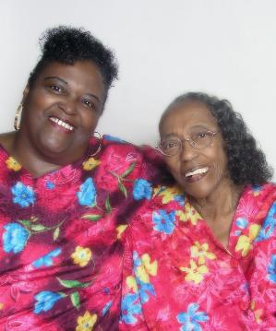
Voluntary vs. Involuntary:
Role of Caregiver
“The likelihood of a caregiver’s mistreatment is
not necessarily linked to amount of care they provide or the amount of care their elder
relatives needs”
Notes:
NEED REFERENCE HERE

Slide 39

Contributing Factors of Caregiver Neglect: Caregiver Conditions
Frailty
Physical Illness
Dementia
Mental Illness
Substance use
Disability

Slide 40

Contributing Factors of Caregiver Neglect:
History of Family Violence/Dysfunction
Family history
Learned behavior
Blame
Punishment

Slide 41

Contributing Factors of Caregiver Neglect:
Cultural & Social Issues
Interests of individual vs. community
Demographics
Language barriers

Slide 42
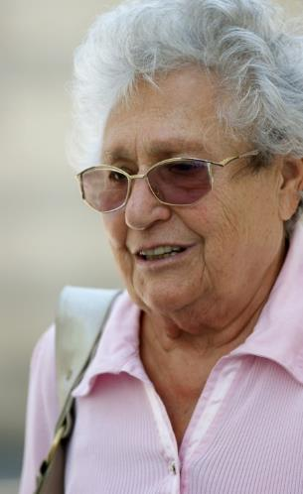
Cultural Stereotypes of Aging
Lacks capacity, “senile”
Non-person, invisible
Powerless
Out of touch
Rigid

Slide 43

Contributing Factors of Caregiver Neglect: Death & Dying
Avoiding
Helpless
Ignorant
Withholding

Slide 44
Five Domains of Assessment
Physical / Medical Impairments
Capacity
Safety / Risk
Financial / Social Situation
Living
Environment

Slide 45

Safety & Risk
Safety issues for victim and professionals
Notifying law enforcement
Severity and duration of neglect
Previous intervention history
Victim indicators of neglect
Signs of other forms of mistreatment

Slide 46

Living Environment
In a high crime area
Adequate heat, cooling, water, sanitation
Dirty, chaotic living space
Multiple animals and/or vermin

Slide 47

Victim’s Physical / Medical Impairments
Need of immediate medical treatment
Functional strengths & impairments
Capacity
Denial
Immediate & long-term care unmet needs
Barriers to providing appropriate care

Slide 48

Financial / Social Situation
Previous intervention history
Resources available
Victim’s support network
Perpetrator’s support network
Perpetrator’s awareness / cooperation

Slide 49

Capacity
Ability to adequately process information in order to make a decision based on that information.
Varies as result of:
  physical or mental stress
  Complexity of the decision
  From morning to evening and day to day
May affect either the victim and/or the caregiver

Slide 50
Assessing Capacity
The victim understands relevant information.
  Question: Do you know that you have a serious cut on your leg?
The quality of the victim’s thinking process.
  Question: How can you get treatment for your wound?
The victim is able to demonstrate and communicate a choice.
  Question: Do you want to get treatment for your wound?
The victim appreciates the nature of his/her own situation.
  Question: What will happen if you don’t get your wound treated?

Slide 51

Victim’s Right to Self-Determination
Victims with the capacity to do so may refuse services
Once legal proceedings are invoked, the individual’s right to self-determine ceases and mediation among family members may be impaired.

Slide 52
Assessing Neglect
Enid Case Example
In your small groups, review the case example to see what aspects of the five domains of assessment are identifiable in this scenario?
Activity # 5 Enid Case Example
Exercise: Tabletop Discussion

Slide 53

Co-dependency Issues
Dependent caregiver
Protective victim
Role reversals

Slide 54
Co-dependency Issues
Using the five domains of assessment, evaluate Jimmie and Susan’s strengths and vulnerabilities. Also, what might be causing Susan’s change in behavior?
Activity #6 - Susan Case Example
Handout #3 - Assessing Neglect Scale
Exercise: Tabletop Discussion

Slide 55
Unintentional Neglect
Neglect may occur because the caregiver:
Lacks understanding of the victim’s needs
Is not trained
Is physically, mentally or emotionally incapable of adequate providing care
Does not have a clear understanding of or agreement about the victim’s expectations
Lacks resources and/or social supports
Benign Neglect

Slide 56
Intentional Neglect
“Intent” is a legal term
APS professionals do not have the legal authority to determine intent
A thorough APS investigation should always explore all the possible causes of the neglect
Focus of the APS investigation and service plan is on assuring the safety and well-being of the victim
Focus of the law enforcement involvement is determining criminal intent and holding the perpetrator accountable.

Slide 57
Caregiver Excuses for Neglect
“She has always lived like this.”
“He doesn't want medication/medical treatment.”
“Taking care of him is very difficult.”
“She refuses to eat.”
“I didn’t know how sick she was.”

Slide 58

Assessing Allegations of Neglect
Handout # 4 - Pop Quiz

Slide 59
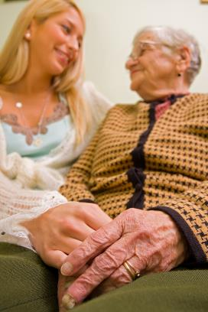
Interviewing Best Practices
Practice your interviewing style
Be aware of possible responses to questions
Avoid questions that assume guilt
Avoid questions that prompt “yes” & “no” responses
Focus on interview content, not who made the report

Slide 60

Dealing with Resistance:
Getting in the Door
“What does (the victim) expect you to
do for him?”
“What are some concerns that have
come up in your work here?”
“Have you had trouble doing some
things? Which ones?”
“What kind of assistance would be
helpful when things get overwhelming?”
“When do things get to be too much?”
Handout # 4
Dealing with Resistance : Open Ended Questions

Slide 61

When the Perpetrator Begins to Talk
Make it easy
Identify with their needs
Be empathetic
Offer support
What was their experience?
Trigger event
History
Bottom line
Do not confuse building
rapport with the perpetrator
with condoning his/her behavior

Slide 62

Maintaining neutrality
Frame questions in neutral, objective language
Use same form of address for victim & perpetrator
Maintain a neutral facial expression
Use active listening
Be respectful
Do not react to perpetrator’s testing behavior

Slide 63

Addressing the Perpetrator
Take notes as if you were preparing for court
Interview the perpetrator alone
Be professional, not friendly
Use your authority
Give perpetrator a chance to cooperate
Be clear about consequences if perpetrator does not cooperate

Slide 64
Interviewing to prevent further reoccurrences
“This is very serious.”
“This cannot continue.”
“How should we work together in order to not get to a point in which law enforcement has to become involved?”
“What would be a plan for providing good care?”

Slide 65
Interviewing Best Practices
Refer to Activity 8.
With a partner, practice interviewing Jacob and apply the best practices we have just covered.
  How will you approach Jacob?
  What questions will you ask?
After 5 minutes, switch roles.
Activity # 8 Betty Case
Exercise: Role-play

Slide 66
Developing a Service Plan
Physical / Medical Impairments
Capacity
Safety / Risk
Financial / Social Situation
Living Environment

Slide 67
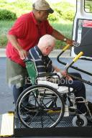
Safety & Risk
The APS worker’s perception of the causes of the problem and level of risk
Emergency services
Removing victim from immediate danger
Removing perpetrator
Least restrictive interventions
Short and long term risk reduction

Slide 68
Living Environment
Immediate environmental changes
Animal car
Cleaning
Repairs

Slide 69
Victim’s Physical / Medical Impairments
Medical treatment
Medications
Assistive devices
Rehabilitation

Slide 70
Financial / Social Situation
Victim’s informal and formal resources
Victim’s service eligibility
Sensitive to victim’s culture
Clear, realistic roles, expectations and accountability
Flexibility to accommodate change

Slide 71
Capacity
Victim’s perception of the problem
Victim’s capacity
Victims’ strengths, needs, wishes and motivation
Perpetrator’s capacity

Slide 72

What about Services for Caregivers?
Caregiver burden
Caregiver training and group interventions
Spousal caregivers
Caregivers of people with dementia

Slide 73
Developing a Service Plan
In your small groups, using HANDOUT # 5 and Activity #2 to develop a service plan. We will compare your service plan with the actual outcomes of the case.
Handout # 5 Developing a Service Plan
Activity # 2 Case of the 59 Pound Victim PART 1
Handout # 6 Case of the 59 Pound Victim PART 2
Exercise: Tabletop Discussion

Slide 74
Closing & Evaluations
  Review
  Questions?
  Please complete evaluations
  Thank you for your time and energy!

