Slide 1

Involuntary Case Planning
Developed by
Susan Castano

Slide 2

Housekeeping and Introductions
Schedule for the day
CEU instructions
Location of restrooms
Set cell phones to vibrate
Introductions

Slide 3

Evaluation Process
All APS Training has 3 evaluation components:
Transfer of Learning Activity
Embedded Evaluation
Satisfaction Survey

Slide 4
Developing an ID Code
What are the first three letters of your mother’s maiden name? Alice Smith
What are the first three letters of your mother’s First name? Alice Smith
What are the numerals for the DAY you were born? Nov 29th
Trainee ID Code
S | M | I | A | L | I | 2 | 9

Slide 5

Learning Objectives
When should you use involuntary interventions?
When is safety more importance than self determination?
What are the ethical issues?
What are involuntary interventions?

Slide 6
It’s a Free Country… Or Is It?
Notes:
Name situations when we can’t do what we want.
Is the APS investigation an involuntary services?

Slide 7

Too Far or Not Far Enough?

Slide 8

We Can’t Do It Alone

Slide 9

Proving the Need for Intervention
Understand the legal process
Determine who else should be involved
Evaluate the social consequences
Gather the evidence
Document clearly
Notes:
Keep your ducks in a row!

Slide 10

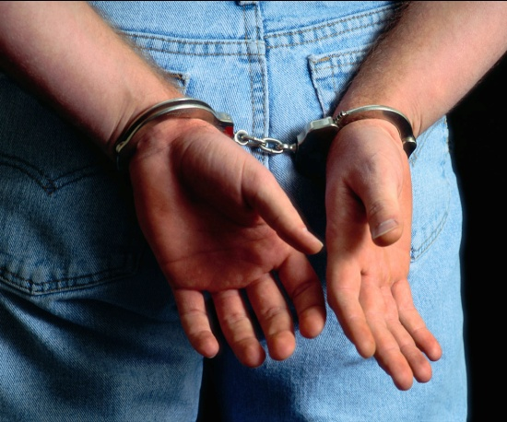

Understand the Legal Process
What are the statutes governing this action?
Has a crime been committed?
What are the legal consequences to the victim?
What are the legal consequences to the perpetrator?
Does the action meet legal standards?
Notes:
guardianship

Slide 11

Who Else Should be Involved?
Who are your partners/Who can help you reach your goal?
Respond to the challenges
Learn their language
Notes:
Issues: Transfer of learning exercise. ID the players in your county, discuss with your supervisor and coworkers some of the challenges.
Who are your partners/Who can help you reach your goal?
Respond to the challenges
Historical mistrust
Definitions and understandings of elder abuse
Settings
Roles
Personality conflicts
Learn their language

Slide 12

Gather the Evidence
Focus on observable facts
  Who
  What
  Where
  When
  How
Obtain supporting information from reliable sources

Slide 13

Document Clearly
Facts
Observations
Dates
Collateral information:
quotes
Collateral documentation
  Medical records
  Hospital records
  Bank records
  Affidavits
  Utility shut-off
  Eviction/foreclosure

Slide 14
Evaluate the Social Consequences
What will happen to client/victim?
What will happen to perpetrator?
What will be the effect on family members?
How will you respond to the larger community?

Slide 15

Tell It to the Judge
Mental health hold
Emergency hospitalization
Home cleanup
Gaining access to victim
Freeze bank accounts
Conservatorship
Notes:
What proof or documentation would you need to gather in order to support your use of involuntary services in the case plan?
5 scenarios, 5 groups, handout, small group activity, large group shout out

Slide 16

Groups: prepare your cases
Judges: prepare your questions
Groups: present your cases
Judges: ask your questions and make a decision

Slide 17

Final Thoughts
Understanding all the factors that may impede rational choice is complex and requires highly sophisticated and critical thinking. Professionals working with the elderly and APS workers must procure on-going training, consultation and supervision, and participate in collaborative activities regarding the principle of self-determination and the duty-to-protect abused elders. In answering the question: “Do we know enough?” ….we do not. The next question is “Are we willing to learn?”
L. Rene Bergeron (2006)

