Slide 1



Slide 2
This training was produced by the Academy for Professional Excellence under 2009-SZ-B9-K008, awarded by the Office for Victims of Crime, Office of Justice Programs, U.S. Department of Justice. The opinions, findings, and conclusions or recommendations expressed in this training are those of the contributors and do not necessarily represent the official position or policies of the U.S. Department of Justice.
The National APS Training Project is a project of the Academy for Professional Excellence, San Diego State University School of Social Work

Slide 3

Housekeeping and Introductions
Schedule for the day
CEU instructions
Location of restrooms
Set cell phones to vibrate
Introductions

Slide 4

Evaluation Process
Transfer of Learning Activity
Embedded Evaluation
Satisfaction Survey

Slide 5
Developing an ID Code
What are the first three letters of your mother’s
maiden name? Alice Smith
What are the first three letters of your mother’s
first name? Alice Smith
What are the numerals for the DAY you were
born? Nov 29th
Trainee ID Code
S | M | I | A | L | I | 2 | 9

Slide 6

Learning Objectives
Identify the factors that influence
intervention needs
Discuss strategies to engage the
victim in developing mutual goals
to decrease risk of abuse
Determine appropriate interventions that
would decrease risk of abuse
Explain when and how to use a Domestic
Violence Safety Planning tool

Slide 7
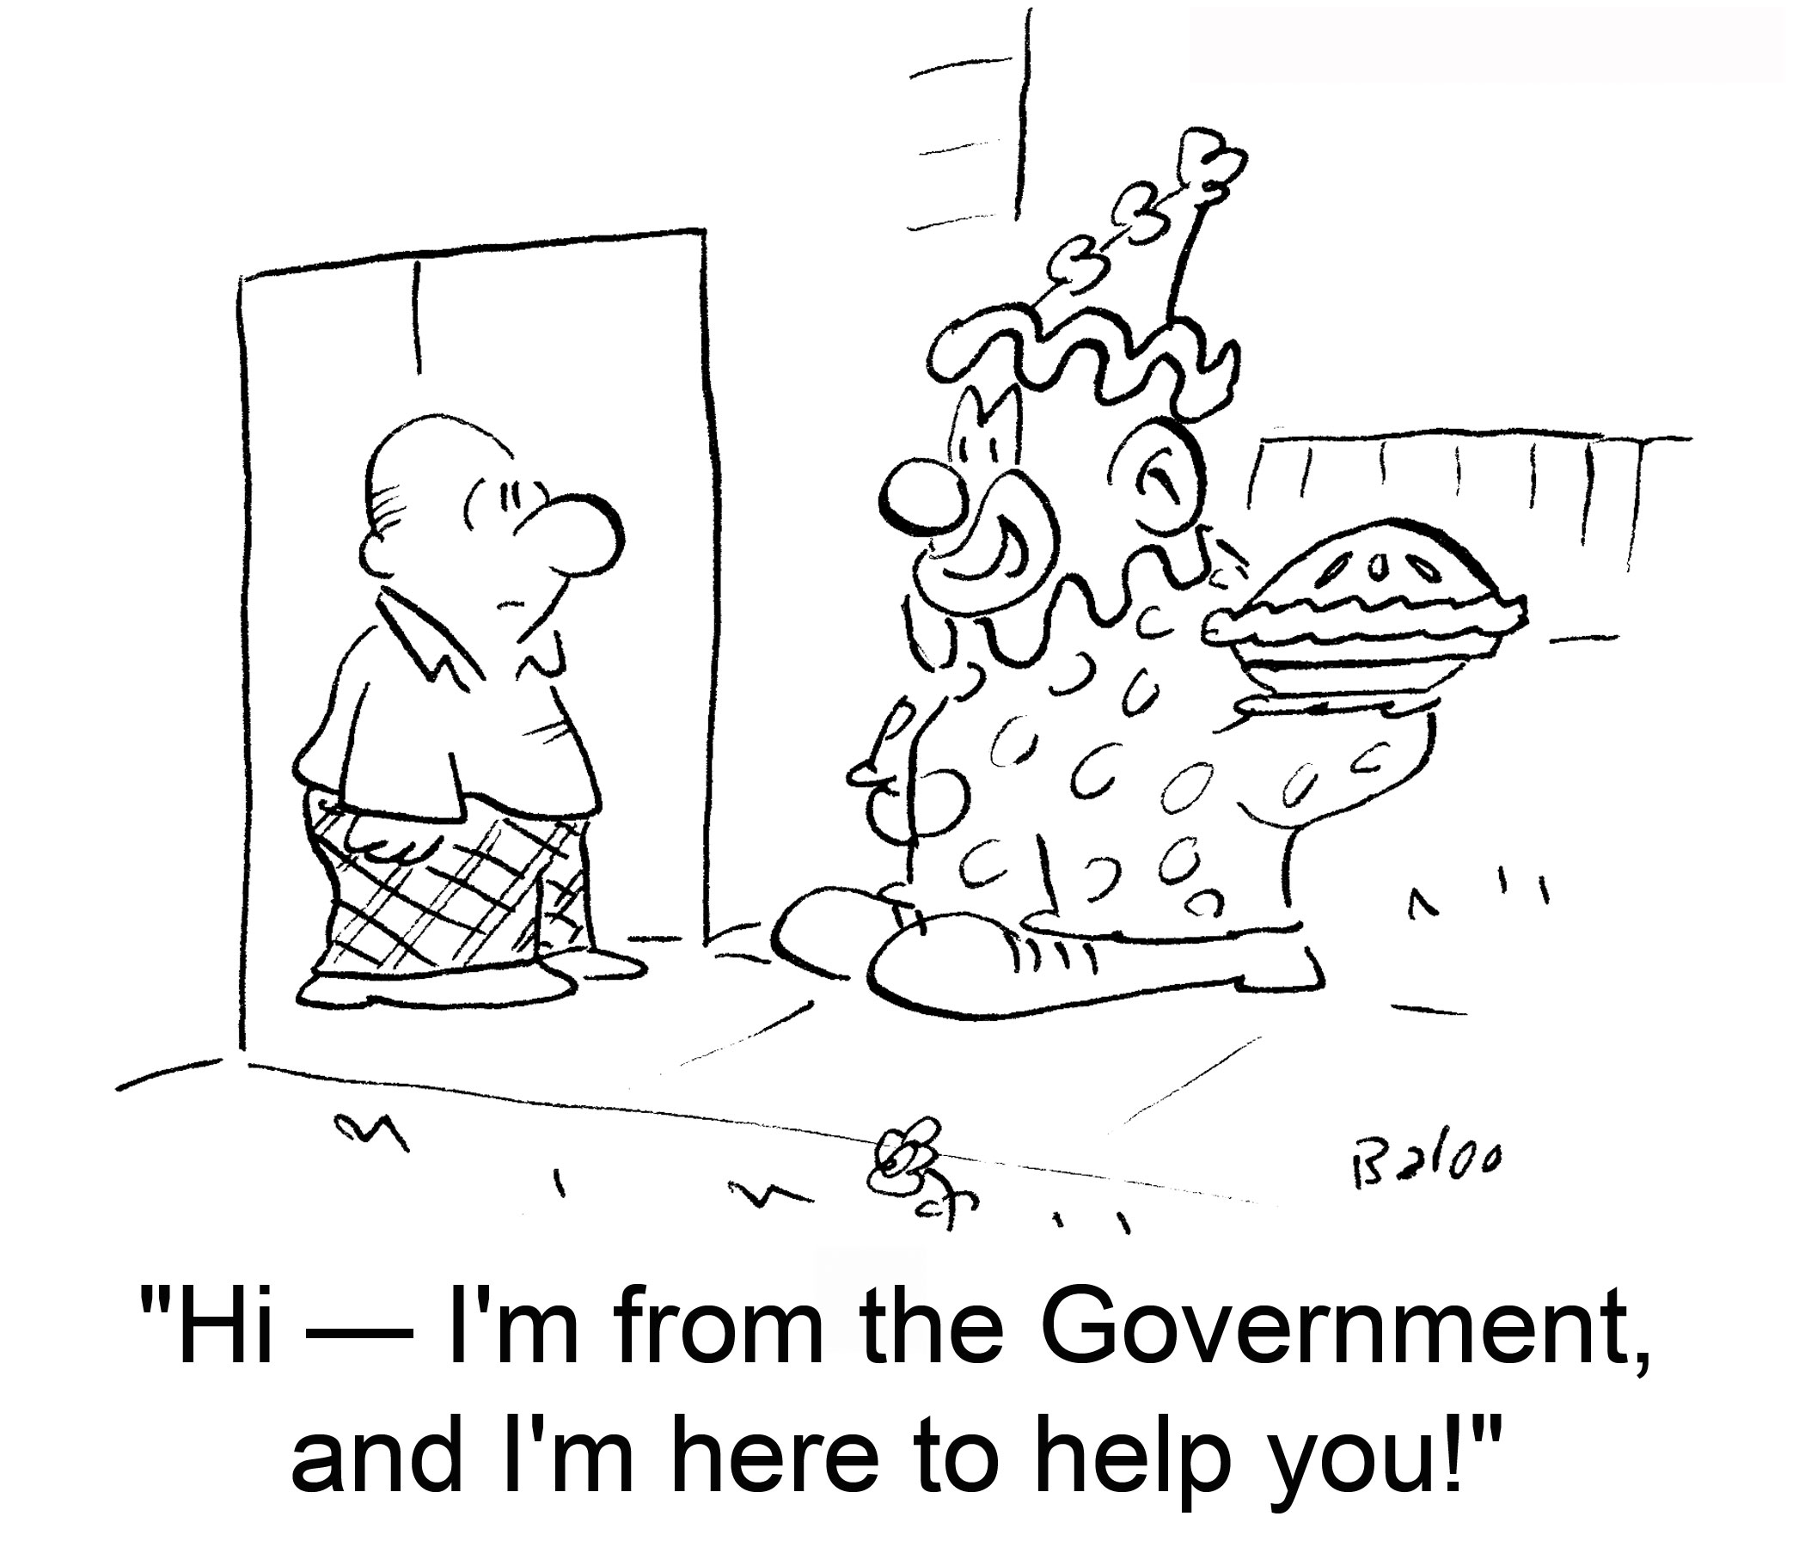

Slide 8
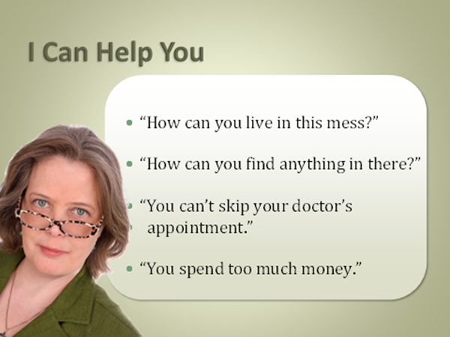

Slide 9
Factors Influencing the Service Plan
Client wishes
Perpetrator issues
Urgency of the Situation
Professional ethics
Cultural Considerations
Adapted from Elder Abuse Prevention: Emerging Trends and Promising Strategies,
Lisa Nerenberg, 2008

Slide 10
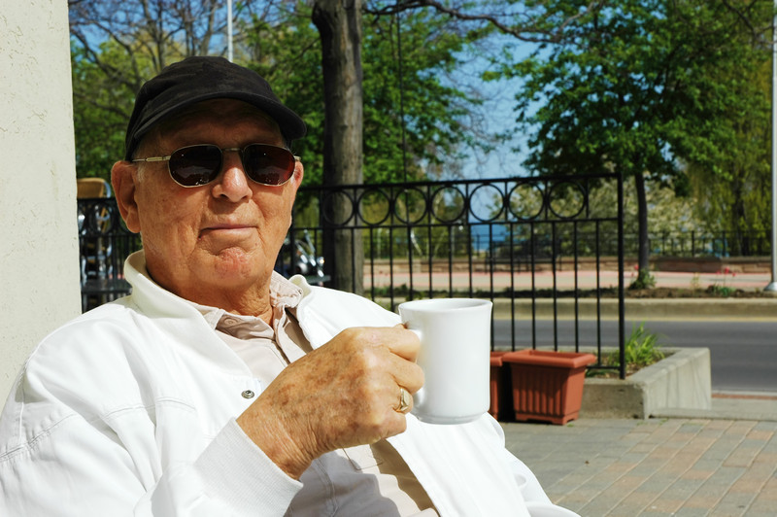
Client Wishes
Mental capacity/
ability & willingness
to consent
Risk factors
Resources and support
systems

Slide 11

Mental Capacity and
Ability to Consent
Levels of consent
Capacity can fluctuate over time
Varied reasons for lack of consent
Capable and consenting
Capable and non-consenting
Incapable and consenting
Incapable and non-consenting

Slide 12
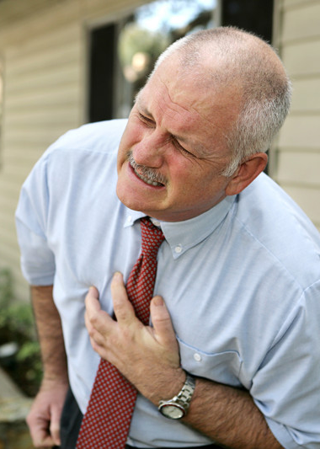
Client Risk Factors
Health and functional ability
Dementia and mental health
problems
Dependency
Relationship to abuser
Isolation/lack of social
support
Age/gender/ethnicity
Recent losses

Slide 13

Client Resources and Support Systems
Informal networks
Public/ private services
  Benefits and limitations
Finances
  Availability
  Willingness to spend
  Eligibility and waiting
  lists

Slide 14

Perpetrator Issues
Relationship to the victim
Mental health/substance abuse
Dependency
Motives for abusing
Willingness/ability to change
Access and level of threat

Slide 15

Motives for Abusing
Financial gain
Mental illness/substance
abuse/other impairment
Caregiving issues
Dependency
Interpersonal dysfunction
Power and control

Slide 16

Assessing Abuser’s Willingness to Change
Victim’s wishes for abuser
Abuser’s willingness to stop
abuse, learn new skills, get
treatment, pay back
Can treatment be monitored
Abuser’s admission of wrongdoing

Slide 17

Assessing Abuser’s Level of Threat
Continued or potential
access to victim
Victim’s ability/desire to
deny access
Weapons in the home
Mitigating factors
  Others in home to monitor
  Assets secured

Slide 18
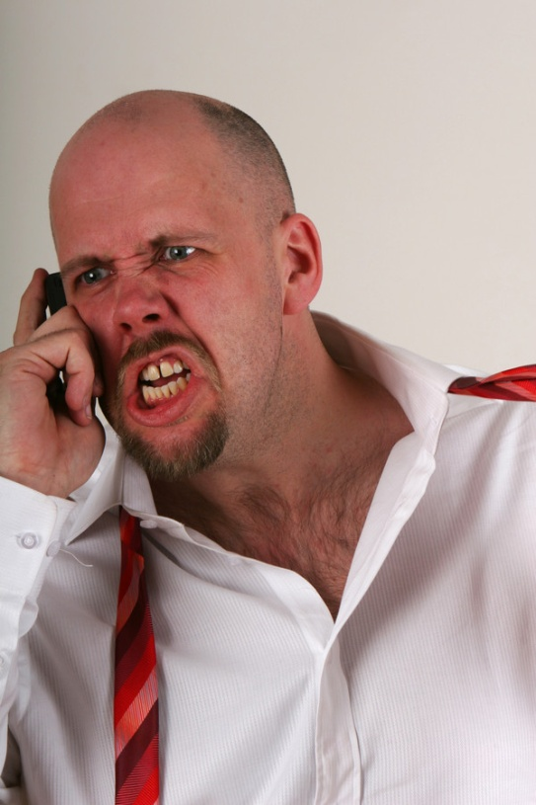
Urgency of Situation
Lack of supervision
Imminent danger of
violence
Imminent eviction
Unsafe environment
Imminent risk of serious
financial losses

Slide 19

Ethical Considerations
Autonomy vs. protection
Least restrictive alternative
Benefits and risks of each
alternative
Competing and conflicting
principles
Self-awareness
  Whose needs are being met?
  Whose life is it anyway?

Slide 20
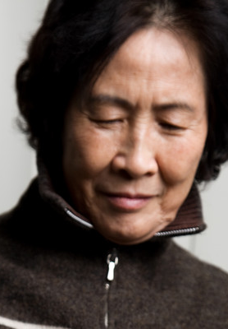
Cultural Considerations
Values
Attitudes about abuse
Which services are
acceptable, compatible,
accessible
Who should provide them
and how

Slide 21

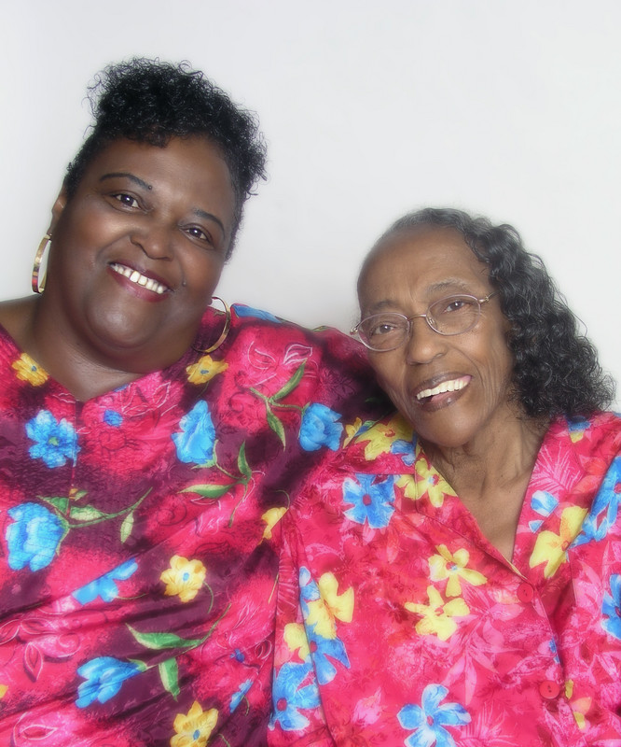
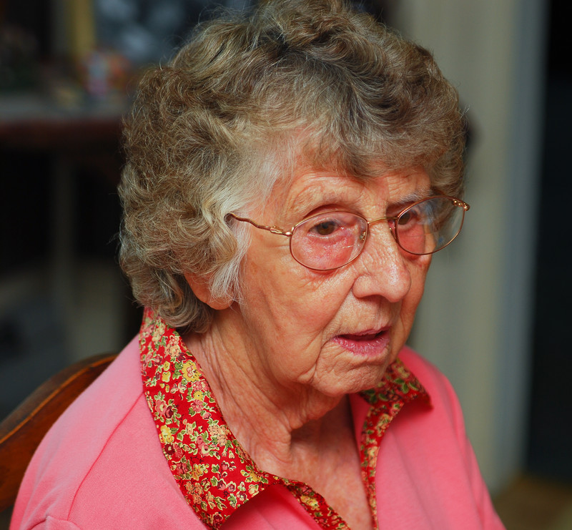
Case Study: Preplanning
Select a recorder and reporter
Read the case
Complete the exercise

Slide 23

Reluctance Stage
Characteristics
  Has not acknowledged abuse
  Denial
  Self-blame
  Low self-acceptance
  Ambivalence
  Isolation
  Belief that abuser needs help

Slide 24

Reluctance Stage
Interventions
  Provide emergency assistance
  Provide information on
    Elder abuse
    Options
    Accessing help
  Implement “keep in touch” method
  Provide services/make referrals

Slide 25

Recognition Stage
Characteristics
  Problem recognized as complex
  Realization that problem can’t be managed alone
  Continued ambivalence
  Lessening of denial, self-blame
  Desire to share with others

Slide 26

Recognition Stage
Intervention
  Provide emergency assistance
  Explore options extensively
  Provide services according to need and/or make appropriate referrals

Slide 27

Rebuilding Stage
Characteristics
  Reshaping identity
  Seeking lifestyle alternatives
  Diminished self-blame
  High self-acceptance
  Development of support system

Slide 28

Rebuilding Stage
Interventions
  Provide emergency assistance
  Assist/support with adjustments and life changes
    New housing arrangements
    Enforcement of orders of protection
  Provide services according to need/make referrals

Slide 29
Where Do We Begin?
Bring your L.O.A.F.
Listen
Observe
Ask
Facilitate

Slide 30

Starting from Strengths
Let’s change our frame of reference!
Difficult
Manipulative
Resistant
CoDependent
Passive
Poor judgment

Slide 31

Strengths to Consider
Hardiness and adaptive
skills
Willingness to learn and
use resources
Loyalty and forgiveness
Survival instincts
Kindness and compassion
Strong faith or religious values
Creativity

Slide 32



What’s Out There?
What are the systems?
  Aging network
  Financial assistance
  Mental health care
  Medical care
  Domestic violence services
  Legal assistance

Slide 33
How To Find The Services
Supervisor
Coworkers
MDT
Known service providers
Service Directories
Internet search

Slide 34
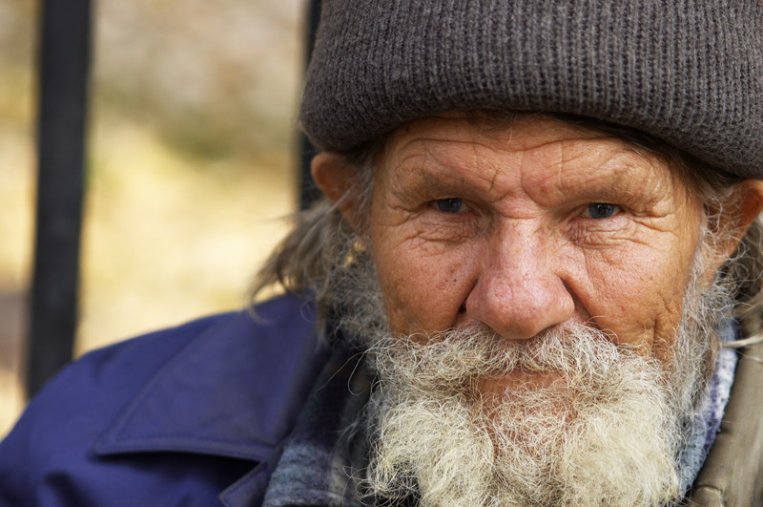
Eligibility for Services
Based on need
Based on income
Based on residence
Based on age
Based on disability
Immigration status

Slide 35

Beware
Stay up to date
  Funding time limited
  Funding income limited
  Funding finished
  Brochures/directories out of date
Maintain professional ethics
  Do not overstate or understate

Slide 36

APS Service Planning Considerations
Complexity of
  cases
Creativity
“Outside the
Box” Thinking

Slide 37

Scavenger Hunt Transfer of Learning
Match Client Needs to
Available Services
Begin your own resource
directory
Select 6 service needs and
research a resource that
will meet the need
Complete Activity Sheet
and return to trainer

Slide 38

Case Planning Essentials
The Case Plan Should Be:
Collaborative
Problem oriented
Appropriate to client’s functional
level and dependency needs
Consistent with culture and lifestyle
Realistic, time-limited, and concrete
Dynamic and renegotiable
Inclusive of follow up

Slide 39

Goal of the Case Plan
Maximizing independence
Resolving crises and
emergencies
Healing, empowering,
supporting victims
  Providing choices
  Helping victims save face
Cultivating new resources
Preserving, protecting, recovering assets
Ensuring safety/risk reduction

Slide 40

Evaluating Case Plan
Hidden/ unintended
consequences
Ethical dilemmas
Workability
Whose needs are being
served
Plan B

Slide 41
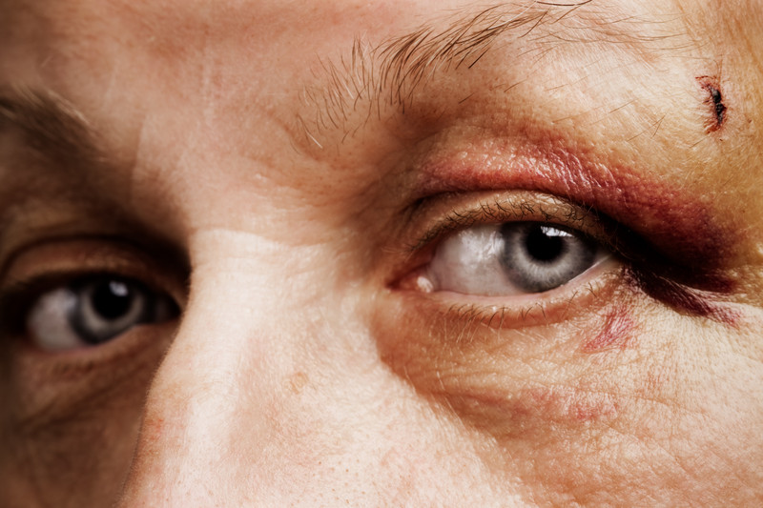
Domestic Violence Safety Planning
What is safety planning?

Slide 42





Safety Plans Include:
Prevention Strategies
Protection Strategies
Notification Strategies
Referral/ Services
Emotional Support

Slide 43
A Victim Centered Plan
Where Will The Victim Live?
Money
Health
Who Else Is Affected By The Abuse?
Legal

Slide 44

Safety Planning Steps
Build rapport and listen to the victim

Slide 45

Safety Planning Steps
Learn what the victim fears

Slide 46

Safety Planning Steps
Ask what the victim wants to do

Slide 47

Safety Planning Steps
Think creatively together about a variety of options and ideas

Slide 48

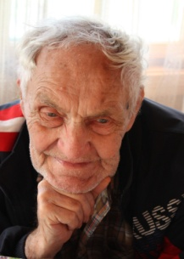
Safety Planning Steps
Build a safety plan that is victim centered

Slide 49
Safety Planning is NOT:
Telling the victim what to do
Helping a victim accomplish your goals
Simply referring the victim to local agencies
Ignoring cultural, spiritual or generational values
Recommending strategies that could increase the risk for the victim
Blaming the victim

Slide 50

Let’s review a safety planning tool

Slide 51

Safety Plan for Irene:
Each group needs:
Irene
Moderator to keep the safety planning on track
Recorder
Primary interviewer
Secondary interviewers

Slide 52

Change of plans
Irene’s husband passed away unexpectedly.
Irene’s son is drinking more and has become more
aggressive.
Based on what
Irene wants,
develop a new
plan.

Slide 53

She needs a new plan
Irene’s son has gotten a job and is drinking less.
Irene is lonely.
Based on what
Irene wants,
develop a new
plan.

Slide 54

Let’s take a moment to reflect:
Questions?
What have you learned?
Please complete:
Self Assessment of Learning
Trainee Satisfaction Survey

