Slide 1
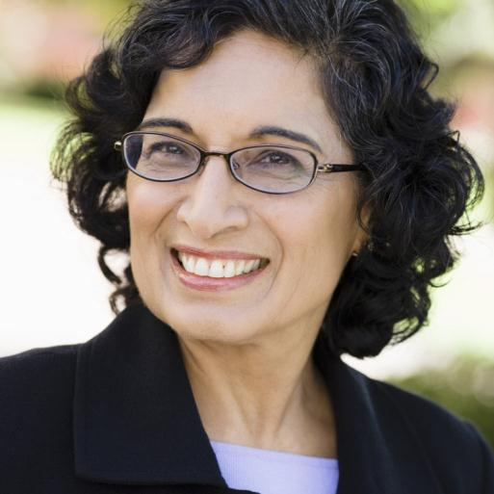
Understanding Self as supervisor
APS Supervisor Core Training
Developed by: APS Training Project Academy for Professional Excellence
San Diego State University School of Social Work

Slide 2
Welcome & Housekeeping

Slide 3
Evaluation Process
Transfer of Learning Activity
Embedded Evaluation
Satisfaction Survey

Slide 4
Developing an ID Code
What are the first three letters of your mother’s maiden name? Alice Smith
What are the first three letters of your mother’s first name? Alice Smith
What are the numerals for the DAY you were born? Nov 29th
Trainee ID Code
S | M | I | A | L | I | 2 | 9

Slide 5
APS Supervisor Core: A Roadmap
Understanding Self as Supervisor
Foundations of Effective Supervision
Data and Fiscal Operations
Teambuilding and Motivating Staff
Management of Personnel Issues
Critical Thinking
Collaborations and Resources
Workplace Safety

Slide 6
Learning Objectives
Identify roles of APS Supervisor and assess your competency in each role.
Integrate strengths-based leadership skills into current supervision style to increase staff performance.
Identify appropriate uses of training, mentoring, and coaching skills and apply these skills with staff.

Slide 7
Learning Objectives
Describe personal vision for effective and productive work environment and identify steps to implement change.
Identify issues relating to professional boundaries and learn strategies for managing these issues.

Slide 8
Introductions
Name
County
Position/Role
What is the best part about being an APS Supervisor?
What is the most challenging part related to being an APS Supervisor?

Slide 9
Defining the Supervisory Role
"An educational process by which a person with certain equipment of knowledge and skills takes responsibility for training a person with less equipment." V. Robinson, 1936

Slide 10
APS Supervisor
Case Conferencing
Managing Personnel Issues
Community Representation
Training Workers
Modeling Good Work Practices
Coordinate Back-up Coverage
Compliance with Mandates/ Policies
Notes:
10

Slide 11
Administrative
Managerial
Educational
Service and Support
Four Supervisory
Leadership Roles

Slide 12
Supervisory Roles
Self-Assessment Inventory

Slide 13
Inventory Reflection
1. In which of the four roles do you feel that you have the most skill or capacity?
2. How do these skills support the ability of your team to serve their frail and vulnerable clients?

Slide 14
Activity
How do you spend your time?
Administrative
Managerial
Educational
Service and Support
?
?
?
?

Slide 15
Collaboration is Key!
Treasure Hunt

Slide 16
L.I.F.E. Reports
Learning
In the
Field
Experience

Slide 17
Assessing Workplace Style
5 Essential Supervisory Workplace Themes
Themes
Applying Authority
Cultivating Fairness & Equity
Establishing Expectations
Tending to Teams
Parallel Process

Slide 18
Applying Authority
Supervisor responsible for: - Making the demand for work - Recognizing the negative feelings that result from expectations.

Slide 19
Cultivating Fairness and Equity
Supervisor is responsible for: -Cultivating skills of self examination -Increasing knowledge about cultural identity

Slide 20
Establishing Expectations
Supervisor is responsible for:
Clarifying expectations for the worker’s performance
Communicating supports available to the worker
Tuning into worker’s feelings, concerns, thoughts

Slide 21
Parallel Process
The relationship between the supervisor and the APS Worker has a direct impact on the way that the APS Worker interacts with elders and dependent adults in the field.

Slide 22
Tending to Teams
Essential Skills for a Supervisor: -Be able to Lead and Follow -Be Consistent and Flexible -Willingness to Teach and Learn

Slide 23
Buddy Activity
Which theme is most challenging for you to integrate into your supervisory role?
Why do you think this?

Slide 24
Leadership Styles
Strengths Based Leadership

Slide 25
Basic Tenets
The most effective leaders are:
Always investing in strengths
Surround themselves with the right people and then maximize their team.
Understand their followers' needs:
Trust
Compassion
Stability
Hope

Slide 26
Activities
Strengths Based Leadership 12 Questions
Strengths Based Leadership Scenario

Slide 27
Learning Journal
What can I do to make sure that I am implementing a strengths based leadership model with my own team?

Slide 28
Coaching, Mentoring and Training

Slide 29
Coaching
Coaching is:
An on-going relationship that offers one-on-one or small group discussions targeted at helping learners become more successful.
A process used to empower employees.
A process that enables staff to improve performance and enhance quality of life.

Slide 30
Distinctions Make the Difference
Aptitude - Is there a lack of skills or knowledge? = Training
Attitude - Is the employee getting in their own way? = Coaching
Available Resources - Is an outside factor getting in the way? = Training or Coaching
Approach - Is the employee showing a desire for long term career development? = Mentoring

Slide 31
Mentoring
A longer term process that assists with career development. Mentors provide motivation, connection, and advice but they do not make a direct connection to learning.

Slide 32
Activities
To Coach or Not to Coach?
Coaching Scenarios

Slide 33
What does it look like to provide coaching?
Mirror
Ask Open Ended Questions
Listen
Feedback
Create Space
Celebrate Progress
Validate

Slide 34
Just-In-Time Coaching
Training
JIT Coaching
Facilitation

Slide 35
Activities
Partner Interview
Coaching Questions

Slide 36
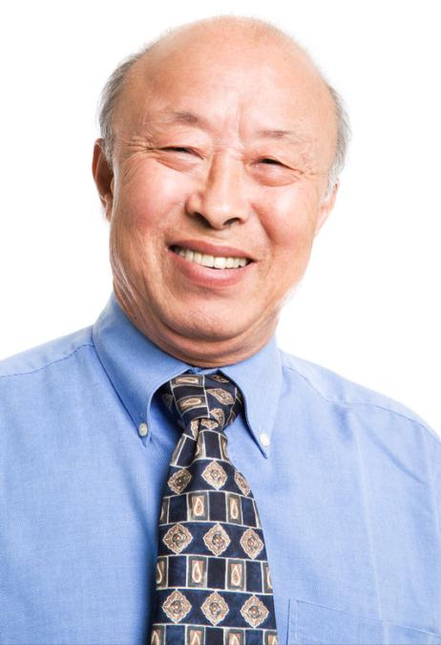
Work Environments
or

Slide 37
Characteristics of Positive Work Environments
1. Open and supportive communication. 2. Strong foundation of trust. 3. Team collaboration. 4. High performance expectations. 5. Free flowing recognition and praise.
Source: Insidejobscoach.com

Slide 38
Characteristics of Positive Work Environments
6. Give credit and take responsibility. 7. Available and approachable management. 8. Aesthetics count! Create an appealing work space. 9. Make performance evaluations a positive experience. 10. Don't forget to have fun!
Source: Insidejobscoach.com

Slide 39
Implementing Change

Slide 40
3 Phases of Transition

Slide 41
Managing Transitions
What behaviors and attitudes need to be changed?
Analyze who may "lose" as a result of the change?
Sell the change.
Hold regular meetings to reinforce change and address new challenges.

Slide 42
Learning Journal
What can I do to create a positive work environment and how can I effectively manage this change for my team?

Slide 43
From Peer to Supervisor
Transitioning into the role of frontline supervisor

Slide 44
From Peer to Supervisor
Managing Caseload 1. Assess and allocate resource needs of clients 2. Coordinate client activities 3. Implement procedures
vs.
Managing People 1. Assess and allocate resource needs of staff 2. Coordinate staff activities. 3. Develop/Implement procedures.

Slide 45
Activity
From Buddy to Boss

Slide 46
Group Activity
Treasure Hunt

Slide 47
Closing/Evaluations
Identify one way that you will apply the materials that were learned today either personally or professionally.
Questions
Training evaluations
Thank you!

