Slide 1
California Consistency in Determining Findings: Instructor-Led Skill Building
Creating experiences that transform the heart, mind and practice.

Slide 2
Welcome & Introductions
Facilitator introduction
APS’s goals with course
Introductions
Course overview

Slide 3
Housekeeping
Cell phones on silent or vibrate
Location of restrooms and emergency exits
Schedule
1 break in morning and one in afternoon
An hour for lunch
Course Materials
PowerPoint handout/ Participant Manuals

Slide 4
Learning Objectives
Determine potential abuse by identifying the abuse indicators, using the APS Standards for Consistency in Determining Findings Matrix.
Critique if evidence meets the abuse type’s legal components (Essential Defining Elements, interpreted from Welfare & Institutions Code) during scenario based skill practice.
Construct a findings rational narrative that includes the components required for it to be descriptive and complete.

Slide 5
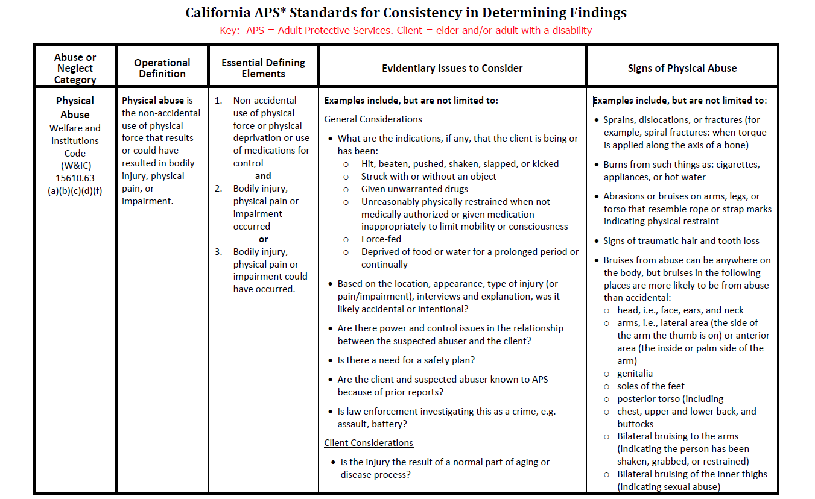
Consistency Matrix and Guiding Principals

Slide 6
Tends to indicate…
Physical
Physical
“Pressured”
Sexual
Sexual
Financial
Financial
Financial
Neglect
Neglect
Self-neglect
Self-neglect
Psychological
Psychological
Abandonment
Abandonment
Isolation
Isolation
Abduction
Abduction
Notes:
KEY
“Crime” – physical, sexual, financial, neglect, abandonment, abduction
“Pressured” – sexual
“Demeanor changed” – sexual
“Power” – physical, sexual, psychological, isolation ALSO: financial and neglect when talking about “power of attorney”
“Restraint” – physical
“Exploited” – financial, isolation
“Malnourished” – physical, neglect, self-neglect
“Deprived” – physical, neglect
“Intimidated” – psychological
“Threat[ened]” – financial, psychological, abandonment, isolation
“Hazard[ous] – neglect, self-neglect

Slide 7
Tends to indicate…
Physical
Physical
“Pressured”
Sexual
Sexual
“Hazard”
Financial
Financial
Neglect
Neglect
Neglect
Self-neglect
Self-neglect
Self-neglect
Psychological
Psychological
Abandonment
Abandonment
Isolation
Isolation
Abduction
Abduction
Notes:
KEY
“Crime” – physical, sexual, financial, neglect, abandonment, abduction
“Pressured” – sexual
“Demeanor changed” – sexual
“Power” – physical, sexual, psychological, isolation ALSO: financial and neglect when talking about “power of attorney”
“Restraint” – physical
“Exploited” – financial, isolation
“Malnourished” – physical, neglect, self-neglect
“Deprived” – physical, neglect
“Intimidated” – psychological
“Threat[ened]” – financial, psychological, abandonment, isolation
“Hazard[ous] – neglect, self-neglect

Slide 8
Tends to indicate…
Physical
Physical
“Pressured”
Sexual
Sexual
“Hazard”
Financial
Financial
“Threat[ened]”
Neglect
Neglect
Self-neglect
Self-neglect
Psychological
Psychological
Abandonment
Abandonment
Isolation
Isolation
Abduction
Abduction
Notes:
KEY
“Crime” – physical, sexual, financial, neglect, abandonment, abduction
“Pressured” – sexual
“Demeanor changed” – sexual
“Power” – physical, sexual, psychological, isolation ALSO: financial and neglect when talking about “power of attorney”
“Restraint” – physical
“Exploited” – financial, isolation
“Malnourished” – physical, neglect, self-neglect
“Deprived” – physical, neglect
“Intimidated” – psychological
“Threat[ened]” – financial, psychological, abandonment, isolation
“Hazard[ous] – neglect, self-neglect

Slide 9
Tends to indicate…
Physical
Physical
“Pressured”
Sexual
Sexual
“Hazard”
Financial
Financial
“Threat[ened]”
Neglect
Neglect
“Demeanor/personality/behavior changed”
Self-neglect
Self-neglect
Psychological
Psychological
Abandonment
Abandonment
Isolation
Isolation
Abduction
Abduction
Notes:
KEY
“Crime” – physical, sexual, financial, neglect, abandonment, abduction
“Pressured” – sexual
“Demeanor changed” – sexual
“Power” – physical, sexual, psychological, isolation ALSO: financial and neglect when talking about “power of attorney”
“Restraint” – physical
“Exploited” – financial, isolation
“Malnourished” – physical, neglect, self-neglect
“Deprived” – physical, neglect
“Intimidated” – psychological
“Threat[ened]” – financial, psychological, abandonment, isolation
“Hazard[ous] – neglect, self-neglect

Slide 10
Tends to indicate…
Physical
Physical
Physical
“Pressured”
Sexual
Sexual
“Hazard”
Financial
Financial
“Threat[ened]”
Neglect
Neglect
Neglect
“Demeanor/personality/behavior changed”
“Deprived”
Self-neglect
Self-neglect
Psychological
Psychological
Abandonment
Abandonment
Isolation
Isolation
Abduction
Abduction
Notes:
KEY
“Crime” – physical, sexual, financial, neglect, abandonment, abduction
“Pressured” – sexual
“Demeanor changed” – sexual
“Power” – physical, sexual, psychological, isolation ALSO: financial and neglect when talking about “power of attorney”
“Restraint” – physical
“Exploited” – financial, isolation
“Malnourished” – physical, neglect, self-neglect
“Deprived” – physical, neglect
“Intimidated” – psychological
“Threat[ened]” – financial, psychological, abandonment, isolation
“Hazard[ous] – neglect, self-neglect

Slide 11
Tends to indicate…
Physical
Physical
Physical
“Pressured”
Sexual
Sexual
“Hazard”
Financial
Financial
“Threat[ened]”
Neglect
Neglect
Neglect
“Demeanor/personality/behavior changed”
“Deprived”
Self-neglect
Self-neglect
Self-neglect
“Malnourished”
Psychological
Psychological
Abandonment
Abandonment
Isolation
Isolation
Abduction
Abduction
Notes:
KEY
“Crime” – physical, sexual, financial, neglect, abandonment, abduction
“Pressured” – sexual
“Demeanor changed” – sexual
“Power” – physical, sexual, psychological, isolation ALSO: financial and neglect when talking about “power of attorney”
“Restraint” – physical
“Exploited” – financial, isolation
“Malnourished” – physical, neglect, self-neglect
“Deprived” – physical, neglect
“Intimidated” – psychological
“Threat[ened]” – financial, psychological, abandonment, isolation
“Hazard[ous] – neglect, self-neglect

Slide 12
Tends to indicate…
Physical
Physical
Physical
“Pressured”
Sexual
Sexual
“Hazard”
Financial
Financial
“Threat[ened]”
Neglect
Neglect
“Demeanor/personality/behavior changed”
“Deprived”
Self-neglect
Self-neglect
“Malnourished”
Psychological
Psychological
“Restraint”
Abandonment
Abandonment
Isolation
Isolation
Abduction
Abduction
Notes:
KEY
“Crime” – physical, sexual, financial, neglect, abandonment, abduction
“Pressured” – sexual
“Demeanor changed” – sexual
“Power” – physical, sexual, psychological, isolation ALSO: financial and neglect when talking about “power of attorney”
“Restraint” – physical
“Exploited” – financial, isolation
“Malnourished” – physical, neglect, self-neglect
“Deprived” – physical, neglect
“Intimidated” – psychological
“Threat[ened]” – financial, psychological, abandonment, isolation
“Hazard[ous] – neglect, self-neglect

Slide 13
Tends to indicate…
Physical
Physical
Physical
“Pressured”
Sexual
Sexual
Sexual
“Hazard”
Financial
Financial
Financial
“Threat[ened]”
Neglect
Neglect
Neglect
“Demeanor/personality/behavior changed”
“Deprived”
Self-neglect
Self-neglect
“Malnourished”
Psychological
Psychological
“Restraint”
Abandonment
Abandonment
Abandonment
“Crime”
Isolation
Isolation
Abduction
Abduction
Abduction
Notes:
KEY
“Crime” – physical, sexual, financial, neglect, abandonment, abduction
“Pressured” – sexual
“Demeanor changed” – sexual
“Power” – physical, sexual, psychological, isolation ALSO: financial and neglect when talking about “power of attorney”
“Restraint” – physical
“Exploited” – financial, isolation
“Malnourished” – physical, neglect, self-neglect
“Deprived” – physical, neglect
“Intimidated” – psychological
“Threat[ened]” – financial, psychological, abandonment, isolation
“Hazard[ous] – neglect, self-neglect

Slide 14
Tends to indicate…
Physical
Physical
“Pressured”
Sexual
Sexual
“Hazard”
Financial
Financial
Financial
“Threat[ened]”
Neglect
Neglect
“Demeanor/personality/behavior changed”
“Deprived”
Self-neglect
Self-neglect
“Malnourished”
Psychological
Psychological
“Restraint”
“Crime”
Abandonment
Abandonment
“Exploited”
Isolation
Isolation
Isolation
Abduction
Abduction
Notes:
KEY
“Crime” – physical, sexual, financial, neglect, abandonment, abduction
“Pressured” – sexual
“Demeanor changed” – sexual
“Power” – physical, sexual, psychological, isolation ALSO: financial and neglect when talking about “power of attorney”
“Restraint” – physical
“Exploited” – financial, isolation
“Malnourished” – physical, neglect, self-neglect
“Deprived” – physical, neglect
“Intimidated” – psychological
“Threat[ened]” – financial, psychological, abandonment, isolation
“Hazard[ous] – neglect, self-neglect

Slide 15
Tends to indicate…
Physical
Physical
“Pressured”
Sexual
Sexual
“Hazard”
Financial
Financial
“Threat[ened]”
Neglect
Neglect
“Demeanor/personality/behavior changed”
“Deprived”
Self-neglect
Self-neglect
“Malnourished”
Psychological
Psychological
Psychological
“Restraint”
“Crime”
Abandonment
Abandonment
“Exploited”
Isolation
Isolation
“Intimidated”
Abduction
Abduction
Notes:
KEY
“Crime” – physical, sexual, financial, neglect, abandonment, abduction
“Pressured” – sexual
“Demeanor changed” – sexual
“Power” – physical, sexual, psychological, isolation ALSO: financial and neglect when talking about “power of attorney”
“Restraint” – physical
“Exploited” – financial, isolation
“Malnourished” – physical, neglect, self-neglect
“Deprived” – physical, neglect
“Intimidated” – psychological
“Threat[ened]” – financial, psychological, abandonment, isolation
“Hazard[ous] – neglect, self-neglect

Slide 16
Tends to indicate…
Physical
Physical
Physical
“Pressured”
Sexual
Sexual
Sexual
“Hazard”
Financial
Financial
Financial
“Threat[ened]”
Neglect
Neglect
“Demeanor/personality/behavior changed”
“Deprived”
Self-neglect
Self-neglect
“Malnourished”
Psychological
Psychological
Psychological
“Restraint”
“Crime”
Abandonment
Abandonment
“Exploited”
Isolation
Isolation
Isolation
“Power”
“Intimidated”
Abduction
Abduction
Notes:
KEY
“Crime” – physical, sexual, financial, neglect, abandonment, abduction
“Pressured” – sexual
“Demeanor changed” – sexual
“Power” – physical, sexual, psychological, isolation ALSO: financial and neglect when talking about “power of attorney”
“Restraint” – physical
“Exploited” – financial, isolation
“Malnourished” – physical, neglect, self-neglect
“Deprived” – physical, neglect
“Intimidated” – psychological
“Threat[ened]” – financial, psychological, abandonment, isolation
“Hazard[ous] – neglect, self-neglect

Slide 17
Tends to indicate…
Physical
“Pressured”
Sexual
“Hazard”
Financial
“Threat[ened]”
What are some other words that come to your mind when thinking of the various types of abuse?
Neglect
“Demeanor/personality/behavior changed”
“Deprived”
Self-neglect
“Malnourished”
Psychological
“Restraint”
Abandonment
“Exploited”
“Crime”
Isolation
“Power”
“Intimidated”
Abduction
Notes:
KEY
“Crime” – physical, sexual, financial, neglect, abandonment, abduction
“Pressured” – sexual
“Demeanor changed” – sexual
“Power” – physical, sexual, psychological, isolation ALSO: financial and neglect when talking about “power of attorney”
“Restraint” – physical
“Exploited” – financial, isolation
“Malnourished” – physical, neglect, self-neglect
“Deprived” – physical, neglect
“Intimidated” – psychological
“Threat[ened]” – financial, psychological, abandonment, isolation
“Hazard[ous] – neglect, self-neglect

Slide 18
The Consistency Matrix

Slide 19
Reviewing the Columns

Slide 20
Finding Standards
✓
Confirmed = evidence reasonably supports all of the essential elements of the alleged abuse.
Inconclusive = evidence reasonably supports only some of the essential elements of the alleged abuse.
Unfounded = evidence reasonably refutes the essential elements of the alleged abuse.
?


Slide 21
Finding Standards Clarified
✓
≥ 51%
Confirmed = evidence with a ≥51% likelihood of supporting all of the legal components of the alleged abuse.
Abuse occurred or most likely occurred
?
Inconclusive = evidence insufficient to lead to a conclusion, BUT ALSO that does not remove all doubt that abuse occurred.

Unfounded = evidence with a ≤49% likelihood of supporting all the legal components of the alleged abuse.
≤ 49%

Slide 22
Using the Matrix with Evidence: Peter Frown
APS receives a report from a caretaker alleging financial abuse by the client, Peter Frown’s son. The RP shows the APS professional a bank statement, with the client’s name on it, and a line item shows that a $10,000 withdrawal was made via check. The RP stated that Peter was upset at his son for taking control of his bank account.
APS professional visits Peter and he is upset about his son taking over his account, but cannot give details of the events that led to it. APS professional calls the son, who offers to scan and email a copy of the DPOA, a copy of the check made to pay the overdue property tax, and a copy of the bill from the County’s tax collector for the overdue $10,000 in property tax and threatening legal action.

Slide 23
Using the Matrix with Evidence: Janice Pho
APS receives a report from the Regional Center alleging sexual abuse. Their 20yo consumer with an intellectual disability is pregnant. The APS professional interviews the client, Janice Pho, who says that her cousin, who moved into her home a few months ago to work for her dad, took her for a ride in the mountains. When she said it was time for her to go home, he said that he would not drive her back unless she had sex with him. She said that she didn’t want to, but he threw the keys in the backseat of the car until she would have sex with him. She reported, “I had to have sex with him so that I could get home”.

Slide 24
Scenario #1
An 83 year old woman, has In-Home Supportive Services (IHSS) and gives her in-home provider her jewelry for safekeeping while she goes to the hospital for surgery. Upon her discharge from the hospital, the client asks the provider to bring back her jewelry. The provider keeps forgetting to return it. The client tells this to her Home Health Nurse, who in turn files a report with APS.

Slide 25
Scenario #2
In groups:
Evaluate evidence for abuse indicators
Determine if the evidence meets the abuse’s legal components
Explain how the evidence meets the abuse’s legal components
Assign a finding(s)

Slide 26
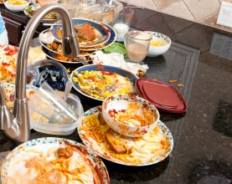
Scenario #3
Individually:
Evaluate evidence for abuse indicators
Determine if the evidence meets the abuse’s legal components
Explain how the evidence meets the abuse’s legal components
Assign a finding(s)
After completed, come to consensus with team members and record in your Findings Report Template.

Slide 27
Scenario #4
Individually:
Evaluate evidence for abuse indicators
Determine if the evidence meets the abuse’s legal components
Explain how the evidence meets the abuse’s legal components
Assign a finding(s)
After completed, come to consensus with team members and record it in your Findings Report Template.

Slide 28
Skill Practice Lessons Learned
What seemed to be the clearest allegation to determine a finding?
What was most difficult?
What surprised you the most?
What will you take away from this activity?

Slide 29
Peer Assessment
Individually:
Evaluate evidence for abuse indicators
Determine if the evidence meets the abuse’s legal components
Explain how the evidence meets the abuse’s legal components
Assign a finding(s)
Then, pass to peer on your left to asses.

Slide 30
Writing with Clarity and Thoroughness: “AFTER”
Findings Rational Narratives should include:
Abuse Type
Finding Determination
Theory of the events that led up to the allegation
Describe how/why abuse appears to have been committed
Evidence that supports the finding
Required Action
Disposition of case (e.g. Referred to L.E., Case closed, No Services needed, Protective Services offered, Conducted a needs assessment)

Slide 31
Narrative Comparison
Identify the “AFTER” elements:
Abuse Type
Findings Determination
Theory of Events that led up to the allegation
Evidence to support the finding
Required Action
Financial Abuse - Unfounded. The client’s son used his DPOA to protect his mother from the consequences of not paying her overdue property tax. He produced copies of the bill for $10,000, the check used to pay the bill, and the DPOA. There is no evidence on the bank statement suggesting that the son is financially abusing the client. APS services are not needed.
Financial Abuse - Inconclusive. Even though I can’t prove it, I know the provider’s sister is totally robbing the client, and the client lacks capacity.
Notes:
Sample narrative to follow.

Slide 32
Narrative Practice #1
Using Scenario #3 from earlier, work in teams to:
Construct a findings rational narrative, including “AFTER”.
Organize info into a comprehensible, coherent explanation of your finding.
Record on the “Narratives” section of a Findings Report Template.

Slide 33
Narrative Practice #2
Using Scenario #4 from earlier, work individually to:
Construct a findings rational narrative, including “AFTER”.
Organize info into a comprehensible, coherent explanation of your finding.
Record on the “Narratives” section of a Findings Report Template.

Slide 34
Wrap-Up and Lessons Learned
Use of the Consistency Matrix, Understanding the Findings Standards, and Findings Rational Narratives can improve consistency of findings determinations within programs and across the State.
Write in participant manuals two key takeaways from today’s training.
Share one of them.

Slide 35
Final Questions and Evaluations
Final Questions?
Thank you for your commitment to older and dependent adults in your community and making them safer with improved quality of life.
Thank you for attending and participating in this training!
Please fill out your evaluations.

