Slide 1
Financial Abuse in Estate Planning: Documents and Misuses
Creating experiences that transform the heart, mind and practice.

Slide 2
Welcome and Housekeeping Details
Cell phones on silent or vibrate
Location of restrooms and emergency exits
Schedule
1 break in morning and one in afternoon
An hour for lunch
Course Materials
PowerPoint handout/ Participant Manuals

Slide 3
Experience With Estate Planning
How many have had experience with an Estate Plan or Conservatorship?
Come in contact with estate planning documents or Conservatorships personally, or
Dealt with estate planning documents or conservatorships in relation to their clients?
How many have investigated or testified regarding estate planning documents?

Slide 4
Course Goal
Improve APS professional’s ability to identify estate planning documents in relation to client contact, as well as investigations and testimony when those documents are involved in financial abuse.
Help APS professionals develop an understanding and appreciation for estate planning as it relates their profession.
Enhance APS professionals ability to help direct clients’ use of necessary legal documents, and identify red flags within these documents for financial abuse.

Slide 5
Learning Objectives
Identify all relevant estate planning documents
Recognize the role and options for Conservatorships in relation to financial abuse
Understand mental capacity as it relates to estate planning
Identify how to access and use estate planning documents for investigations into financial abuse
Demonstrate important documentation skills for investigations for maximum potential of prosecution of financial abuse.

Slide 6
What is Estate Planning
“What does Estate Planning mean to you?”

Slide 7
Who Needs an Estate Plan?
Everyone, but there are appropriate plans for certain types of situations.
Whether the value of your assets are large or small, everyone needs estate planning documents to designate someone to manage your assets and make health care and personal care decisions for you if you ever become incapacitated.
Generally, everyone also needs a Will or a Trust.
Guardian designations for minor children or dependent adult children.

Slide 8
Legal Description of Small Estate in CA
A small estate: Under $150,000 total AND no real estate
A large estate: Over $150,000 total and/or real estate

Slide 9
Estate Planning Documents
Pre-Death Estate Planning Documents: Everyone over 18 should have the Following – Regardless of Estate Value
Financial Power of Attorney
Health Care Power of Attorney
HIPAA Authorization
Guardian Designation for Minor Children (Pre and Post Death)
Post-Death Estate Planning Documents:
Will
Revocable Living Trust (with Pour-over Will)
Irrevocable Trust including Special Needs Trusts

Slide 10
Who is at higher risk for financial abuse?
Jose’s niece is an Attorney and has worked with Jose to create his trust
Laura downloaded LegalZoom and created a Health care and Financial Power of Attorney with the help of her caretaker, Jacob.
Kayla hired an Estate Planning Attorney to develop a trust.

Slide 11
Powers of Attorney
1. Medical or Financial, and
2. Effective Immediately or Upon Incapacity

Slide 12
Financial Powers of Attorney
Most Often Used/Abused Document
Everyone over 18 should have one
Other names:
Durable POA
Springing POA
General Durable POA

Slide 13
Case Sample
APS is assigned a case after Jamal, son of Nathan, 71, reported to APS that Jamal’s sister, Keisha, is transferring their father’s retirement into her bank account. APS professional, Adam, interviewed Keisha and she mentioned she has POA and explained it was her father’s wishes. 3 weeks after Adam’s first collateral interview, Jamal called back and stated that Keisha had drained her father’s account and left the state. During his follow up, Adam confirmed that all funds were transferred to Keisha’s account.
What type of POA (Medical/Financial) does Keisha have and when is it effective (immediately or upon incapacity)?

Slide 14
Short Form Review
Terminology to look for:
Agent
Springing Power of Attorney
Durable Power of Attorney
General or Special Powers of Attorney
Principal (Creator)
Free CA Statutory POA Reference: saclaw.org

Slide 15
Long Form Review
Terminology to look for:
Agent
Springing Power of Attorney
Durable Power of Attorney
General or Special Powers of Attorney
Principal (Creator)
***Often financial institutions require this one (specifies powers such as withdrawal or close bank account.

Slide 16
Short and Long POA Forms
Activity #3: Understanding the Forms
Using both short and long forms
Group 1:
Identify “Effectiveness”, pros/cons and areas for potential for abuse
Durable? General? Springing POA?
Group 2:
Identify “Incapacity” and pros/cons
Identify the ability to regain capacity
Identify areas for potential abuse

Slide 17
Various Powers Often Granted by a Financial Power of Attorney
Create, amend, revoke, or terminate a revocable trust
Make a gift
Create or change rights of survivorship
Create or change a beneficiary designation
Authorize another person to exercise authority under this Power of Attorney
Access the content of electronic communications
Exercise fiduciary powers that the principal has authority to delegate

Slide 18
Conservatorship –Alternative to Financial Power of Attorney
Conservatorship is a very effective way to have power over an individual who is incapacitated that creates court oversight of the Agent’s actions rather than a private document that grants this immense power.

Slide 19
Conservatorships
Handled in the probate court.
Probate court has legal authority to make decisions about life and property of a conservatee. When a judge appoints a conservator, the court’s authority to care for the conservatee is partly delegated to the conservator, under the court’s supervision.
General/Limited conservatorship; in addition, a Temporary conservatorship may need to be set up until a permanent conservator can be appointed.
In a Limited Conservatorship, for adults with developmental disabilities who cannot fully care for themselves or their property, but do not need the higher level of care or help that is given under a general conservatorship. The judge gives a limited conservator authority to take care of specific aspects of the conservatee’s life and no others;
In a General Conservatorship, the general conservator has authority to take care of a broad range of the conservatee’s needs.

Slide 20
Second Pre-death Estate Planning document – Medical Power of Attorney
Everyone over 18 should have one.
Medical Powers of Attorney/Advanced Heath Care Directive
Medical Powers of Attorney go by many names: Durable Power of Attorney for Medical, Advanced Health care directive, Power of attorney for health care, POLST, 5 Wishes, Living Will…
Section 1: Designate an Agent
Section 2: End of Life Decisions
Section 3: Organ Donation

Slide 21
To Witness or Notarize?
Probate Code Section 4121:
A power of attorney is legally sufficient if all of the following requirements are satisfied:
(a) The power of attorney contains the date of its execution.
(b) The power of attorney is signed either (1) by the principal or (2) in the principal’s name by another adult in the principal’s presence and at the principal’s direction.
(c) The power of attorney is either (1) acknowledged before a notary public or (2) signed by at least two witnesses who satisfy the requirements of Section 4122.

Slide 22
Reviewing a Client’s POA
Group(s) 1: You are given a financial or medical POA document to review by the daughter of a client who you suspect may be being abused. You notice the POA was witnessed by two people and not notarized. You ask the daughter who the two witnesses were and are informed that they are the client’s granddaughter and granddaughter’s spouse.
Group(s) 2: You are given a financial or medical POA document to review by the daughter of a client who you suspect may be being abused. You notice that the POA was notarized but you know that the client has not been mobile for many years.
Write down pros/cons of using witness vs. authentication
How would you discuss the issue of execution of documents with your client to help gather evidence of abuse?

Slide 23
Additional Pre-death Documents
HIPAA Authorization
Guardian Nomination for Minor children

Slide 24
Helpful Tip
Always remember to READ the document for answers to questions first.
What is written in the document is what, how and who has power, so READ the documents for answers first.

Slide 25
Post Death Estate Planning documents
What is the difference between a will and a trust?
A will goes through the probate court to oversee the manage your estate; pay your debts, expenses and taxes; and distribute your estate according to the instructions in your will, whereas a Trust avoids probate and does the same process privately.

Slide 26
Revocable Living Trusts
Revocable Living Trust is a legally enforceable contract, which can be made by an individual or couple. A Revocable Living Trust agreement allows property to be owned by the Trust itself.
Various names such as Living Trust, Revocable Living Trust, Grantor Trust, Intervivos (during life) trust

Slide 27
Revocable Trust Elements
Revocable
Changeable through Amendments or Restatement
Maker retains Complete Control
Same use of your SS# and tax returns
Irrevocable after your Death and upon your incapacity
Low Cost
Avoids probate

Slide 28
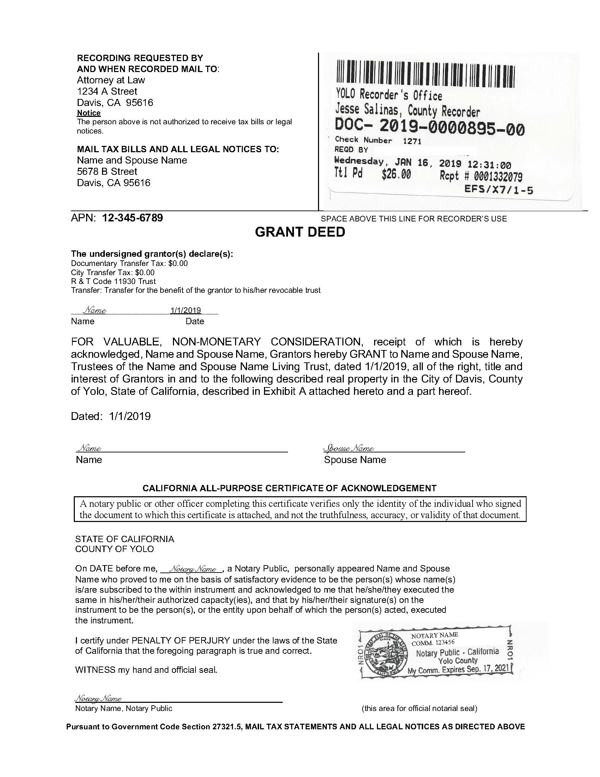
Funding
Titling Assets in the Name of Your Living Trust

Slide 29
Unfunded Trust Case Scenario
You are meeting with the Reporting Party, Tom, who is the son of Elisa. Elisa is living with Alzheimer’s and has been medically found incapacitated. Tom is named as the Successor Trustee in Elisa’s trust and reported to APS that he believes his sister is taking advantage of their mother’s situation.
He gives you a copy of the Trust and a copy of the deed to Elisa’s house that is in Elisa’s name only.
When you look over it, you notice that the deed to the house has not been put in the name of the trust.
Who would have authority over Elisa’s house or to change the name of the house (“fund”) the house into Elisa’s trust?

Slide 30
Options for Transferring Assets After Death
Savings and Checking Accounts
Investment Accounts
Business Holdings such as Partnerships and LLC’s
Real Estate including Time Shares
Retirement Accounts
Life Insurance
Pensions

Slide 31
Helpful Hints
Always check for recent beneficiary changes when suspected financial abuse.
A private fiduciary, for a Conservatorship or a Trust can be a valuable option for a client who may not have family or friends who could be in charge.
Most major banks also have Trust administration departments as well.

Slide 32
Potential for Abuse
Negligence?
How to Remove an Agent/Trustee
Activity- Reviewing a Trust

Slide 33
Trust Review Activity
Using the Revocable Living Trust Sample
Locate the section for removal of a Trustee
Find definition of capacity
Find where the trustees are listed (incapacity and death)

Slide 34
Other Types of Trusts:
Irrevocable Trusts or “Control from the Grave Trusts”
Irrevocable Trust for Problematic children
Trust for second (or third..) spouse, where you want to control where the assets go after their death
Special Needs Trusts for dependent adult children

Slide 35
Concerns and Remedies for Clients
Richard has an irrevocable trust that was set up by his deceased wealthy wife Georgette. Georgette insisted on making the terms of the trust become irrevocable upon her death because she wanted to protect the principal of the assets for her four children by a prior marriage.
Doug is the Trustee of the trust for Richard and is directed by the terms of the trust to distribute all of the income produced by the trust to Richard Quarterly.
Doug has invested the Trust money in a joint venture which Doug owns half of, and the investment has not produced income in three years. Richard is living at a poverty level, is in need of a medical procedure to save his life and has not seen an accounting of the trust assets in 4 years.
Discuss issues and possible remedies for Richard.

Slide 36
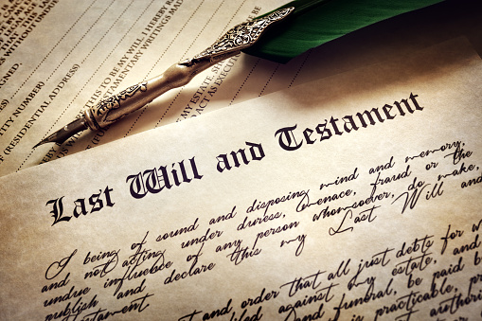
Wills
Standard Will
Holographic wills
Pour-over Will

Slide 37
Helpful Hint:
Often when someone does their own trust, they do not know how to properly “fund” their trust, and may not have executed a pour-over will.
An unfunded trust or lack of other estate planning documents accompanying the Trust can be indicators that something is amiss.

Slide 38
Trust Promoters
There are many who call themselves “trust specialists,” “certified planners” or other titles that suggest the person has received advanced training in estate planning.
California is experiencing an explosion of promotions by unqualified individuals and entities which only have one real goal—to gain access to our elders’ finances in order to sell insurance-based products such as annuities and other commission-based products.
They often offer a package deal of estate planning as well as the financial product they are trying to sell.

Slide 39
Estate Planning Documents: Wrap-Up
What are the main Estate Planning Documents?
Probate Codes:
§ 16002: Duty of loyalty
§ 16004: Conflicts of interest

Slide 40
Final Red Flag Case Study
Jema created a living trust with Estate-Planning’s R-Us, a company who gave a seminar at Jema’s retirement community and advertised themselves as a “full service” estate planning firm. Leo was the attorney who drafted the trust for Jema at her bedside because she was now bedridden. Leo advised her that she should list Leo’s partner Sami as her Financial POA and Successor trustee because Sami is a private fiduciary and Jema has no family members that she could trust to be her successor trustee.
The compensation for being a financial POA and successor trustee was listed as 5% annually of the assets. The Financial POA was effective immediately because Leo was worried about Jema’s recent diagnosis of Dementia.
Leo had Jema sign over the deed to her house to the Trust and helped her sign the new beneficiary designations of her retirement accounts to the Trust.
After 6 months, Sami decided that the retirement facility was costing too much and moved Jema to an apartment and hired his nephew to care for Jema 24/7. You have been called in on a report of neglect for Jema and find her alone with no food in the house, unwashed and delirious.

Slide 41
Investigations and Documenting for Prosecution
The better you are at interviewing – and documenting, the better chance your case has for conviction at trial.

Slide 42
Helpful Tip
DOCUMENT, DOCUMENT everything, and always remember the end-game.

Slide 43
CalCrim Jury Instruction No.1807-Theft from an Elder or Dependent Adult
That defendant committed (theft, embezzlement, forgery, fraud, or identity theft
The (property taken/or personal identifying information used) was owned by/that of an elder/a dependent adult)
The property, goods, or services obtained was worth more than $950, AND
The defendant knew or reasonably should have known that the (owner of the property/person to whom the identifying information belonged) was and elder/a dependent adult

Slide 44
Case Scenario: Theft from an Elder/Dependent Adult
APS received case from RP Bianca, neighbor of Francisco, 82 years old, who was diagnosed with stage 4 colon cancer and needs assistance with his ADLs. Bianca reported that Michelle, a member at Francisco's church, recently moved in to help him.
When Bianca was helping clean out and organize Francisco’s office, she noticed multiple past due bill statements and bank statements with overdrawn charges dating back many months. Bianca suspects Michelle is withdrawing funds from Francisco’s accounts.
Bianca has asked Francisco many times if he has a Medical and/or Financial Power of Attorney and he has responded that he does not. She was unable to find any estate planning documents in the office.
When Bianca asked Michelle about the withdrawals, Michelle stated that she considered it payback fro her quitting her job to care for Francisco.

Slide 45
Jury Instructions

Slide 46
Locating Documents
Trusts, Wills and FPOA’s:
not “filed” so no great way to find them other than in client’s possession
HCPOA’s:
Often filed at the doctor’s office or hospital

Slide 47
Locating Documents (continued)
Grant deeds to houses:
Public at recorder’s office
can see change in title and get name of trust and possibly the attorney from the recording information at the top

Slide 48
Locating Documents (continued)
Bank/Brokerage Accounts – may be titled in Trust name, checks may have trust name on address line.

Slide 49
Locating Documents - Confidentiality
Client’s Attorney – Confidentiality is always an issue. If Client can authorize you to speak to attorney, can get access to documents.

Slide 50
Executing Financial Documents – Legal Capacity
Legal capacity and Clinical capacity:
Legal=ability to make judgments about one’s legal rights and responsibilities.
Clinical=a judgment about one’s functional abilities to care for themselves mentally or physically (for example food, clothing and shelter). This is a very low threshold.
Legal Capacity is part of one’s Decision Making Capacity which can include:
Sign a contract (purchase an annuity)
Sign a will (testamentary capacity)
Give away property/assets
Medical decision making (take a medication, treat a condition, leave a facility)
Identify alternative decision makers (DPOA, successor trustee, executor)

Slide 51
4 Step Questioning Technique to Assess Capacity
1. Can the client understand relevant information?
Do you know that you have a serious cut on your leg?
Ask for options in open-ended question.
“Tell me what you know about the purpose of a trust.”
2. What is the quality of the client’s thinking process?
How can you get treatment for your wound?
“How would you go about making changes to your will if need be?”
3. Is the client able to demonstrate and communicate a choice?
Do you want to get treatment for your wound?
Ask for options for an open-ended question.
“What reasons or circumstances would make you want to make changes to your Estate Plan?”
4. Does the client appreciate the nature of his/her own situation?
What will happen if you don’t get your wound treated?
“What will happen if you keep your Estate Plan as is?”

Slide 52
Lessons Learned & Wrap Up
Take a moment and look through today’s materials.
In Participant Manual, write down two lessons learned from today or something(s) you will share with others after this training.

Slide 53
Evaluations and Questions
Final Questions?
Please fill out evaluations!
THANK YOU for attending today, and your commitment to serve older and vulnerable adults.

