Slide 1
Risk Assessment of Victims of Older Adults
Creating experiences that transform the heart, mind and practice.

Slide 2
Housekeeping and Introductions
Schedule for the day
CEU instructions
Location of restrooms
Set cell phones to vibrate
Introductions

Slide 3
Learning Objectives
Define risk assessment and its function.
Assess risk factors in five domains.
Assess overall levels of risk in terms of severity, urgency and likelihood of harm occurring.
Describe the benefits and limitations of risk assessment tools.
Develop risk reduction service plans.

Slide 4
What is Risk Assessment?
An analysis that uses information from investigations, research, and practice experience, to:
Help workers enhance clients’ safety, health, independence, and rights.
Help managers optimize resources and ensuring quality, effectiveness, efficiency, and fairness.

Slide 5
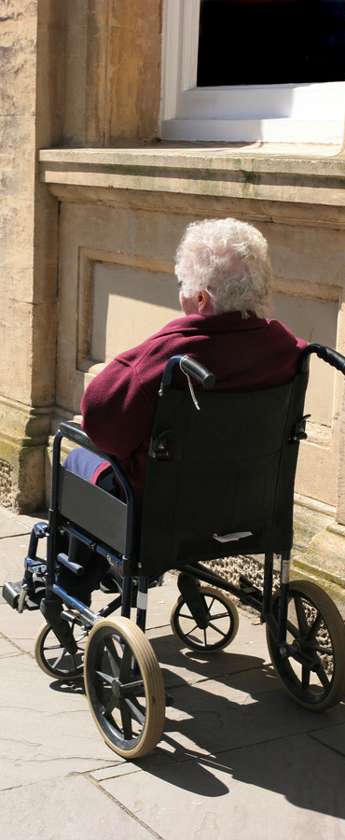
Why Risk Assessment?
Need to make an initial determinations on safety and risk.
Initial information may be incomplete or inaccurate.
Increased workloads and case complexity.
Need to know when interventions are likely to succeed.

Slide 6
How Risk Assessment Helps APS Workers
Plan interviews/investigations
Develop plans to ensure clients’ immediate safety and reduce future risk
Prioritize cases, allocate time and resources
Detect changes over time
Determine if interventions are successful in reducing risk
Decide when to close cases

Slide 7
How Risk Assessment Helps APS Managers
Target services to those in greatest need
Reduce the rate of re-referrals
Increase consistency and accuracy in assessment and case management
More effectively target outreach
Assign cases equitably
Evaluate workers’ performance
Understand risk factors, patterns, trends, and clients

Slide 8
When are Risk Assessments Conducted?
During initial phone contact
After first face to face interview
At substantiation
During the early stages of case planning
Periodically to identify changes and new needs
At case closure

Slide 9
Levels of Risk & the 3 S’s
Levels of Risk Low, Medium, High
3 S’s of Risk:
Levels of Risk
Soon
Severe
Sure (likely)

Slide 10
Phases of Risk Assessment
Initial assessments and emergencies
Case planning
Reassessments and case closure

Slide 11
Phase 1: Initial Assessment and Emergencies
Helps workers decide:
Whether/how quickly to investigate
Immediate danger? (soon)
Consequences if delayed? (severe)
Why is the reporter calling now?
Is client able to understand/make decisions?
What is at risk?
What, if any, immediate measures are needed?
What is the likelihood that they will be harmed without intervention? (sure)

Slide 12
Activity: Mrs. Anderson
Levels of Risk Low, Medium, High
3 S’s of Risk:
Levels of Risk
Soon
Severe
Sure (likely)

Slide 13
Phase 2: Case Planning Matching Services to Types and Levels of Risk
Are protective services needed?
How likely is harm or abuse?
What factors indicate future harm?
EVALUATE:
On-going risks
Risk mitigation factors
Informal support systems

Slide 14
Phase 3: Reassessments and Case Closure
Factors to consider:
Has risk has changed over time?
What accounts for the changes?
Are changes to the care plan needed?
What is the likelihood that the situation will recur?

Slide 15
When to close a case…
Client risk of abuse/neglect is reduced or eliminated.
A client with capacity requests it.
Client dies or leaves jurisdiction.
Other jurisdiction specific situations.

Slide 16
Risk: Indicators vs. Factors
Risk Indicators – observable signs that you can see or hear that indicate risk may be present.
Risk Factors – conditions which put a person at risk of harm. Increases likelihood of that abuse or neglect has or will occur.

Slide 17
Types of Risk Indicators:
Physical
Behavioral
Environmental

Slide 18
Risk Factors: Five “Domains”
Health and Functional status
Mental Health status and capacity
Financial
Social
Living environment

Slide 19
Principles of Risk: #1
The strongest predictor of future victimization is low social support.
(Acierno, R., Hernandez, M. A., Amstadter, A. B., Resnick, H. S., Steve, K., Muzzy, W., et al. (2010).)

Slide 20
Principles of Risk: #2
The experience of previous traumatic events — including interpersonal and domestic violence — increases the risk for mistreatment.
(Acierno, R., Hernandez, M. A., Amstadter, A. B., Resnick, H. S., Steve, K., Muzzy, W., et al. (2010). )

Slide 21
Lethality
Women who were threatened with a gun are 20 times more likely to be murdered.
Women whose partners threatened them with murder are 15 times more likely to be killed.
Strangulation is a high-risk indicator of eventual homicide.

Slide 22
Key Questions to Determine Lethality
Has your partner ever used a weapon against you or threatened you with a weapon?
Has he or she ever threatened to kill you or your children?
Do you think he/she might try to kill you?

Slide 23
Example
Client states she is afraid to tell her caregiver when she has had a toileting accident.
Risk Indicator?
Risk Factors?
Possible Harm?

Slide 24
Factors that Mitigate Risk
Client's strengths, resiliency, and motivation
Interpersonal relationships
Support networks

Slide 25
Caveats
Cultural variations
How clients view their
situations

Slide 26
Assessing Risk in Five “Domains”
Health and Functional status
Mental Health status and capacity
Living environment
Financial
Social

Slide 27
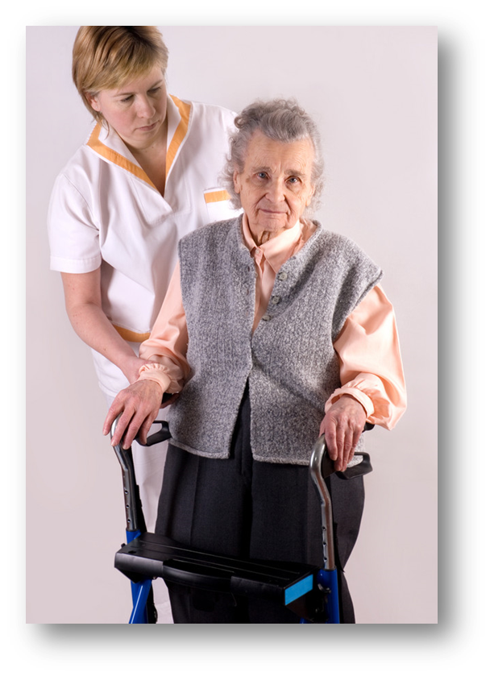
Assessing Health and Functional Status
Health assessments:
What is the client’s health and medical status?
Are they ill or injured?
Functional assessments:
Is the client able to perform daily tasks and meet their own needs?

Slide 28
Cognitive Assessments
Helps determine clients’
vulnerability and level of risk
Helps workers determines
what actions are needed and
whether clients are able to
help with planning
Document behavior rather than diagnosis (unless you are licensed to do so).

Slide 29
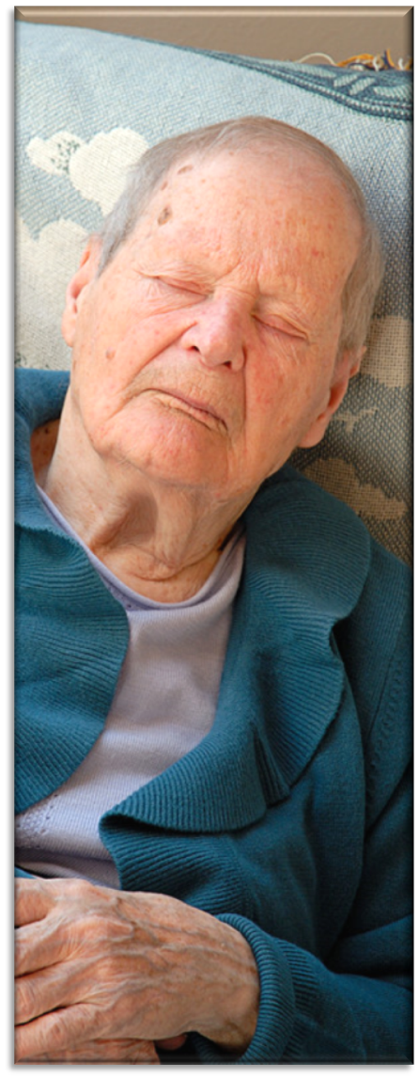
Activity: Assessing Risk in the Five Domains

Slide 30
Levels of Risk & the 3 S’s
Levels of Risk Low, Medium, High
3 S’s of Risk:
Levels of Risk
Soon
Severe
Sure (likely)

Slide 31
Assessing Emergencies in 5 “Domains”
Health and Functional status
Mental Health status and capacity
Living environment
Financial
Social

Slide 32
Activity: Assessing Emergencies In 5 Domains

Slide 33
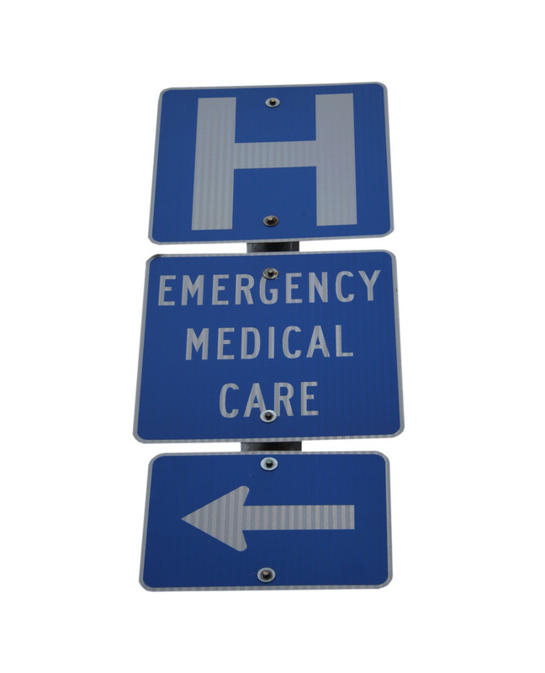
Medical Emergencies
Stroke
Drug related emergencies
Heart attack
Heat stress and heat stroke
Injuries (burns, hip fractures,
head injuries)

Slide 34
APS Workers Role
Recognize signs and symptoms
Arrange for emergency care
Provide information
Alert medical professionals to concerns about abuse and neglect

Slide 35
Mental Health Emergencies
Recognize signs and symptoms
Changes in mental status
Hallucinations and delusions
Abrupt changes in mental status
Risk factors for suicide
Role of APS in mental health
emergencies
Provide information to health care professionals
Alert mental health professionals to concerns about abuse and neglect

Slide 36
Caregiver Emergencies
If functional or cognitive deficits are present, emergencies can happen very quickly. For example:
A caregiver leaves a frail elder
unattended
A caregiver quits or is fired, arrested,
missing, etc.
Other examples?

Slide 37
Living Environment Emergencies
Unsafe - disrepair
Unhealthy - rodents, insect
infestations, human or animal waste
Homeless or at risk of becoming
homeless
Does not meet the needs of the client.

Slide 38
Financial Emergencies
Insufficient funds to meet critical
needs
The offender has access to finances
through a POA, contract, or checks.
Pursued or courted by disreputable,
unscrupulous, or opportunistic
persons

Slide 39
Social Emergencies
Result from action or inaction of others and may underlie risks associated with other domains.
For example:
Threats, particularly if firearms are
involved.
Living with someone who has been
violent in the past.
Left alone and unable to provide for
themselves.

Slide 40
Activity: Levels of Risk
What is at risk (assets, independence, safety)?
What is the level of risk? (low, medium, high?)
What additional information do you need to assess Mrs. Brown’s level of risk?
What actions would you take to reduce future risk?

Slide 41
Activity: Red Flags
Red = High Risk
Yellow = Medium Risk
Green = Low/No Risk

Slide 42
“We live in an age where form-filling, clipboard-wielding rule enforcement is assumed to be the enemy of effectiveness.
But that is the product of box-ticking gone bad.
The right kind of checklist liberates rather than stifles professional intuition.” Atul Gawande, author of “The Checklist Manifesto.”

Slide 43
Types of Assessment Tools
Functional assessment tools
Cognitive assessment tools
Self Care tools
Lethality assessment tools
Trauma assessments

Slide 44
Risk Assessment Tools: +/-
Goals (+):
Guide investigations (what to look for and what questions to ask)
Develop service plans
Evaluate changes over time
Provide objective measures on which to compare and prioritize cases.
Criticisms (-):
Experts disagree about their effectiveness
Time-consuming and cumbersome
Interfere with client-worker rapport

Slide 45
Specialized Tools
IDEAL protocol (Bennett Blum)
Self-neglect Severity Scale (SSS)(Consortium for Research in Elder Self-Neglect of Texas)
Structured Decision Making (SDM)®
SHIELD Assessment Tools (Texas DFPS)
APS-TRIO (Ventura County HSA)

Slide 46
Risk Reduction in Five Domains
Health and Functional status
Mental Health status and capacity
Living environment
Financial
Social

Slide 47
Health and Functional Capacity
Goals of service plans in this domain are to reduce
the risk of:
Illness
Accidents
Dependency
Neglect
Abuse

Slide 48
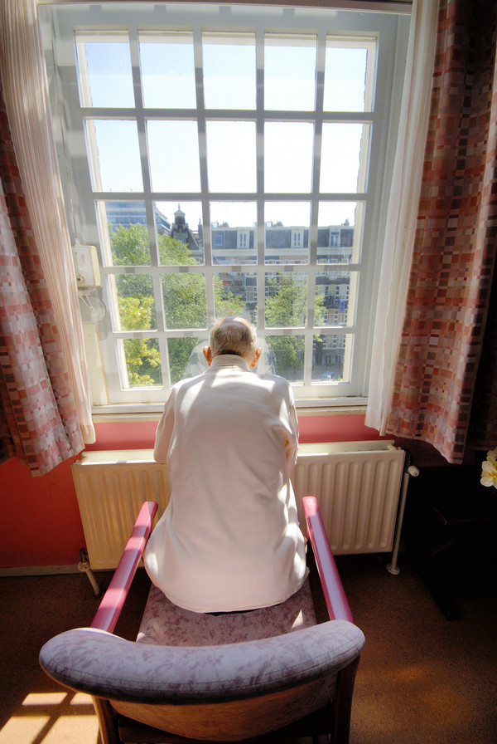
Mental Health Status and Capacity
Goals of service plans in this domain are to reduce the risk or mitigate the impact of mental health issues.

Slide 49
Living Environment
Goals of service plans in this domain are increase safety in the home.

Slide 50
Financial
Goals of service plans in this domain are to ensure that clients have adequate resources, reduce the risk of financial loss or abuse, and secure finances that in jeopardy.

Slide 51
Social (including risk posed by others)
Goals of service plans in this domain are to reduce the risk of abuse and neglect by others.

Slide 52
Safety Planning- The Basics
Identify safe contacts
Decide where to go in emergencies
Practice how to leave safely
Develop lists with phone numbers for emergency services
Pack a bag
Devise code words
Obtain consent to contact others

Slide 53
Assessing Capacity to Consent to Help
Does the client:
Understand information that’s needed to make an informed decision?
Give a plausible explanation for decisions ?
Weigh the risks and benefits of options?
Appreciate his/her own situation and its consequences?
Communicate a choice?

Slide 54
Balancing Capacity with Risk
When risk is high and capacity is low, the APS worker should intervene, even if this means involuntary interventions.
Low Capacity
High Risk
Involuntary Intervention

Slide 55
Balancing Capacity with Risk
When clients’ capacity is high, their decisions must be respected even if the risk is high
High
Capacity
Any Level of Risk
No Intervention without consent

Slide 56
Balancing Capacity with Risk
When clients’ capacity is in question or moderate, the level of risk needs to be taken into account.
Capacity
Any Level of Risk
Risk Determines Intervention
?

Slide 57
Case Planning Activity
What type of abuse do you suspect?
What is at risk?
What is the level of risk (low, medium, high)
Use the 3 S’s (Soon, Severe, Sure)
What services or supports can be employed to reduce or eliminate the risk(s)?

Slide 58
Innovations & Changes in APS
Stay informed!
Join community forums, including multidisciplinary teams, elder abuse prevention coalitions, and task forces.
Subscribe to journals, newsletters, listservs
Suggest to supervisors that resources and new services be brought up at staff meetings, posted on bulletin boards, etc.
Attend trainings and webinars
National Adult Protective Services Association (NAPSA)
napsa-now.org
National Center on Elder Abuse (NCEA)
ncea.aoa.gov

Slide 59
Let’s review what we’ve learned:

Slide 60
Evaluations & Thank You
Thank you for attending this course and for the important work you do every day protecting older and vulnerable adults in your community!
Please complete the course evaluation

