Slide 1
Working with the Criminal Justice System
Creating experiences that transform the heart, mind and practice.

Slide 2
This training (original version) was produced by the San Diego State University School of Social Work, Academy of Professional Excellence under grant #2009-SZ-B9-K008, awarded by the Office for Victims of Crime, Office of Justice Programs, U.S. Department of Justice. The opinions, findings, and conclusions or recommendations expressed in this training are those of the contributors and do not necessarily represent the official position or polices of the U.S. Department of Justice.
Curriculum revisions (version 2.0) was developed by the San Diego State University School of Social Work, Academy for Professional Excellence with funding from the California Department of Social Services, Adult Programs Division.

Slide 3
Introductions
Instructor
Participants
Name
Agency/assignment
Years of experience

Slide 4
Welcome and Housekeeping
Location of restrooms
Set cell phones to vibrate
Please return promptly from breaks and help us keep to the schedule
Materials
PowerPoint Slides
Participant Materials

Slide 5
Have You?
Worked with law enforcement?
Worked with prosecutors?

Slide 6
Course Goal
Improve your ability to successfully work with the criminal justice system

Slide 7
Learning Objectives
Distinguish the role of Adult Protective Services from role of Law Enforcement and Prosecution
Identify factors that help make a case provable in the criminal justice system
Explain APS’s role when a case is accepted for prosecution
Identify the rights of victims and defendants

Slide 8
Learning Objectives Continued
Identify the elements of a crime when given the statute
Explain the importance of APS documentation to enhance credibility when testifying in a criminal case
Develop at least 2 questions for cross examination in response to a scenario.

Slide 9
The Criminal Justice System
Law Enforcement
Prosecution
Corrections
Victim Witness Assistance Program
Terminology Difference #1:
Client vs. Victim (reporting party or complaining party)

Slide 10
Activity II: Mrs. Gask
What is the role of APS?
What is the role of Law Enforcement?

Slide 11
Who’s Focused on What?

Slide 12
Case Discussion
Where do the roles of
APS and the criminal
justice system intersect?

Slide 13
Intersecting Roles
Well checks
Safety backup for APS
Advance information
Involuntary mental health commitments
Cross reporting
Provide APS information
to LE
Testify in court as a witness
Arrange capacity declaration
Provide services
Provide info about suspect

Slide 14
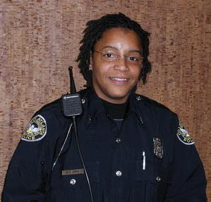
Information Sharing
Can APS share information with law enforcement?
Is everything in the APS file provided to law enforcement

Slide 15
Understanding the Criminal Justice System “Rules of the Road”
-Adversarial system designed to “elicit the truth”

Slide 16
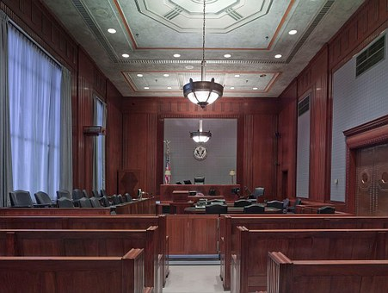
Two parties; different roles
Prosecution is the representative of the
state or government *responsible for
ethically prosecuting
crimes
Defense owes total
allegiance to the defendant
*responsible for
protecting that person’s
rights and attempting
to get the best possible outcome
Terminology Difference #2:
Case referenced by client’s name
vs.
case referenced by defendant’s name or case number

Slide 17
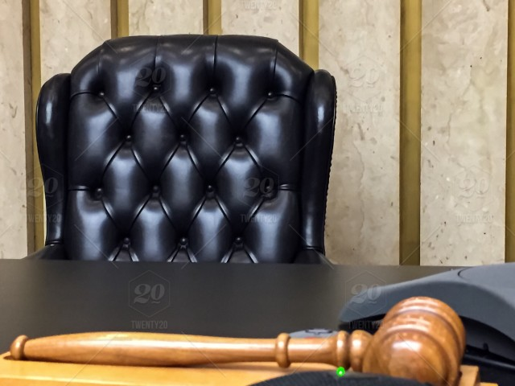
Burden of Proof/Standard of Evidence
Terminology Difference #3:
Standard of Proof vs. Burden of Proof
Preponderance of Evidence
More evidence in favor of a
position than against it.
50% plus anything
Civil cases
Often the substantiation standard for an APS investigation.
Same as probable cause and is evidence needed to make an arrest
Clear and Convincing Evidence
- Highly probable that the fact is true so that the fact finder has a firm conviction or belief that the cause is true
Terminology Difference #4:
Preponderance of Evidence vs. Probable Cause

Slide 18
Burden of Proof
“Beyond a reasonable doubt”
Highest legal burden of proof in law
Required for a criminal conviction
Proof that leaves the fact finder with an abiding conviction that the charge is true.
The evidence need not eliminate all possible doubt because everything is open to some possible or imaginary doubt

Slide 19
Burden of Proof
Beyond a
reasonable doubt
Clear and convincing
Preponderance of the evidence
(Probable Cause)
Reasonable suspicion

Slide 20
Activity III: What Level of Proof Do You Have?
Part 1- The Report:
APS receives a report that Mrs. Xander is being neglected by her daughter. The Reporting Party (RP) states that Mrs. Xander had been very friendly and social and was always very clean and groomed. A year ago, her daughter Marianne moved in to help her as she was becoming very confused and had serious arthritis so she could no longer write checks or maintain her home. The RP stated that Mrs. Xander came to her door and was dirty and crying. She said she was hungry, cold, and alone.

Slide 21
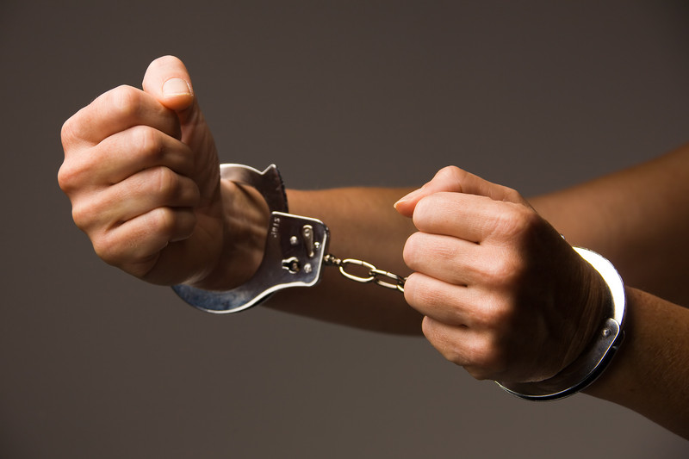
What Can You Do With This Level of Information?

Slide 22
Mrs. Xander, Part 2

Slide 23
Discussion
What level of proof do you have?
For what allegation?
As an APS professional, what can you do with this level of proof?
Do you have reasonable suspicion that any other form of abuse may be occurring?

Slide 24
Class Discussion
What more is needed to prove this case
beyond a reasonable doubt?

Slide 25
Beyond Reasonable Doubt
Statements by Marianne
Confirm Marianne to provide
care /pay bills
Bank records
Proof of unpaid bills
Ongoing drug investigation
Medical providers re: Mrs. Xander’s condition
Doctors’ statements to Marianne
Statement by Mrs. Xander

Slide 26
Collaborative Relationships
LE and APS should negotiate/agree who should do what and who should obtain these items. Consider the value of developing MOUs and interagency protocols and cross training.

Slide 27
EVIDENCE
Physical Evidence
Confessions
Witnesses

Slide 28
Investigative Mindset
What
How
Motive vs. Intent

Slide 29
Victim-Based vs. Evidence-Based
“Victim Based”
“Evidence Based”

Slide 30
Why do APS workers
need to understand the importance of evidence based cases and build your own cases accordingly?

Slide 31
Importance
The criminal justice system often cannot
proceed with a case built exclusively on the
victim’s information
Insufficient evidence
Series of events
Mortality of victim
Cognitive issues
Victim recantation

Slide 32
Corroborating Evidence
Your observations
A/P statements against interest or admissions
Spontaneous Statements
Business Records
Medical Records
Statements for Medical Care
Diagnosis and Treatment
Discharge Planning
Chance overheard remarks
Statements to non governmental agents
Friends and Family
Who have you talked to about this?
Who else knows?

Slide 33
Victim Testimony
Defendant has constitutional right to face and confront all witnesses called against them
Crawford v. Washington (2004)
If victim is competent to testify likely they will be called as a witness
Can taking of testimony be expedited?
Conditional examination, deposition

Slide 34
Conditional Examination
Early memorialization of victim testimony with full cross examination
Can be taken at victim’s location if victim cannot travel
Can be videotaped
Can be used if victim unavailable to testify at trial
Penal Code §§1335-1345

Slide 35
Activity V
Mrs. Xander and Marianne
How can this case be proven if the victim does not testify?
If the victim were able to testify, how could that testimony be corroborated?
Select a spokesperson to report back

Slide 36
APS Role in the CJS Process
Once a case is charged is your involvement over?
What is you role?
How can you advocate with the prosecution for your client?

Slide 37
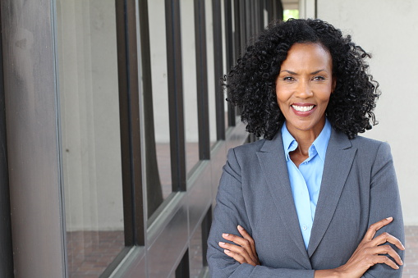
Role of APS
Work with and through victim witness program advocates
Arrange for transportation to follow up interviews, court appearances, forensic examinations if required
Arrange for emergency or transitional housing as needed
Develop longer term resources for victim
Serve as witness
Identify other witnesses developed through your own investigation

Slide 38
Lessons Learned
What are 2 things you have learned so far that you can apply to your job?
Note these in your Participant Workbook

Slide 39
Lunch Break

Slide 40
Rights
Victim’s Rights
Defendant’s Rights
Terminology Difference #5:
Alleged Perpetrator or Suspected Abuser vs.
Suspect (investigation) or Defendant (charged)

Slide 41
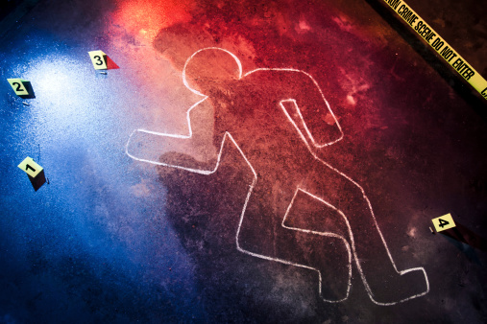
Categories of Crimes
Infraction
Misdemeanor
Felony

Slide 42
Rights of Defendants and Adults
The criminal justice system operates under rules that protect the rights of the parties
Criminal defendants have state and federal constitutional rights and other legal protections that limit what evidence can be presented against them
States also afford all adults in general and in a more limited way, crime victims, rights and protections

Slide 43
Rights of Crime Victims
To protection
To notice of court proceedings
To be heard
To confer with the state’s attorney
To restitution
To proceedings free from unreasonable delay.
To be treated with fairness and with respect for the victim’s dignity and privacy.

Slide 44
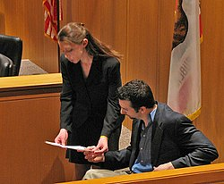
Rights of the Accused
What are the legal rights of those accused of a crime?

Slide 45
Rights of the Accused Include:
Counsel
Jury (or other) trial
Against compulsory self-incrimination (be required to testify against themselves)
Call witnesses
Confront accusers
Be free of unlawful search and seizure
Bail
Presumption of innocence

Slide 46
Why Do APS Professionals Need This Information?
Educate clients
Understand own role and reasons why must testify
Prepare clients who are possible witnesses or whose cases may be reviewed by the criminal justice system

Slide 47
What Makes a Crime a Crime?

Slide 48
Overview of Crimes
Crimes are composed of elements
Must prove each element
APS must recognize common crimes
APS must know their elements

Slide 49
Finding the Elements
Most criminal laws are in the
California Penal Code available at
https://leginfo.legislature.ca.gov/
To determine the elements of a crime, read the crime’s definition.
The elements of a crime are also in the jury instruction books (CALCRIM) available online at http://www.courts.ca.gov/partners/312.htm

Slide 50
Example
CA Penal Code Section 273.5
Any person who willfully inflicts corporal injury resulting in a traumatic condition upon the offender's spouse or former spouse; cohabitant or former cohabitant; fiancé or fiancée, or someone with whom the offender has, or previously had, an engagement or dating relationship; or the mother or father of the offender's child.

Slide 51
Elements
The suspect willfully inflicted corporal injury resulting in a traumatic condition
Traumatic condition is a condition of the body, such as a wound, or external or internal injury, including, but not limited to, injury as a result of strangulation or suffocation, whether of a minor or serious nature, caused by a physical force.
On a person in one of these relationships
Spouse or former spouse;
Cohabitant or former cohabitant;
Fiancé or fiancée;
Someone with whom the offender has, or previously had, an engagement or dating relationship; or
The mother or father of the offender's child.

Slide 52
Activity VI: Identifying State Statutes
Working with your assigned statute
Review the crime and on chart paper list
The name of the crime
The statute number
The elements
Post your list on the wall

Slide 53
Penal Code §368
HANDOUT #5
Elders– person 65 years or older
Dependent adults—
18 to 64
has physical or mental limitations which restrict his or her ability to carry out normal activities or to protect his or her rights,
including, but not limited to, persons who have physical or developmental disabilities or whose physical or mental abilities have diminished because of age.
Persons admitted as an inpatient to a 24-hour health facility

Slide 54
Crimes in Penal Code §368
“Caretaker”++
“Any Person”**
Neglect
Caretaker financial abuse
++Must prove suspect was a caretaker—had the care, custody, or control of, or who stands in a position of trust with, an elder or a dependent adult.
Infliction of physical pain
Infliction of mental suffering
Financial abuse
False imprisonment
**Must prove perpetrator knew or reasonably should have known the victim was an elder or a dependent adult

Slide 55
Activity VII: Fact Patterns
Working with your assigned scenario
Identify the applicable crimes in Penal Code 368
Pick 1 crime in Penal Code 368
List the elements
List the evidence and witnesses available to prove each element
Determine if there are questions that need to be asked to clarify any of the elements
Document your findings on chart paper

Slide 56
Case Building Framework
The Crime is:
The Legal Elements are:
For each element, what facts will prove that element…
Then for each fact…
Who Will Say It?
Alternative Interpretations?
Likely Defense(s)?
What Evidence Supports It?
Is Information Corroborated?
How to Overcome Defense(s)?

Slide 57
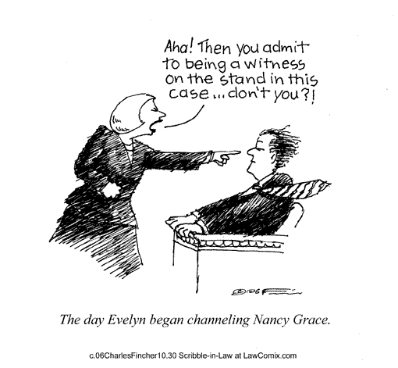
Your Documentation and the Courtroom

Slide 58
“If it wasn’t written down, it didn’t happen.”
…. and you won’t be credible.

Slide 59
Direct and Cross Examination: Your Documentation in Court
Direct Examination
Questions asked of you by the attorney who has called you to testify
Usually non leading questions that ask you to describe what you saw, heard or did
Cross Examination
Questions that follow direct examination intended to advance the other side’s case theory or to challenge the information (or you as a witness) provided on direct examination
Leading questions are usually asked

Slide 60
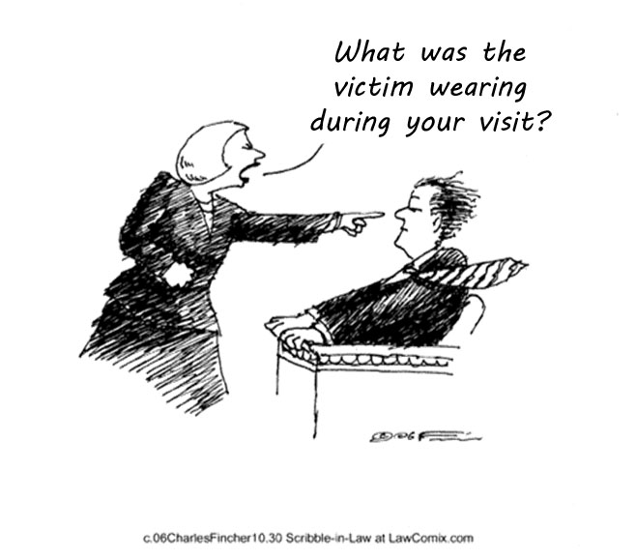
Activity VIII: Mock Courtroom- Cross Examination
Madison Gray

Slide 61
Mock Courtroom Debrief: Lessons Learned
Importance of complete documentation to enhance memory and credibility as a witness
You must talk from your documentation

Slide 62
Wrap Up: Review Terms and Their Meanings

Slide 63
Transfer of Learning Tool (TOL)
Build this into your Supervision time, applying skills you’ve gained from today!

Slide 64
“What two things will you do to enhance your effectiveness when working with the Criminal Justice System?”

Slide 65
Please Complete Evaluations
THANK YOU FOR THE WORK THAT YOU DO!

