Slide 1


ETHICS, VALUES AND CULTURAL RESPONSIVENESS IN ADULT PROTECTIVE SERVICES
We create experiences that transform the heart, mind, and practice.

Slide 2









The Academy is a project of San Diego State School of Social Work.
Serving over 20,000 health and human services professionals annually, the Academy’s mission is to provide exceptional workforce development and learning experiences for the transformation of individuals, organizations and communities.
We create experiences that transform the heart, mind, and practice.

Slide 3
About APSWI & The Academy
Adult Protective Services Workforce Innovations (APSWI)
  Training program of the Academy for Professional Excellence, a project of the San Diego State University School of Social Work.
  APSWI provides innovative workforce development to APS professionals and their partners.
The Academy provides workforce development and learning experiences to health and human service professionals.
Academy Programs include:
We create experiences that transform the heart, mind, and practice.

Slide 4

Housekeeping & Introductions
Location of restrooms
Set cell phones to silent/vibrate
Please return promptly from breaks and help us keep to the schedule
Materials
  PowerPoint Slides
  Participant Materials
Introductions

Slide 5

APS Core Competencies
There are 23 modules in the Adult Protective Services (APS) Core Competencies identified by NAPSA.

Slide 6
Training Goals
The purpose of this workshop is to enhance self-awareness and ongoing self-reflection of the APS professional in their practice relating to ethical decision-making process in the field.
This workshop will also introduce concepts (implicit bias, intersectionality, power and privilege) that provide a culturally responsive framework for use by the APS professional.
Promote critical thinking, consultation and ongoing assessment of ethical-decision making.

Slide 7
Learning Objectives
Define 7 ethical principles in APS work.
List 4 major ethical influences on APS decision-making.
Describe cultural humility.
Describe how the concepts of implicit bias and intersectionality affect APS work with vulnerable adults.
Provide 1 example of using cultural responsiveness in working with vulnerable adults.
List the components of an ethical and culturally responsive decision-making framework.

Slide 8

Brainstorming
Brainstorming:
What are some challenging ethical issues you confront in your daily practice?

Slide 9

ETHICS: Defined
Moral principles that govern a person’s behavior
Branch of philosophy that explores “right action” and “wrong one”
Useful in assessing the rightness of decisions and the fairness of the decision-making process

Slide 10
Codes of Ethics
Why do we need them?
How do they guide us professionally?
Cannot guarantee ethical behavior.
Sets forth values, ethical principals and standards to which professionals aspire and by which their actions can be judged.

Slide 11

NASW Code of Ethics
Service
Social Justice
Individual Dignity
Human Relationships
Integrity
Competence

Slide 12
NAPSA (or APS) Code of Ethics
Guiding Values:
Every action taken by APS must balance the duty to protect with the right to self-determination
Older people and people with disabilities who are victims of abuse, exploitation or neglect should be treated with honesty, caring and respect

Slide 13
NAPSA: APS Ethical Principles
Adults have the right to be safe.
Adults retain all their civil and constitutional rights unless some of these rights have been restricted by court action.
Adults have the right to accept or refuse services.
Adults have the right to make decisions that do not conform with societal norms as long as these decisions do not harm others.
Adults are presumed to have decision-making capacity unless a court adjudicates otherwise.

Slide 14

Ethical Principles
Autonomy
Beneficence
Non-maleficence
Privacy
Fidelity
Accountability
Justice

Slide 15


Ethical Principle: Autonomy
Right of individuals to make choices as long as they have decision-making capacity and cause no harm to others. Decisions should be voluntary, intentional and not due to coercion, duress, or undue influence.
Decision of Autonomy & Autonomy of Execution
APS professionals: Respect the client’s self-determination.
Consider:
  Physical disability
  Mental illness or cognitive impairment
  Financial limitations
  Lack of resources
  Lack of information
  Religion
  Culture
  Influence of family members: loyalty, fear, shame

Slide 16

Ethical Principle: Beneficence
Right to receive care by others that maintains and/or enhances the client’s welfare.
APS professionals: Do good for others. Promote the welfare of others.
  Empowerment
  Advocacy
  Persuasion (look for opportunities to compromise)

Slide 17
Ethical Principle: Non-maleficence
Right to expect others to “do no harm” in the maintenance or enhancement of the client’s welfare.
APS professional: Do not act in a way that will inflict harm on others. Weigh out all the possible consequences of your actions.

Slide 18
Ethical Principle: Privacy
Right to maintain privacy regarding personal information, interpersonal relationships, physical environment, and lifestyle, as long as it does not infringe on the rights of others.
APS professional: Respect client’s right to control information about themselves.

Slide 19

Ethical Principle: Fidelity
Right to have others show loyalty or commitment to the client when they need help.
Right and responsibility of family members to care for and assist one another (e.g. filial piety).
APS professionals: Include and
respect ideas of family members
and significant others.

Slide 20
Ethical Principle: Accountability
Right to expect others to tell the truth and be responsible for their actions.
Right to expect others to expose the deception and irresponsibility of others.
APS professionals: Be accountable and responsible for your actions and expect others to do the same.

Slide 21

Ethical Principle: Justice
Right to be treated equitably whether they are a caregiver or care receiver.
APS professionals: Fairly distribute benefits (or costs or harms) among individuals.

Slide 22
Ethical Principles: Impact
Typical problems begin with specific situations:
  Limited, specific, individual focus, requiring…
  Limited, specific, individual answers.
At the same time, we use a set of standards in order to analyze situations.

Slide 23

Ethical Dilemma: Definition
An ethical dilemma presents a choice between two relevant sets of values, two good things.

Slide 24

Ethical Dilemmas- Scenarios
Individually read scenarios on handout.
Share ethical issues and dilemmas found with large group.

Slide 25

Influences on Ethical Decision-Making
(Part 1)
Part 1:
Small groups discuss one influence
  Report out will be shared with large group in Part 2

Slide 26
Influences On Ethical Decision-Making
(Part 2)
Client wishes
Professional obligations
Personal values
Community pressure

Slide 27
Changes in the United States
This afternoon, we are going to focus primarily on:
Changes in the U.S. that affect APS work and why they matter
Increasing Self-Awareness and Practicing Ongoing Self-Reflection
Understanding Implicit Bias and Recognizing Intersectionality
Cultural Humility. Culturally Learned Assumptions. Cultural Bias.
Cultural Responsiveness in Practice
Employing a Trauma-Informed Approach
Ethical and Culturally Responsive Decision-Making

Slide 28

Aging in the United States
Currently, about 10,000 people a day turn 65 in the U.S.
There are also distinctive needs and values for different aging generations, i.e. the Greatest Generation, Silent Generation, Baby Boomers and Generation X… “young old”, “old”, “oldest old”

Slide 29
Increased Population Variety
There are many changes in the types of populations that live within this country.
This requires consideration of variables such as age, disabilities, race, ethnicity, social class, educational background, immigration status, gender, etc.

Slide 30

Introducing Community Agreements

Slide 31

Understanding Intersectionality and
Privilege
“Through an awareness of intersectionality, we can better acknowledge and ground the differences among us…” (Kimberlé Crenshaw)
Intersectionality is the complex, cumulative way in which the effects of multiple forms of discrimination (such as racism, sexism, and classism) combine, overlap or intersect, especially in the experiences of marginalized individuals or groups.
Privilege is an uneven distribution of unearned power within a society.
People occupy multiple social positions with multiple levels of privilege or disadvantage (NOT absolute)

Slide 32
Considering Intersections
1. From your experience as an APS professional, which two or more of the following categories of identity have impacted your work with clients or collateral contacts and how?
Age
Ability
Race
Ethnicity
Religion
Social Class
Gender Identity
Sexual Orientation
2. Discuss which categories have been sources of strength and resilience for clients and how?

Slide 33
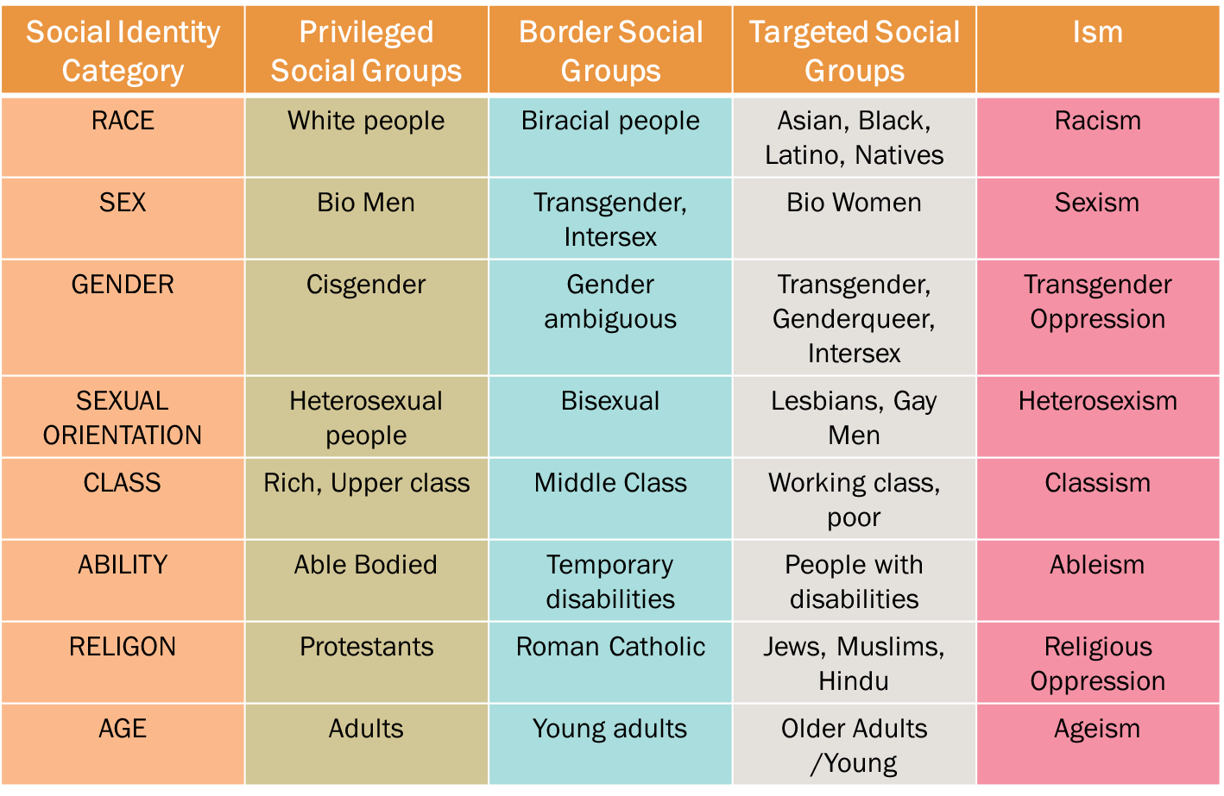
Matrix of Oppression
HANDOUT #06
For self-reflection only: answer Question 1 individually
In groups: choose Question 2 or 3 to discuss
(adapted from Power, Privilege, and Allyship in Therapy Spaces, 2019)

Slide 34
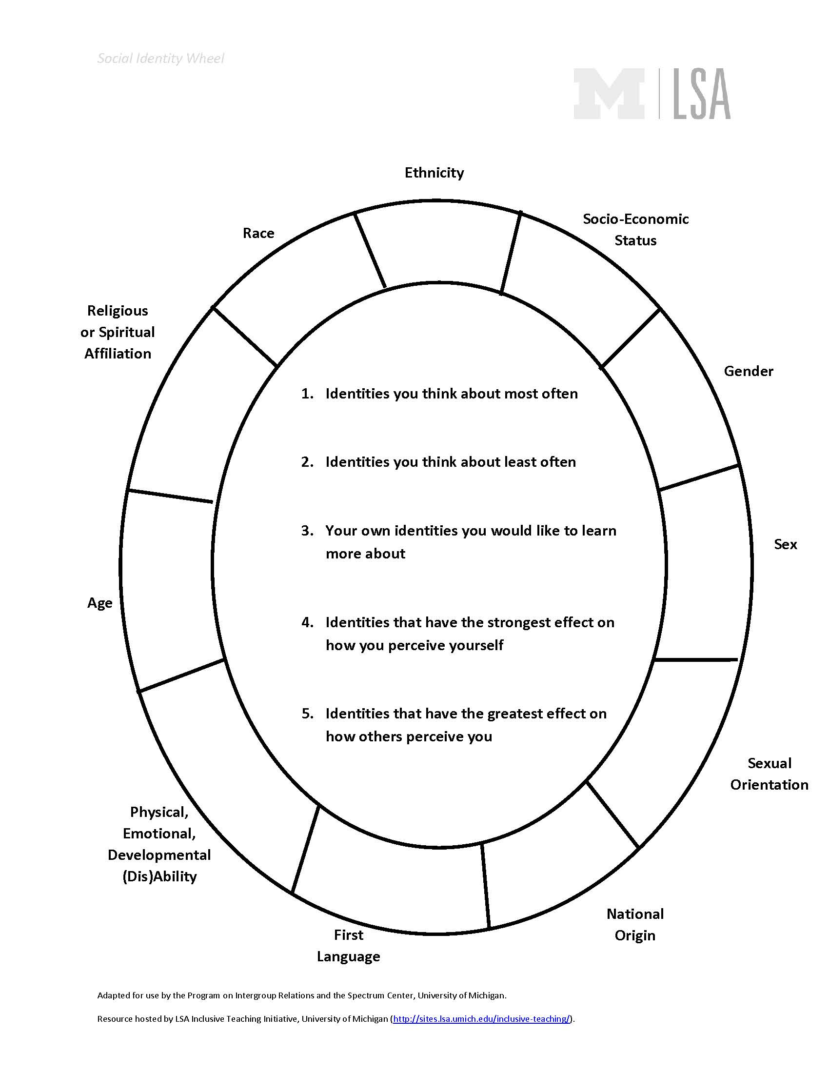
Social Identity Wheel Exercise
“If we think we are interacting as individuals but are consciously or unconsciously stereotyping someone based on their group memberships, then our work is less productive. When we are aware of both who we are as individuals and as members of groups, we can work most effectively together.”
-Catalina Ormsby, Associate Director for the Undergraduate Research Opportunity Program and Lecturer at the School of Social Work at LSA Undergraduate Education Campus

Slide 35

Intersectionality and Privilege
Case Example #1

Slide 36
Follow-Up Questions
What are the intersections of identity you noticed for Russell, Dalvin and the APS professional?
Who holds privilege in this situation and why?
In your professional role, considering intersectionality and privilege, what, if anything, would you have done differently and why?
Reflecting on the above case scenario, in addition to being able to consider the concepts of intersectionality and privilege, what are some of the client’s strengths and indicators of his resilience?

Slide 37
Implicit Bias
Implicit- unaware of thoughts and feelings or mistaken about their nature.
Bias- have a preference or aversion to a person or group of people.
Implicit bias describes when we have attitudes towards people or associate stereotypes with them without our conscious knowledge.
Why does it matter?
What can be done about it?

Slide 38


Illustrating Implicit Bias in APS Context
Case Example #2

Slide 39
Follow-Up Questions
How might implicit bias impact the above client-investigator interaction?
What are the client and investigator’s intersectional identities and privilege?
What is a better approach to working with this client considering now what you know about implicit biases, intersectionality and privilege?
What aspects of the case example above might be challenging for you if you were the APS professional?
What are some examples of the client’s strengths and resilience?

Slide 40

Language Matters
Goal = adopt a stance of curiosity, practice and apply ongoing self-reflection and awareness which is informed by the concepts of implicit bias and intersectionality.
  Not to achieve cultural competence (all knowing)
It is beneficial to understand cultural competency as a process rather than an end product.

Slide 41
Developing Cultural Humility Over
Competency
The “ability to maintain an interpersonal stance that is other-oriented (or open to the other) in relation to aspects of cultural identity that are most important to the [person]”
Incorporates an ongoing commitment to self-awareness, evaluation, and critique.
Recognizes and address power imbalances that might exist.
Focus on a strengths-based approach, understanding the value of the client’s experience and viewing the client as the expert of their own life, symptoms and strengths.

Slide 42
Appreciating Differences
The use of cultural humility, by being open and curious about others, is a learning process.
It creates an appreciation for the strength and richness of different viewpoints driven by diversity.
APS professionals can practice self-awareness by reflecting on their own experience while analyzing how their identity interacts with clients and impacts treatment.

Slide 43

Cultural Humility and Ethics
How do cultural humility and ethics work together in APS practice?

Slide 44


Cultural Humility in Practice
Case Example #3
How is the APS professional approaching this case from a stance of cultural humility rather than cultural competence?
What are some additional ways the APS professional could practice cultural humility?

Slide 45
What is a Culturally-Learned
Assumption?
Beliefs you have about groups of people who may be different from you.
Often formed by the messages we hear from people around us growing up.
Whether or not you believe these messages now, they do impact our attitudes about people from different groups.
How does this relate to implicit bias?

Slide 46

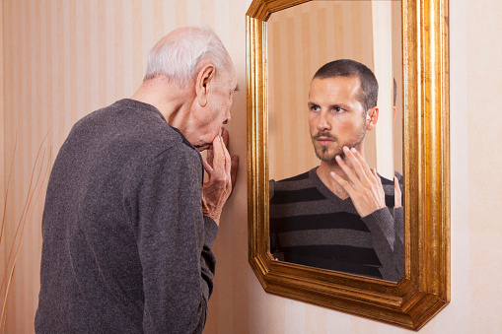
Cultural Bias
“We don’t see things as they are. We see things as we are.”- Anais Nin
Tendency to judge another person based on one’s own cultural standards.
Culturally learned assumptions may influence individuals to experience a cultural bias.
We may think that what we believe, and value is appropriate for everyone.
Although all people who provide services are well-meaning and wish to support their clients, they may provide services that are not culturally responsive.

Slide 47
Being Culturally Responsive
Services should be culturally grounded to meet each individual’s unique needs.
Be mindful not to impose your culture, cultural biases, or culturally-learned assumptions on others.
Practice from the perspective that the majority of the people receiving services will have experienced some kind of trauma in their life.
Use recovery language-person-centered, hope-filled, non-stigmatizing
  “How can I address you while we talk today?”
  Avoid labeling a person by their mental health diagnosis
  Emphasize abilities, not limitations

Slide 48

Cultural Responsiveness in Practice
Case Example #4
For Mahvash to provide culturally responsive services, what does she need to be mindful of and why?
From the client’s perspective, what could be some potential barriers to him being open to receiving services? What might the client view as positive in this interaction?

Slide 49
Tying it All Together
Culture
Ethical Principles
Ethical Practices
People
Trauma-Informed
APS Policies

Slide 50
Foundational Ethical Principles
Earlier we reviewed 7 ethical concepts:
Autonomy
Beneficence
Nonmaleficence
Privacy
Fidelity
Accountability
Justice
All 7 ethical principles should be considered in culturally responsive practice with clients.

Slide 51
Culturally Responsive Practice
Understand the underlying intent, or purpose, of the basic ethical principles.
Analyze how the underlying intent of an ethical principle can be applied to each unique client’s situation.
APS professionals must understand the underlying intent of the ethical principles of APS code and analyze how to apply that purpose in specific cultural situations.

Slide 52
Autonomy and Beneficence
Autonomy
  Underlying intent is respect for persons and communities.
  Key cultural questions: Who is the fundamental decision-making unit? How does accountability work in this culture? What does dignity and respect for older and disabled adults look like in this culture?
Beneficence
  Underlying intent is to create more good than harm.
  Key cultural questions: Whose welfare will be promoted in this cultural context?

Slide 53

FRAMEWORK - Ethical and Culturally
Responsive Decision-Making
Making ethical and culturally responsive decisions in APS Practice encompasses several steps.

Slide 54

FRAMEWORK: Assess the Needs and
Strengths of the Client
Examine it from all sides.
Collect information and facts
  Evaluate all sources of information.
  Identify different cultural interpretations of facts.
Separate facts from opinions, beliefs, theories held by all.
Consider intersectionality and cultural factors.

Slide 55

FRAMEWORK: Identify Stakeholders
Take into account the individuals, families, communities and agencies that are involved in the situation.
Identify stakeholder’s strengths and resilience.
Assess how the decision(s) may affect them all.

Slide 56

FRAMEWORK: Identify Relevant
Ethical Standard Involved
Determine the conflicts and dilemmas presented.
Be aware of your personal and professional values.
Consider the values of the stakeholders and how they may perceive the situation.

Slide 57
FRAMEWORK: Brainstorm Options
Determine benefits and burdens of each possible action for all involved.
Eliminate the impractical, inappropriate, illegal.
Obtain stakeholders’ input.
Monitor cultural biases and culturally-learned assumptions.
Practice self-awareness and self-reflection.
Ask for consultation.

Slide 58

FRAMEWORK: Select Most
Appropriate Action
Find an acceptable balance that meets the challenge.
Look at the long term as well as the immediate fix.
Reduce as much harm as possible to all involved.
Employ culturally responsive approach.

Slide 59

FRAMEWORK: Evaluate the Action
Examine values and cultural considerations.
Put yourself in the situation and see how it feels.
Run it by your supervisor.
Imagine the media getting hold of the story: Plan your response.

Slide 60

FRAMEWORK: Document the Plan
Make a systematic step-by-step outline.
Plan how you will collaborate with those who disagree with you.
Follow up and monitor your plan.
Be willing to accept new credible information and change your course of action.

Slide 61
Making Ethical and Culturally
Responsive Decisions
Use Case Example #1
Choose a recorder.
Use the framework to develop a plan of action.
Listen to and respect ideas of all group members (brainstorm).
Document your plan in writing.
Be prepared to defend it.

Slide 62
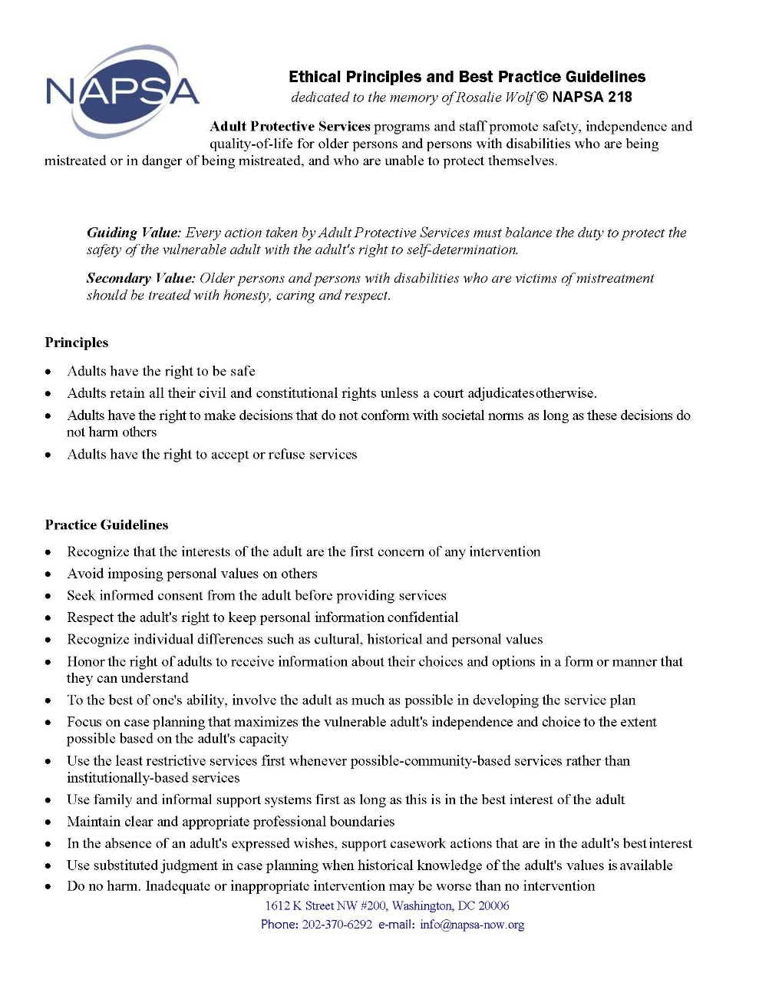
NAPSA

Slide 63
Lessons Learned
What is the most important thing you will take from this training that will help you be a more effective APS professional?

Slide 64
Final Comments
Oftentimes APS work can be an isolating, difficult job.
You are part of a larger APS family. There are many avenues of support for line staff, supervisors, and administrators.
Become involved with NAPSA
  As one of its primary goals, NAPSA believes in the highest quality training for APS professionals to provide the knowledge, skills, and self-confidence needed to do this challenging job.
Take care of yourself!
  Engage in regular self-care, both professional (through peer support, supervision, networking with other agencies, further educational activities) and personally (time for self, stress management, hobbies).
  This is critical for you to have a firm foundation and the professional strength to thrive and provide clients with the support they deserve!

Slide 65
Evaluations
Please remember to complete the course evaluation.

Slide 66





Thank You!
Follow us on Social Media:
@SDSUAcademy
@Acad4ProfExcell
@sdsu-academy-for-professional-excellence/
@TheAcademySDSU

Slide 67

We envision a world where the quality of life for individuals, organizations, and communities is transformed to a healthier place.

