Slide 1
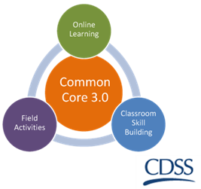
Fairness and Equity
California Common Core
Version 3.3 |

Slide 2
What is Fairness and Equity?

Slide 3
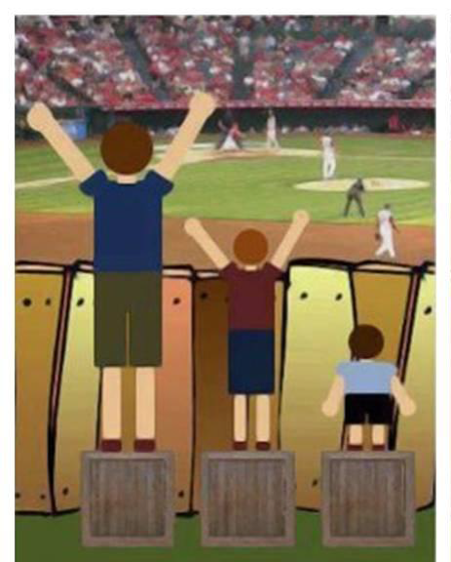
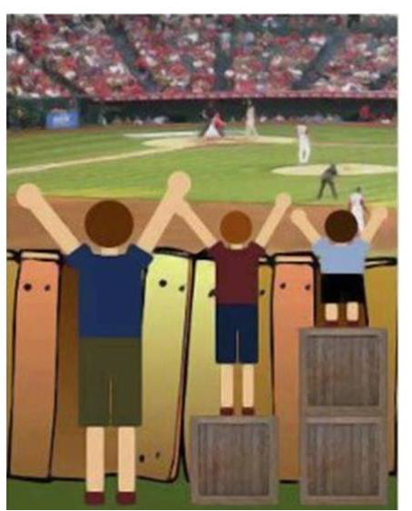
What is Fairness and Equity?
Introduction to Environmental, Justice, Equity and Health. Lesson Plan 3 How are Equality and Equity Different? Retrieved 6/6/2016 from justhealthaction.org/resources/jha-curriculum-material/

Slide 4
What is Fairness and Equity?
Equity and equality are not the same.
Equity doesn’t strive for sameness; it strives for fairness.
Fairness is achieved by treating everyone in a way that recognizes who they are and what their needs are.
Everyone’s needs are met according to their circumstances (i.e., barriers and opportunities).
Excerpt from "The School That Equity Built“, An Equitable Classroom Environment. Elementary Teacher’s Federation of Ontario, 2000, Ontario, Canada.

Slide 5
“Equity is the process and equality is an outcome.”
Education reform. Equity. (2016, April 21) Retrieved 6/6/2016 URL http://edglossary.org/equity/

Slide 6
Are Child Welfare Services fair and equitable?
Yes or No

Slide 7
Disparity And Disproportionality
DISPARITY is the disparate or inequitable treatment or services provided in non-dominant groups (i.e., non-White, LGBTQ, rural) compared to those provided to similarly situated (e.g., socio-economic status) children from dominant groups.
DISPROPORTIONALITY is the over- or under-representation of children in foster care and child welfare, based on membership in certain groups, as compared to their representation in the general population
Orange County Children and Family Services, Eliminating Racial Disparity and Disproportionality Retrieved 6/6/16 URL: https://cms.ocgov.com/gov/ssa/adopt/oc4kids/ff/strategy/workgroups/erdd/default.asp

Slide 8
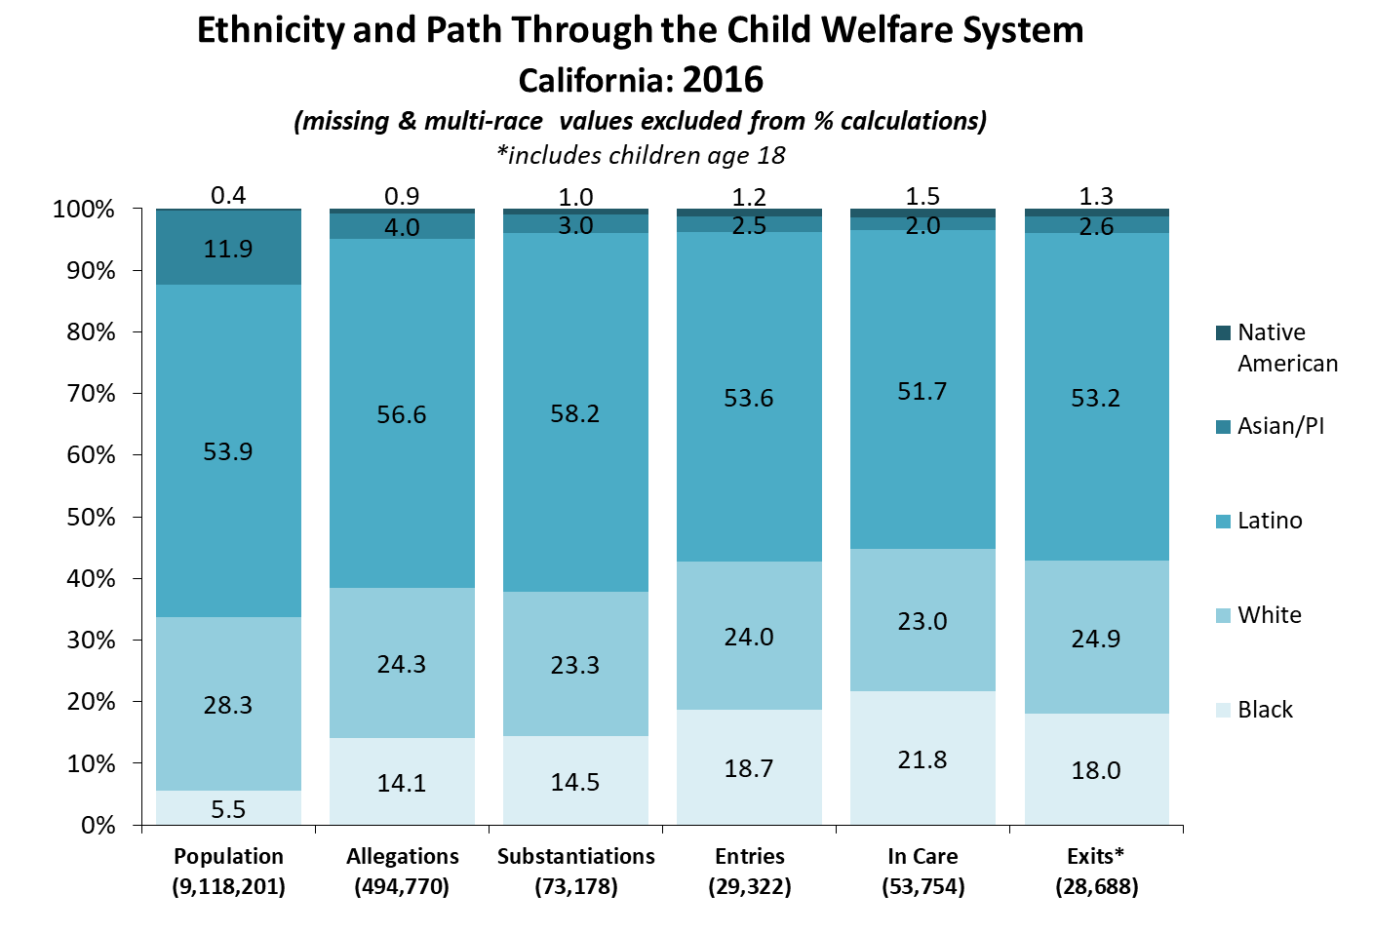
Notes:
Q1_2017
Allegation and Substantiation Rates Reports which includes Entries
http://cssr.berkeley.edu/ucb_childwelfare/RefRates.aspx
In Care Rates Report
http://cssr.berkeley.edu/ucb_childwelfare/InCareRates.aspx
Exit Report
http://cssr.berkeley.edu/ucb_childwelfare/Exits.aspx

Slide 9
Fair and Equitable Practice
Acknowledges that an accurate assessment is predicated on understanding the present day impact of historical oppression and resulting social stratification on an individual’s and/or family’s positionality (i.e., access to barriers and opportunities) in the community and society in which they belong.
Notes:
Once maltreatment has been substantiated, White families are more likely to receive in-home services (Derezotes & Poertner, 2005).
Only 14 out of 41 states received a favorable rating in efforts to recruit and retain resource parents who reflect the racial and ethnic diversity of the foster care population in that State.
Risk characteristics that disproportionately effect families such as poverty, incarceration (Hines, Lemon, Wyatt, & Merdinger, 2004).

Slide 10
Fair and Equitable Practice
Requires a cultural awareness of ourselves and others while continuously acknowledging and examining our own biases, prejudices and privileges, and the ways in which both our actions and our inactions consciously or unconsciously perpetuate inequality.
Excerpt from "The School That Equity Built“, An Equitable Classroom Environment. Elementary Teacher’s Federation of Ontario, 2000, Ontario, Canada.

Slide 11
Questions or Comments?
Thank you!

