Slide 1
APS Investigations Involving Allegations of Undue Influence
Instructor Led Training

Slide 2
About the Academy & APSWI
The Academy is a project of San Diego State School of Social Work. Serving over 20,000 health and human services professionals annually, the Academy’s mission is to provide exceptional workforce development and learning experiences for the transformation of individuals, organizations and communities.
APSWI, or Adult Protective Services Workforce Innovations, is a training program of the Academy that provides innovative workforce development to APS professionals and their partners.

Slide 3
Housekeeping
Length of training
Participation
Breaks
Technology
Introductions

Slide 4
Who You Are and Your Experience with Undue Influence Cases
Who here are:
  APS professionals (investigators)
  APS Supervisors
  APS Trainers
  Other Roles
How many cases have you handled in which undue influence was suspected?
  None
  Under 10
  Under 25
  Under 100
  More than 100

Slide 5
Thinking About Your Experience or Knowledge
Share a word that comes to mind when you think about undue influence.
If any, what makes undue influence investigations different or challenging from other types of investigations?

Slide 6
Why This Course
Undue influence cases are complex, typically occurring behind closed doors
Undue influence is difficult to define or fully understand
The concept is not named in CA crimes so law enforcement may not treat a matter as a criminal case, including conducting an investigation
Prosecutors may also be unfamiliar with undue influence and if and how it may support a criminal charge
Clients may have cognitive conditions that limit their understanding of what has occurred
Clients may not acknowledge what has occurred

Slide 7
Learning Objectives
Define undue influence through legal and psychological lenses, including cases in which the alleged perpetrator has a professional relationship with the person being harmed
Describe how consent and decision-making ability relate to undue influence
Describe investigative steps and how to document an undue influence investigation
Describe how undue influence can be part of a crime in California

Slide 8
A Word about Terminology
Different programs use varied terms. For clarity these terms will be used:
  The person who is harmed will be referred to by that term or as the “client” or “victim”
  The person who caused the harm will be referred to by that term or as the “influencer” or “alleged perpetrator”
  Statutory language will be used when referencing statutes
  Undue Influence will be abbreviated as UI at times

Slide 9
Undue Influence Overview
Is a process, not a single event
May occur in a variety of types of cases:
  financial abuse, neglect, domestic violence and sexual abuse
Typically arises when an alleged abuser justifies actions as consent, i.e., the client agreed or wanted this to be done
Requires that the APS professional conduct an investigation of the underlying form(s) of abuse as in any case and also explore whether the tactics of undue influence have been used to overcome the client’s free will and decision making.
May require collaboration across systems to address

Slide 10
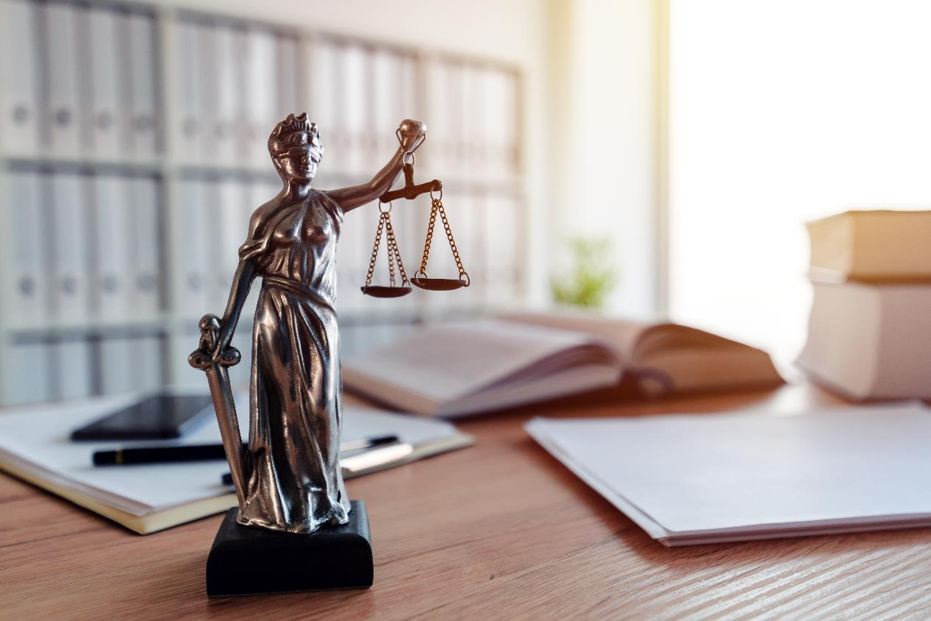

Defining Undue Influence
Psychological Construct
Legal Statutes
  Welfare & Institution Code §15610.70
  Probate Code §86

Slide 11
Undue Influence: Psychological Construct
“The substitution of one person’s will for the true desires of another.” (Singer, 1996)
  It occurs when “one person uses his or her role and power to exploit the trust, dependency, and fear of another in order to gain control of that person’s decision making.” (American Bar Association, American Psychological Association, 2021)
Fraud, duress, threats or other types of pressure often accompany it. (Quinn, 2001)

Slide 12
The Undue Influence “Process”
Find someone likely to be influenced
Gain confidence of potential victim
Induce dependence through exploitation of weakness
Gain dominance of victim’s life circumstances and wealth

Slide 13
Undue Influence Common Tactics
Financial Exploitation
© COPYRIGHT 2006 YWCA OMAHA, NEBRASKA

Slide 14
Case Example (Summary)
Client= Sam, 65, symptoms of his lifelong anxiety disorder have been debilitating in areas of finances and work
Meets Larry when seeking legal help, who becomes Sam’s support in various areas and requests payment (to be kept secret)
Sam contacts his niece who contacts APS and LE
During a joint investigation, Sam seemed confused and nervous, knew little about his finances and referred questions to Larry
Larry contacted LE as Sam’s “legal advisor”, and complained that Sam should not have been interviewed
Evaluations from a psychologist and psychiatrist concluded that Sam has borderline intellectual functioning that is apparent to others
Sam had a total loss of $600,000

Slide 15
Small Group Discussion
What tactics of undue influence did you observe in the case study?
Financial Exploitation
© COPYRIGHT 2006 YWCA OMAHA, NEBRASKA

Slide 16
Legal Definitions
“Undue influence” means excessive persuasion that causes another person to act or refrain from acting by overcoming that person’s free will and results in inequity. (Welfare & Institutions Code §15610.70)
Probate Code §86 defines undue influence for all probate actions as having “the same meaning as defined in Section 15610.70 of the Welfare and Institutions Code.”
  Probate Code §1801 authorizes creation of conservatorship when there is substantial inability to resist fraud or undue influence and all less restrictive options have been explored.
Same definition as for APS Standards for Consistency in Determining Findings Matrix

Slide 17

Those Harmed by Undue Influence
True or False?
All victims of undue influence have diminished decision-making ability

Slide 18
Decision-Making Ability and Undue Influence
Under the right circumstances anyone can be victimized by undue influence
  Those with full decision-making ability
  Those with diminished decision-making ability
  Those with some decision-making ability
Easier to victimize those with cognitive impairments
  Less likely to recognize what is occurring, be able to report, or be believed if attempt to report
  Lack of decision-making ability is just one area of vulnerability and not always present in UI situations.
Explore all vulnerabilities

Slide 19
Explore What Makes Your Client Susceptible/Vulnerable to Undue Influence
What life situations and vulnerabilities may make a client susceptible or vulnerable to undue influence?
Lonely
Frightened
Naïve, uninformed
Dependent
Ill or cognitively impaired
Fatigued, exhausted
Distracted
Adverse life conditions (e.g. grief, trauma)
Inexperience handling financial matters
Lacking developmental ability to read or write and/or limited education

Slide 20

Class Discussion
Think about the Case Study of Sam and Larry, what made Sam vulnerable/susceptible to undue influence by Larry?

Slide 21
Who are the Perpetrators?
In your experience who are the perpetrators of undue influence?
Perpetrators may be
  Family
  Friends and neighbors
  Caregivers
  Fiduciaries
  Professionals
  Others
Those able to gain (or have gained) your client’s trust/confidence
  Opportunists
  Predators/career criminals

Slide 22
Fiduciaries and Professional as Perpetrators
Types of fiduciaries and professionals:
Attorney-in-fact, conservator, trustee
Financial advisor, doctor, spiritual advisor
What is different when the person doing the harm is a professional or a fiduciary?
Relationship of trust
Inherent power imbalance
May be professional codes of conduct for that professional
May be ethical standards for that professional
May be a professional body that oversees the conduct of members
  They may have prior cases or may conduct tan investigation of your case
  May have restitution funds

Slide 23
Establishing that Undue Influence Has Occurred
Remember, undue influence is: “Excessive persuasion that causes another person to act or refrain from acting by overcoming that person’s free will and results in inequity.” (Welfare & Institutions Code §15610.70)
What kind of evidence or information do you think is needed to show that undue influence has occurred?

Slide 24
California Undue Influence Law
In determining whether a result was produced by undue influence, all of the following shall be considered:
  Victim’s vulnerability to undue influence
  Influencer’s apparent authority (e.g., confidential or fiduciary relationship)
  Actions or tactics used by the influencer to overcome victims free will
  Equity of the outcome
Vulnerability
Apparent authority
Tactics
Equity

Slide 25
Vulnerability/Susceptibility
Evidence of vulnerability may include, but is not limited to:
  Incapacity, illness, disability, injury, age, education, impaired cognitive function, emotional distress, isolation, or dependency, and
Whether the influencer knew or should have known of the alleged victim’s vulnerability.

Slide 26
Evidence of Apparent Authority
May include, but is not limited to:
Status as a fiduciary
Family member
Care provider
Legal professional
Spiritual adviser
Expert, or
Other qualification

Slide 27
Actions or Tactics of the Perpetrator
Evidence of actions or tactics used may include, but is not limited to, all of the following:
(A) Controlling necessaries of life, medication, the client’s interactions with others, access to information, or sleep
(B) Use of affection, intimidation, or coercion.
(C) Initiation of changes in personal or property rights, use of haste or secrecy in effecting those changes, effecting changes at inappropriate times and places, and claims of expertise in effecting changes.

Slide 28
Equity of the Result
Evidence of the equity of the result may include, but is not limited to:
  The economic consequences to the victim, any divergence from the victim's prior intent or course of conduct or dealing, the relationship or the value conveyed to the value of any services or consideration received, or the appropriateness of the change in light of the length and nature of the relationship.
Evidence of an inequitable result, without more, is not sufficient to establish undue influence.

Slide 29
Undue Influence Summary
Undue influence is the substitution of the will of the influencer for the free will of the APS client.
The investigation must establish that all 4 elements of undue influence are present:
  Victim vulnerability to influence;
  Influencer’s apparent authority;
  Actions or tactics of the influencer; and
  An inequitable result
Vulnerability
Apparent authority
Tactics
Equity

Slide 30

Consent and Undue Influence
How do influencers justify their actions when questioned?

Slide 31

Consent and Personal and Cultural Values, Beliefs, and Practices
Consent has both legal, personal and cultural elements
Important to invite clients to discuss their values as part of understanding their view of consent.
  “How do you make decisions?”

Slide 32
What Is Consent--Elements
A person giving consent must:
Have decision making ability to make the decision; and
Understand the true nature of the transaction; and
Freely and voluntarily agree
Decision-Making Ability
Freely and voluntarily
Understand the true nature

Slide 33
Consent and Undue Influence Activity: Part 1
Assume that you are interviewing Sam and he says he consented to having Larry cancel the annuity he obtained for his niece.
Develop at least 2 questions for each of the elements of consent.
Select a spokesperson to report back to the class.
Decision-Making Ability
Freely and voluntarily
Understand the true nature

Slide 34
Undue Influence and Consent
If there is evidence of consent, then explore if the consent was the result of undue influence.
Do not accept consent at face value. Dig further if you suspect undue influence.
Undue influence focuses on whether the person harmed understood the true nature of the transaction and whether they freely and voluntarily give consent.
When consent results from undue influence, consent is not valid.

Slide 35
Consent and Undue Influence Activity: Part 2
Vulnerability
Apparent authority
Tactics
Equity
Using the case study, work in your groups to develop questions that explore the four elements of undue influence.
Develop at least 2 questions for each of the elements of undue influence.
  Victim’s vulnerability to undue influence
  Influencer’s apparent authority
  Actions or tactics used by the influencer to overcome victims free will
  Equity of the result
Select a different spokesperson to report back to the class.

Slide 36
Is Undue Influence a Crime in California?
There is no crime called “Undue Influence”
  Evidence discovered in an UI investigation can be used to support evidence of other crimes
Theft Can Be Committed by:
  Taking without consent or without the owner’s knowledge, including where owner is unable to give valid consent and offender is aware of owner’s inability
  Embezzlement—taking by person authorized to have owner’s assets who uses them for an unauthorized purpose, e.g., attorney in fact or conservator who uses a client’s funds to benefit self when not authorized.
  False Pretenses: obtaining property/funds by deceitful representations and then using them for own benefit

Slide 37
What Does This Mean?
The tactics of undue influence can undermine a claim of consent for theft
Lies and deceits by an influencer may help prove theft by false pretenses
Misuse of legal authority obtained by undue influence may help prove embezzlement.
When discussing or referring cases to law enforcement, rather than talking about undue influence, discuss case in terms of theft.

Slide 38
Investigating Allegations of Undue Influence (1)
Process, not an event—affects investigation
  Examine entire relationship and how it changed
    Length, closeness, is this person a new friend?
    What caused change in relationship? Are there any efforts to isolate from family, friends or others or efforts to undermine existing relationships?
    How does victim view the suspected influencer?
      Professional consultant, friend, spiritual advisor, clergy, family, etc.
      Is client afraid of influencer?
      Is client able to make decisions that the influencer does not like?
  Client susceptibilities and vulnerabilities and influencer’s knowledge of them

Slide 39
Investigating Allegations of Undue Influence (2)
How did client historically make important decisions?
  Gifting patterns
  Spending patterns
  Income sources
  Use online banking, or face to face, or mail to do banking
  Consult others on major/significant purchases (what did that process look like)
  Financial concerns if any (make sure have enough to live on for rest of life; savings for possible LTC; leave legacy for family, causes)
  Financial arrangements—trust, POAs, financial advisor, advanced directives, personal attorney

Slide 40
Investigating Allegations of Undue Influence (3)
Compare with what is known about questionable transactions/decisions once influencer came into the picture
  Who suggested transaction? Who benefits? How does transaction help victim and overall financial planning and patterns
  Was transaction completed in haste? Secrecy?
  If attorney involved, was this the victim’s regular attorney? If not, who selected the attorney? Who was present attended any meetings with the attorney? Who set up appointment? Did victim have time alone with the attorney? Did suspect tell victim what to say or do in meeting
  Did victim see a medical professional prior to event? Who? Why? Usual doctor or someone new? Who selected? Who present?
Use information to build timeline illustrating when critical events happened

Slide 41
Sam and Larry Part 2- APS Report
Reporting Party: Karen, Sam’s niece
Allegation: Financial Exploitation
Alleged Perpetrator: Larry, legal advisor and friend of Sam
Sam was setting up an annuity for her but he canceled it right after setting it up.
Reports that Sam said that his legal advisor, Larry, told him he did not have sufficient money to fund it.
Has been unable to speak to her uncle as Larry, who says he is taking care of Sam, tells her that Sam is too sick to talk.

Slide 42
Activity: Investigative Steps
Work with your group and develop a list of investigative steps you would take, including types of evidence, to investigate each element of undue influence in the case of Sam and Larry.
Use the handout to collect and organize your ideas:
  Victim Vulnerability
  Influencer’s apparent authority
  Influencer's actions and tactics
  Equity of the result
Select a different spokesperson for report backs.
Vulnerability
Apparent authority
Tactics
Equity

Slide 43
The CA Undue Influence Screening Tool (CUIST)
Screening tool, not assessment tool, patterned on CA Welf & Instit §15610.70
Created for APS, with input from APS
Helps distinguish cases where UI may be present from others
  If anything missing, either this is not UI or further investigation is needed to determine if UI is present
Roadmap for analyzing and assessing a case for protective measures, or referrals, and/or possible legal action
  Offers a way to categorize and organize information and evidence to determine if elements can be proven and to identify gaps in information or evidence
  May provide guidance for when to refer for assessment

Slide 44
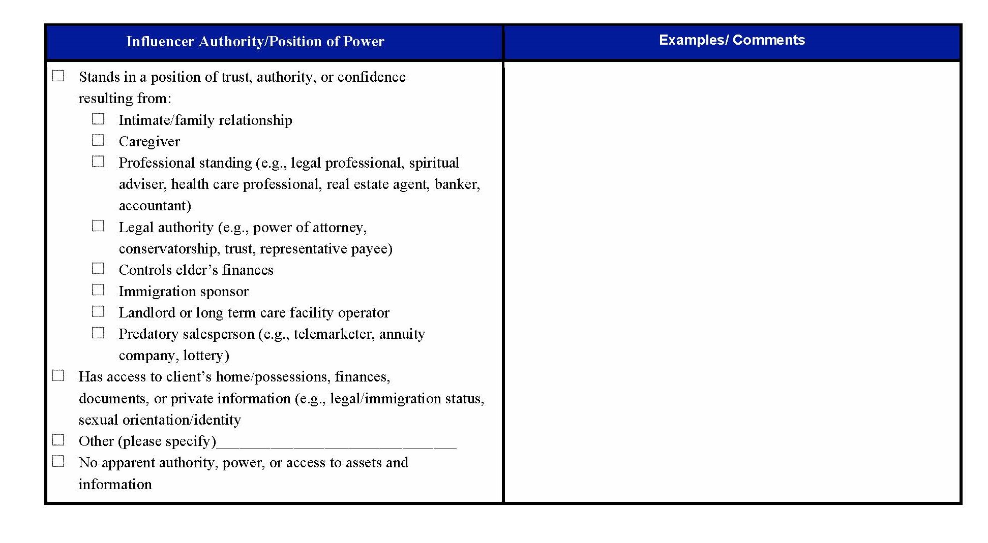
CUIST in Detail

Slide 45
Activity- Using CUIST with Sam and Larry’s Investigation
In groups:
Using the case study of Sam and Larry, fill out your assigned element(s) by putting in relevant information on the CUIST.
Remember, the left side provides some but not all possible examples. You may have something different from what is listed.
Be creative with what types of evidence you “gathered” in this case

Slide 46
Meeting Client Needs
Who will you need to collaborate with to best help minimize or mitigate the undue influence?
Make a list of client needs and what systems or professionals will be needed to meet those needs.

Slide 47
Various Remedies for Undue Influence
Civil Justice Remedies
Criminal Justice Interventions
Health Care
Community Services
Others
Importance of MDTs and collaborations

Slide 48
Course Wrap Up
Today we covered:
What Undue Influence is including all 4 legal elements
Decision-Making and Consent
Additional investigative steps needed in UI cases
CUIST and collaboration opportunities
Final Questions?
What will you take from the course that you will use when investigating allegations where undue influence might be present?

Slide 49
Thank You!
We envision a world where the quality of life for individuals, organizations, and communities is transformed into a healthier place.

